Slide 1


QUALITY STANDARDS
Chronic Obstructive Pulmonary Disease
Guiding evidence-based care for people in Ontario

Slide 2
Objectives
Overview of quality standards: What are they? How are
they used?​
Why this quality standard is needed: Gaps and variations in quality of care for people with chronic obstructive pulmonary disease (COPD) in Ontario
Quality statements to improve care: The key statements in the COPD quality standard
Measures to support improvement: Indicators that can help measure your quality improvement efforts

Slide 3
Quality standards
Inform clinicians and patients what quality care looks like
Focus on conditions or processes where there are large variations in how care is delivered, or where there are gaps between the care provided in Ontario and the care patients should receive
Are grounded in the best available evidence
Notes:
Quality standards are a small set of high impact statements that describe optimal care where identified quality gaps exist in Ontario.
Voluntary and aspirational in nature​.
Designed to “raise the ceiling” with the goal of having the best possible care available to all Ontarians, regardless of where they live in the province.
There are many guidelines, professional standards, and other recommendations that contribute to the evidence ecosystem. Quality standards complement these resources.
Quality standards outline the what of care that should be delivered but are agnostic on who should be delivering it (unlike other CPGs, BPGs).
Quality standards are:
Concise: 5 to 15 strong, evidence-based statements focused on high-priority areas for improvement.
Accessible: help clinicians and provider organizations offer the highest-quality care; and patients to know what to discuss with their care providers (compared with CPGs that are quite dense, these are very accessible, also written in plain language).
Measurable: each statement is accompanied by 1 or more quality indicators (structure, process, or outcome), with a set of outcome measures for the overall standard.
Implementable: quality improvement tools and resources support each standard, to fuel adoption.

Slide 4
Quality standards
Help health care professionals know what care to offer, based on evidence and expert consensus
Help health care organizations measure, assess, and improve
the quality of care
they provide
Help ensure consistent,
high-quality care across the province
Help patients, residents, families, and caregivers know what to ask for in their care
Notes:
Patients, caregivers and the public can use quality standards to understand what excellent care looks like, what they should expect from their health care providers, and how to discuss the quality of their care.
Provincial regions and disease agencies can use quality standards to measure health outcomes, hold health service providers accountable for delivering high-quality care, and inform regional improvement strategies.
Provider organizations can use quality standards to measure and audit their quality of care, identify gaps, guide organizational improvement strategies, and inform clinical program investments.
Health care professionals can use quality standards to evaluate their practice and identify areas for personal and organizational quality improvement, and can incorporate the evidence-based statements into professional education.
Government can use quality standards to identify provincial priority areas, inform new data collection and reporting initiatives, and design performance indicators and funding incentives.

Slide 5
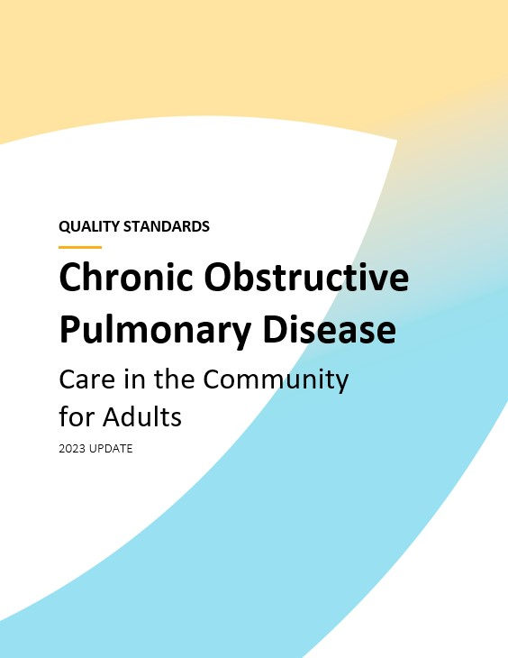
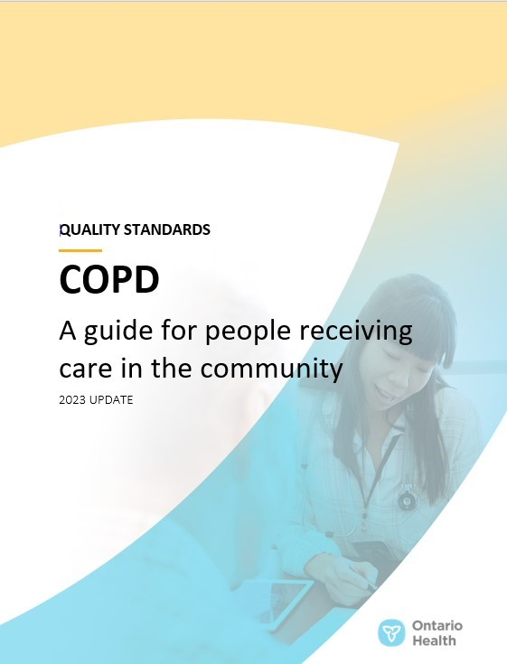
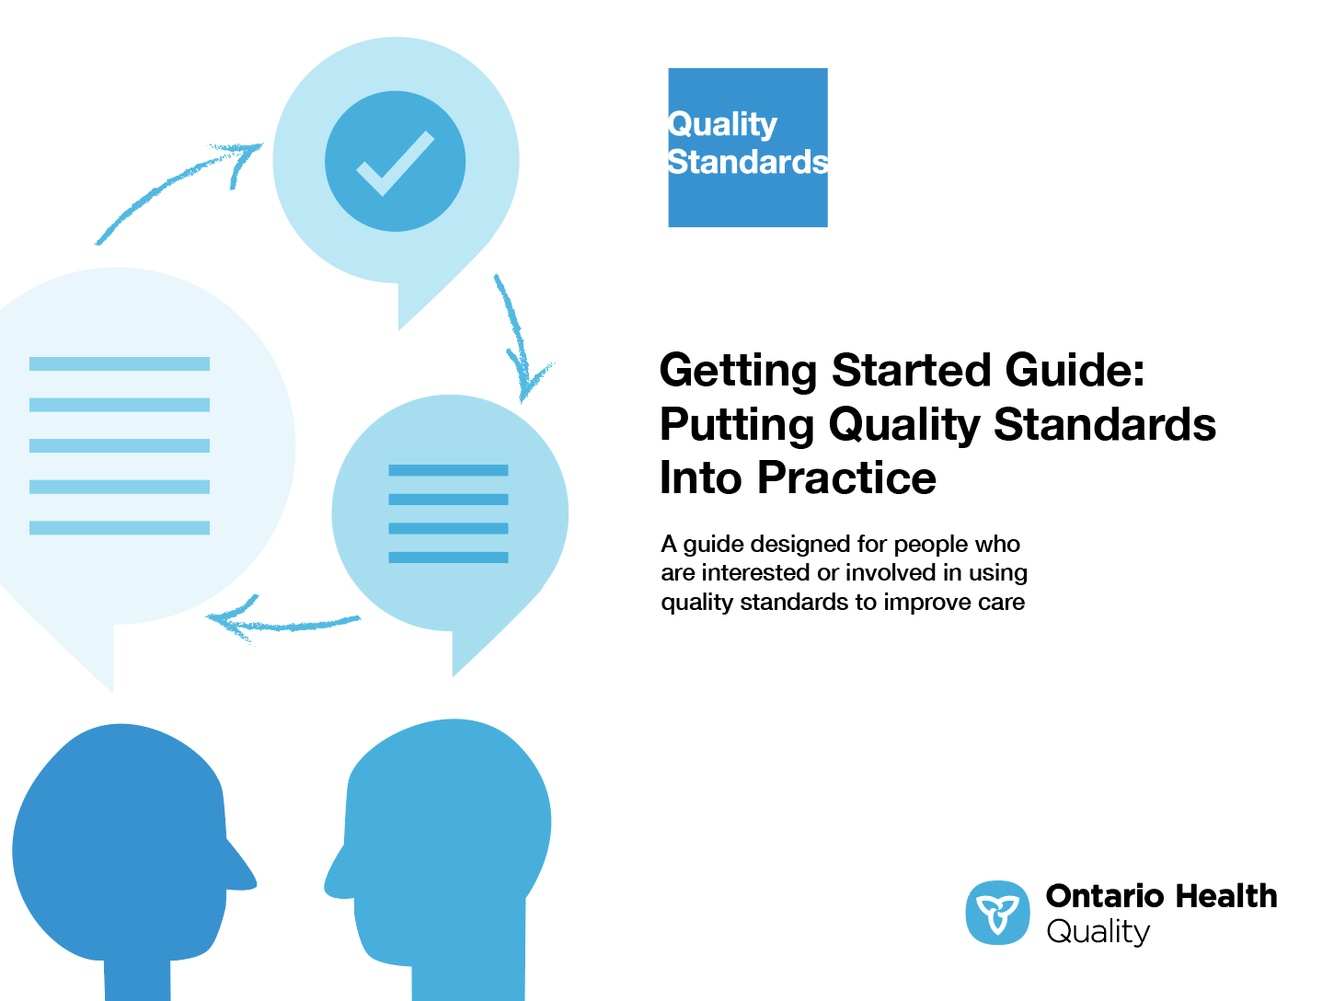
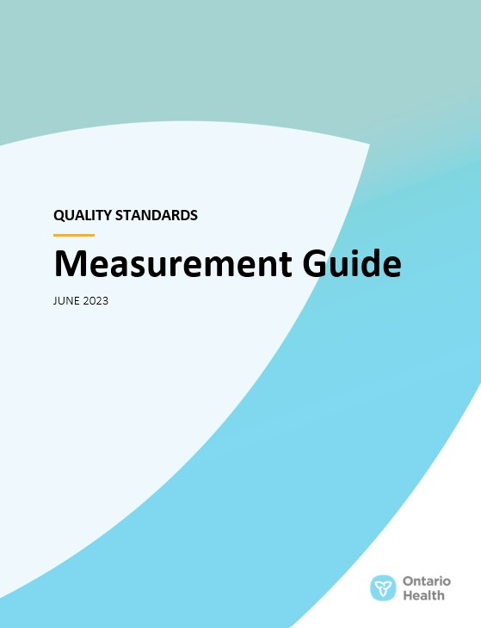
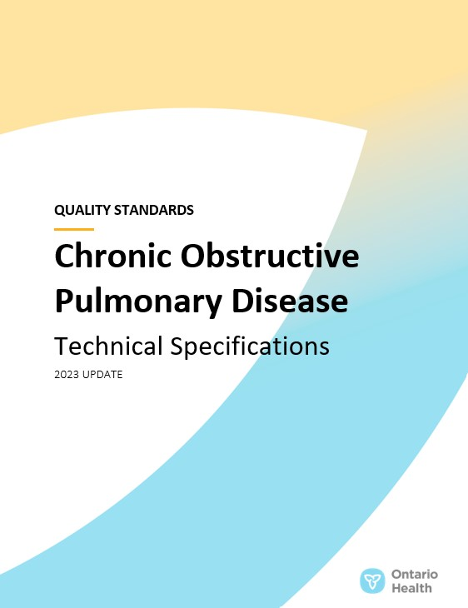
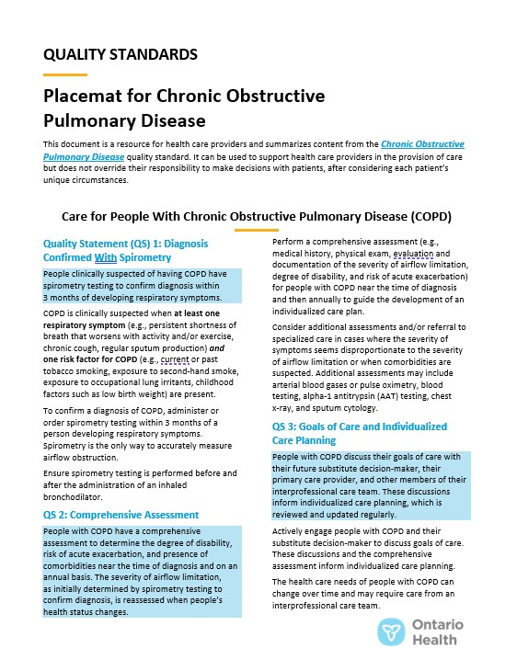
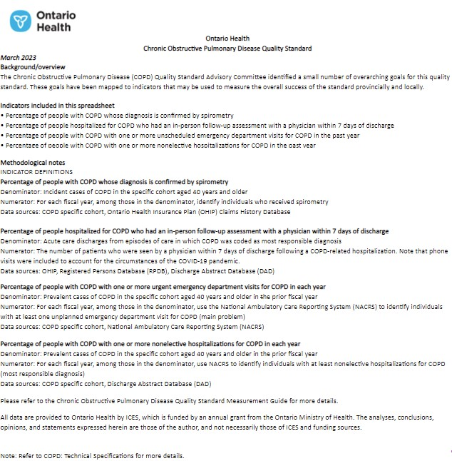
Quality standard resources
Quality Standard
Patient Guide
Getting Started Guide
Measurement Guide
Technical Specifications
Data Tables
Placemat
Find these resources here:
https://www.hqontario.ca/Evidence-to-Improve-Care/Quality-Standards/View-all-Quality-Standards/Chronic-Obstructive-Pulmonary-Disease
Notes:
Each quality standard focuses on a specific health care issue. The development of each quality standard is accompanied by an assortment of resources.
Through concise, easy-to-understand statements, quality standards outline what quality care looks like for a condition or topic based on the evidence.
Each quality standard is accompanied by a:
Patient guide
Getting started guide
Measurement guide
Technical specifications
Data tables
Placemat
Quality standards provide the blueprint to enable the health care system in Ontario to work better, facilitate smooth transitions, and ensure patients receive the same high-quality care, regardless of where they reside.

Slide 6
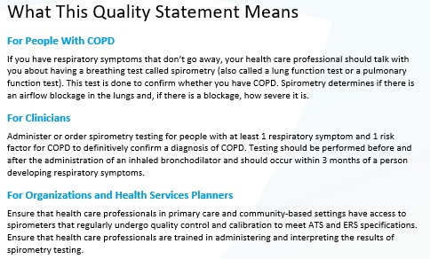
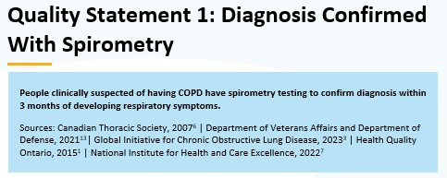
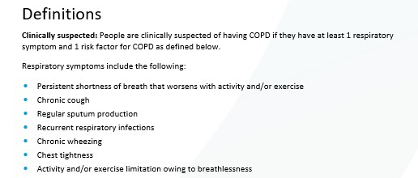
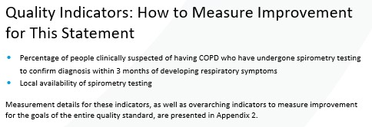
Inside the quality standard
The Audience Statements
The Quality Statement
The Definitions
The Indicators

Slide 7
Quality standards
Patient guide
The patient guide is designed to give patients information about what quality care looks like for various conditions based on the best evidence, so they can ask informed questions of their health care providers.
Notes:
Every quality standard includes a plain language summary for patients, families, caregivers, and the public called the patient guide.
Patient engagement in quality standards:
Membership on advisory committees
Focus groups and key informant interviews on topic-specific content (when necessary)
Public comment period for each quality standard
Consultations on the patient guide

Slide 8
Quality standards
How the health care system can support implementation
Implementing quality standards can be challenging owing to system-level barriers or gaps, many of which have been identified throughout the development of this standard
Ontario Health will work with and support other provincial partners, including the Ministry of Health, to bridge system-level gaps to support the implementation of quality standards

Slide 9
Quality standards
Implementation tools
The Getting Started Guide:
Outlines the process for using the quality standard as a resource to deliver high-quality care
Contains evidence-based approaches, as well as useful tools and templates for implementing change ideas at the practice level
Notes:
There are things we can do today despite the larger systemic barriers that may take time to resolve. The Getting Started Guide is a document that outlines a process for using the quality standards as a resource to deliver high-quality care. It compiles a number of resources to support adoption, such as links to implementation and quality improvement resources, examples and activities for reflection, and templates and documents to support the implementation planning activities. The Getting Started Guide also includes an Action Plan Template and examples on how Quality Improvement Plans can help to advance quality standards.

Slide 10


Quality standard adoption tools
Quorum
Quorum is an online community dedicated to improving the quality
of health care in Ontario.
The Quality Standards Adoption Series highlights efforts in the field to implement changes and close gaps in care related to quality standard topics.
quorum.hqontario.ca
Notes:
The Quality Standards program has highlighted several stories from organizations and groups using various standards and statements within their clinical care settings, organization, or institutions; these are available through posts and discussions on Quorum.
As well, we are working on compiling resources and tools, for both clinicians and patients and families.
The focus is on implementation/adoption stories and how organizations are using quality standards in practice to inform care.
We’d love to hear from you if you are interested in contributing to a post or article.

Slide 11
Quality standards
Measurement guide
The measurement guide has 3 sections:
Quality indicators: the types of indicators that guide quality improvement, monitoring, and evaluation
Local data collection and measurement: what you can do to assess the quality of care that you provide locally
Provincial sources of data: the data we can use to monitor the progress being made to improve care on a provincial level

Slide 12
Quality standards
Technical specifications
The technical specifications has
2 dedicated sections:
Provincial measurement: how we can monitor the progress being made to improve care at the provincial level
Local measurement: what you can do to assess the quality of care that you provide locally

Slide 13
Quality standards
Data tables
Data tables can be used to examine variations in indicator results across the province. They include data on key indicators:
Over time for Ontario
Across regions in Ontario
For specific measures of equity
(age, sex, rurality, and household income)

Slide 14
Quality standards
Placemat
The placemat is a quick-reference resource for clinicians that summarizes the quality standard and includes links to helpful resources and tools.

Slide 15
Why do we need a quality standard for COPD?

Slide 16







More than
1 in 10 people in Ontario have COPD
Note: Based on data for people aged 40 years and older.
Sources: COPD sensitive cohort, data provided by ICES, 2023; adapted from methods by Gershon AS, Wang C, Guan J, Vasilevska-Ristovska J, Cicutto L, To T. Identifying individuals with physician diagnosed COPD in health administrative databases. COPD. 2009;6(5):388-94.

Slide 17
The prevalence of COPD varies across regions in Ontario
Prevalence of COPD among people aged 40 years and older by Ontario Health region, 2021/22
The highest prevalence of COPD in 2021/22 was in the North East region (16%)
Note: Geographic boundaries for the Toronto and Central regions have changed since the data were published.
Sources: COPD sensitive cohort, data provided by ICES, 2023; adapted from methods by Gershon et al, 2009.

Slide 18
COPD is more prevalent among people in lower-income neighbourhoods
Prevalence of COPD by neighbourhood income quintile in Ontario, 2021/22
The prevalence of COPD was significantly higher for each successive lower neighbourhood income quintile
(P < 0.05)
Note: Age- and sex-standardized rates among adults with COPD aged 40 years and older. Income quintile is an area-based ranking of the household income in each neighbourhood of residence, compared to surrounding neighbourhoods.
Sources: COPD sensitive cohort, data provided by ICES, 2023; adapted from methods by Gershon et al, 2009.

Slide 19
Regional variation in the percentage of people with COPD who visit the emergency department or are hospitalized for a COPD-related complication
Health care utilization among people with COPD aged 40 years and older, by Ontario Health region, 2021/22
* Significantly higher than overall (P < 0.05)
The percentage of people who received physician follow-up within 7 days after a COPD hospitalization was significantly lower in the North East region (29% vs. 35% overall).
Notes: Age- and sex-standardized rates. Based on COPD as the main problem for an emergency department visit or the most responsible diagnosis for a hospitalization. Geographic boundaries for the Toronto and Central regions have changed since the data were published.
Sources: COPD specific cohort, data provided by ICES, 2023; adapted from methods by Gershon et al, 2009. Discharge Abstract Database.

Slide 20
Spirometry (a breathing test) is the only way to accurately diagnose COPD
In Ontario, it is estimated that in 2021/22, less than 40% of adults with COPD received spirometry testing to confirm their diagnosis
This figure is down from 45%
in 2016/17
Spirometry testing was significantly lower in the North East (32.8%) and North West (26.7%) regions in 2021/22
Note: Age- and sex-standardized rates among adults with COPD aged 40 years and older.
Source: COPD specific cohort, data provided by ICES, 2023.

Slide 21
People in lower-income neighbourhoods have the lowest rates of spirometry testing, and had the greatest decrease in testing from 2016/17 to 2021/22
–2.2%
The impact of the COVID-19 pandemic reduced health care utilization overall in Ontario. The impact was greatest among people with COPD living in the lowest income quintile neighbourhoods; they experienced a 7-percentage-point decrease in spirometry testing, compared to a 2-percentage-point decrease among those in the highest income quintile neighbourhoods.
Notes: Age- and sex-standardized rates among people aged 40 years and older with an incident clinical COPD diagnosis as of each year presented. Income quintile is an area-based ranking of the household income in each neighbourhood of residence, compared to surrounding neighbourhoods.
Source: COPD specific cohort, physician billed services, data provided by ICES, 2023; adapted from methods by Gershon et al, 2009.

Slide 22
People with COPD living in lower-income neighborhoods are significantly less likely to have their condition confirmed through spirometry
Percentage of people with COPD who received spirometry testing; by neighbourhood income quintile in Ontario, 2021/22
*Significantly lower than the highest income quintile
(P < 0.05)
Notes: Age- and sex-standardized rates among people aged 40 years and older with an incident clinical COPD diagnosis as of 2021/22. Income quintile is an area-based ranking of the household income in each neighbourhood of residence, compared to surrounding neighbourhoods.
Source: COPD specific cohort, physician billed services, data provided by ICES, 2023; adapted from methods by Gershon et al, 2009.

Slide 23
“A quality standard will go a long way toward implementing a collaborative care approach to managing patients with COPD. The current management tends to be in silos – especially for patients with severe disease, who oscillate between the community and acute care, have little rehabilitation, and can become bewildered when navigating the health care system. Overall care is fragmented, associated physical and mental health conditions are not addressed, follow-up can be unpredictable, and transmission of information is incomplete. With an agreed-upon quality standard, the care manager (coordinator or navigator) can oversee each of the elements and enable the care team (primary care, specialist care, interprofessional community team, patient and family) to function optimally together. This will have a positive impact on our patients, reduce health care resource utilization, and improve population health.”
– Dr. Roger Goldstein, co-chair, COPD Quality Standard Advisory Committee

Slide 24
Quality statements to improve care

Slide 25
Scope of this quality standard
This quality standard addresses care for people with COPD, including the assessment of people who may have COPD
It provides guidance on the diagnosis, management, and treatment of COPD in community-based settings
It applies to primary care, specialist care, and in long-term care and other home and community care settings
It does not address care provided in an emergency department or hospital inpatient setting for the management of acute exacerbations of COPD
Notes:
Scope of This Quality Standard
This quality standard addresses care for people with chronic obstructive pulmonary disease (COPD), including the assessment of people who may have COPD. It provides guidance on the diagnosis, management, and treatment of COPD in community-based settings. The scope of this quality standard applies to primary care, specialist care, and in long-term care and other home and community care settings. This quality standard does not address care provided in an emergency department or hospital inpatient setting for the management of acute exacerbations of COPD.

Slide 26
Quality statement topics
Diagnosis confirmed with spirometry
Comprehensive assessment
Goals of care and individualized care planning
Education and self-management
Promoting smoking cessation
Pharmacological management of stable COPD
Vaccinations
Specialized respiratory care
Pulmonary rehabilitation
Management of acute exacerbations of COPD
Follow-up after hospitalization for an acute exacerbation of COPD
Pulmonary rehabilitation after hospitalization for an acute exacerbation of COPD
Palliative care
Long-term oxygen therapy

Slide 27
Quality statement 1:
Diagnosis confirmed with spirometry
People clinically suspected of having COPD have spirometry testing to confirm diagnosis within 3 months of developing respiratory symptoms.

Slide 28
Quality statement 2:
Comprehensive assessment
People with COPD have a comprehensive assessment to determine the degree of disability, risk of acute exacerbation, and presence of comorbidities near the time of diagnosis and on an annual basis. The severity of airflow limitation, as initially determined by spirometry testing to confirm diagnosis, is reassessed when people’s health status changes.

Slide 29
Quality statement 3:
Goals of care and individualized care planning
People with COPD discuss their goals of care with their future substitute decision-maker, their primary care provider, and other members of their interprofessional care team. These discussions inform individualized care planning, which is reviewed and updated regularly.

Slide 30
Quality statement 4:
Education and self-management
People with COPD and their caregivers receive verbal and written information about COPD from their health care professional and participate in interventions to support self management, including the development of a written self-management plan.

Slide 31
Quality statement 5:
Promoting smoking cessation
People with COPD are asked about their tobacco-smoking status at every opportunity. Those who continue to smoke are offered pharmacological and nonpharmacological smoking-cessation interventions.

Slide 32
Quality statement 6:
Pharmacological management of stable COPD
People with a confirmed diagnosis of COPD are offered individualized pharmacotherapy to improve symptoms and prevent acute exacerbations. Their medications are reviewed at least annually.

Slide 33
Quality statement 7:
Vaccinations
People with COPD are offered influenza, pneumococcal, and other vaccinations, as appropriate.

Slide 34
Quality statement 8:
Specialized respiratory care
People with a confirmed diagnosis of COPD are
referred to specialized respiratory care when clinically indicated, after receiving a comprehensive assessment and being offered treatment in primary care. This consultation occurs in accordance with the urgency of their health status.

Slide 35
Quality statement 9:
Pulmonary rehabilitation
People with moderate to severe, stable COPD are referred to a pulmonary rehabilitation program if they have activity or exercise limitations and breathlessness despite appropriate pharmacological management.

Slide 36
Quality statement 10:
Management of acute exacerbations of COPD
People with COPD have access to their primary care provider or a health care professional in their care team within 24 hours of the onset of an acute exacerbation.

Slide 37
Quality statement 11:
Follow-up after hospitalization for an acute exacerbation of COPD
People with COPD who have been hospitalized for an acute exacerbation have an in-person follow-up assessment within 7 days after discharge.

Slide 38
Quality statement 12:
Pulmonary rehabilitation after hospitalization for an acute exacerbation of COPD
People who have been admitted to hospital for an acute exacerbation of COPD are considered for pulmonary rehabilitation at the time of discharge. Those who are referred to a pulmonary rehabilitation program start the program within 1 month of hospital discharge.

Slide 39
Quality statement 13:
Palliative care
People with COPD and their caregivers are offered palliative care support to meet their needs.

Slide 40
Quality statement 14:
Long-term oxygen therapy
People with stable COPD who have clinical indications of hypoxemia receive an assessment for and, if needed, treatment with long-term oxygen therapy.

Slide 41
Measures to support improvement
Notes:
The COPD Quality Standard Advisory Committee identified a set of overarching goals for this quality standard. These have been mapped to indicators that may be used to assess quality of care provincially and locally.

Slide 42
Indicators that can be measured using provincial data
Percentage of people with COPD whose diagnosis is confirmed by spirometry
Percentage of people hospitalized for COPD who had an in-person follow-up assessment with a physician within 7 days of discharge
Percentage of people with COPD who have filled a prescription for long-acting bronchodilator therapy (measurable for people aged 65 years and older only)
Percentage of people with COPD with 1 or more unplanned acute care visits for COPD in each year. Stratify by:
  Unscheduled emergency department visits
  Nonelective hospitalizations
Percentage of people with COPD who smoke cigarettes daily

Slide 43
Indicators that can be measured using only local data
Percentage of people with COPD whose disease has an impact on their life. Stratify by:
  Low impact
  Medium impact
  High impact
  Very high impact
Percentage of people with moderate to severe COPD who have access to a pulmonary rehabilitation program. Stratify by:
  Community-based rehabilitation
  Inpatient rehabilitation

Slide 44
Data sources and acknowledgement
The data used in this presentation was provided by ICES, which is funded by an annual grant from the Ontario Ministry of Health (MOH). The opinions, results, and conclusions reported in this report are those of the authors and are independent from the funding sources. No endorsement by ICES or the MOH is intended or should be inferred. These datasets were linked using unique encoded identifiers and analyzed at ICES.

Slide 45

Thank you.
LET’S CONTINUE THE CONVERSATION
HQOntario.ca | OntarioHealth.ca
@OntarioHealthOH
Ontario Health
@OntarioHealthOH
Ontario Health

