Slide 1

Low Back Pain Quality Standard
Guiding evidence-based
care for people living with acute low back pain in Ontario
Notes:
If you have any questions about the content of this presentation, please contact us at QualityStandards@hqontario.ca

Slide 2
Objectives
Overview of Quality Standards What are they? How are they used?​
Why this Quality Standard is needed? Gaps and variations in quality of care for people living with low back pain (LBP) in Ontario
How success can be measured Indicators that can help measure your quality improvement efforts
Quality statements in brief The key recommendations in the low back pain quality standard

Slide 3
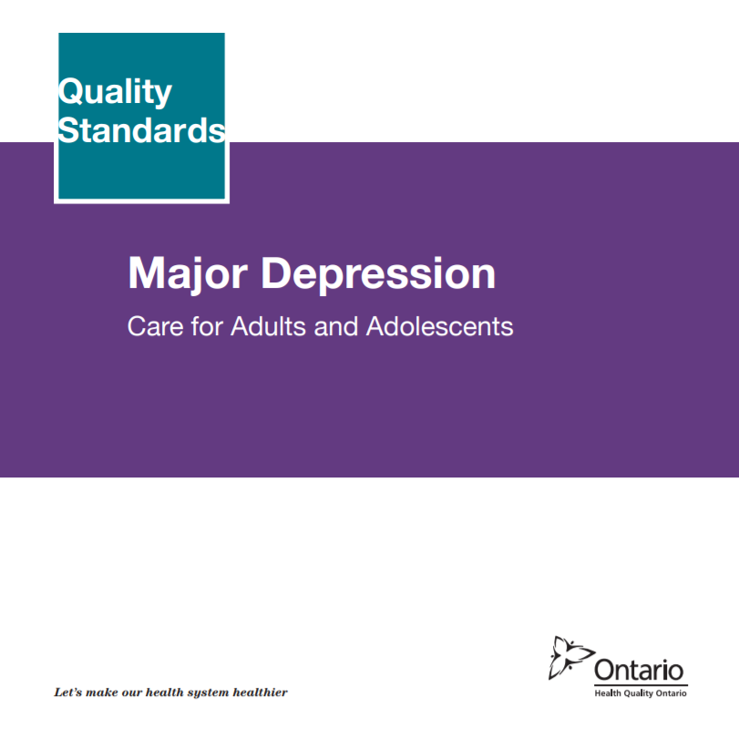


Quality Standards
Inform clinicians and patients what quality care looks like
Focus on conditions where there are large variations in how care is delivered, or where there are gaps between the care provided in Ontario and the care patients should receive
Are grounded in the best available evidence
Notes:
Quality standards are a smaller set of high impact statements that describe optimal care where identified quality gaps exist in Ontario.
Voluntary and aspirational in nature​.
Designed to “raise the ceiling” with the goal of having the best possible care available to all Ontarians, regardless of where they live in the province.
There are many guidelines, professional standards, and other recommendations that contribute to the evidence ecosystem. Quality standards complement these resources.
Quality standards outline the what of care that should be delivered but is agnostic on who should be delivering it (unlike other CPGs, BPGs).
Quality standards are:
Concise: 5 to 15 strong, evidence-based statements focused on high priority areas for improvement.
Accessible: help clinicians and provider organizations offer the highest quality care; and patients to know what to discuss with their care providers (compared to CPGs that are quite dense, these are very accessible, also written in plain language).
Measurable: each statement is accompanied by one or more quality indicators (structure, process or outcome), with a set of outcome measures for the overall standard.
Implementable: quality improvement tools and resources support each standard, to fuel adoption.

Slide 4
Quality Standards
Help health care professionals know what care to offer, based on evidence and expert consensus
Help health care organizations measure, assess, and improve the quality of care they provide
Help ensure consistent, high quality care across the province
Help patients, residents, families, and caregivers know what to ask for in their care
Notes:
Patients, caregivers and the public can use quality standards to understand what excellent care looks like, what they should expect from their health care providers, and how to discuss the quality of their care.
LHINs and disease agencies can use quality standards to measure health outcomes, hold health service providers accountable for delivering high-quality care, and inform regional improvement strategies.
Provider organizations can use quality standards to measure and audit their quality of care, identify gaps, guide organizational improvement strategies, and inform clinical program investments.
Health care professionals can use quality standards to evaluate their practice and identify areas for personal and organizational quality improvement, and can incorporate the evidence-based statements into professional education.
Government can use quality standards to identify provincial priority areas, inform new data collection and reporting initiatives, and design performance indicators and funding incentives.

Slide 5
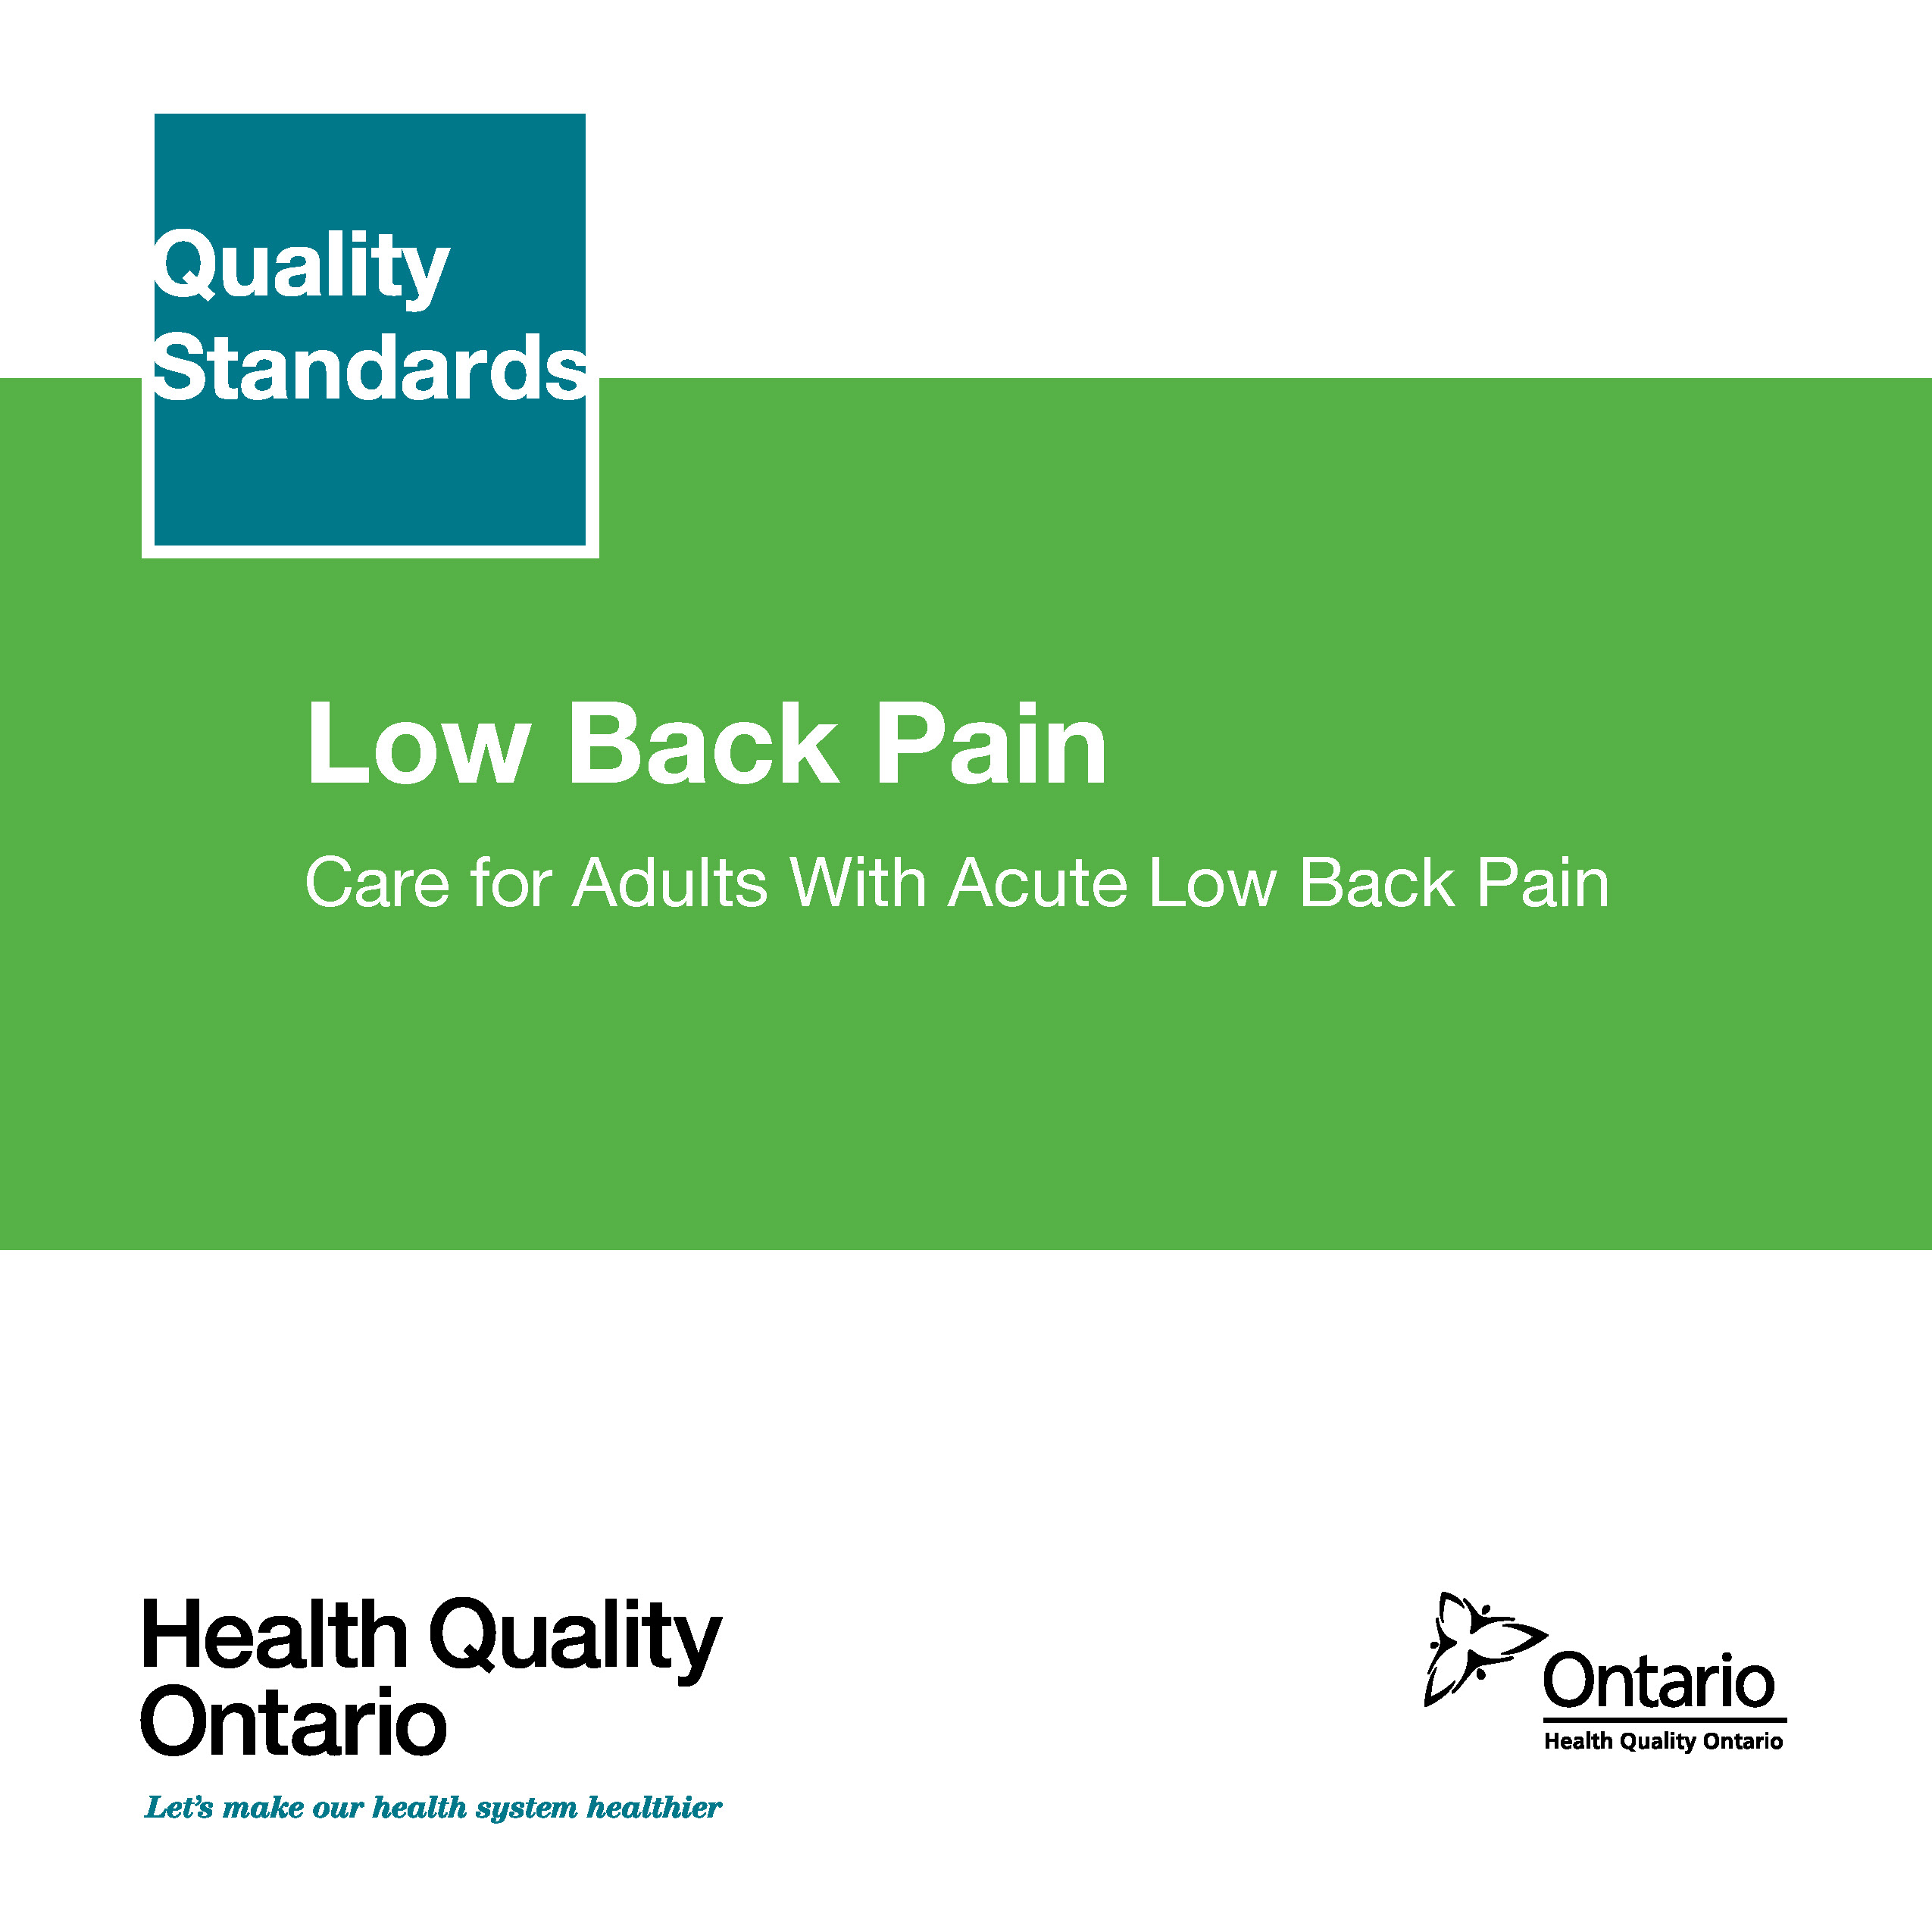
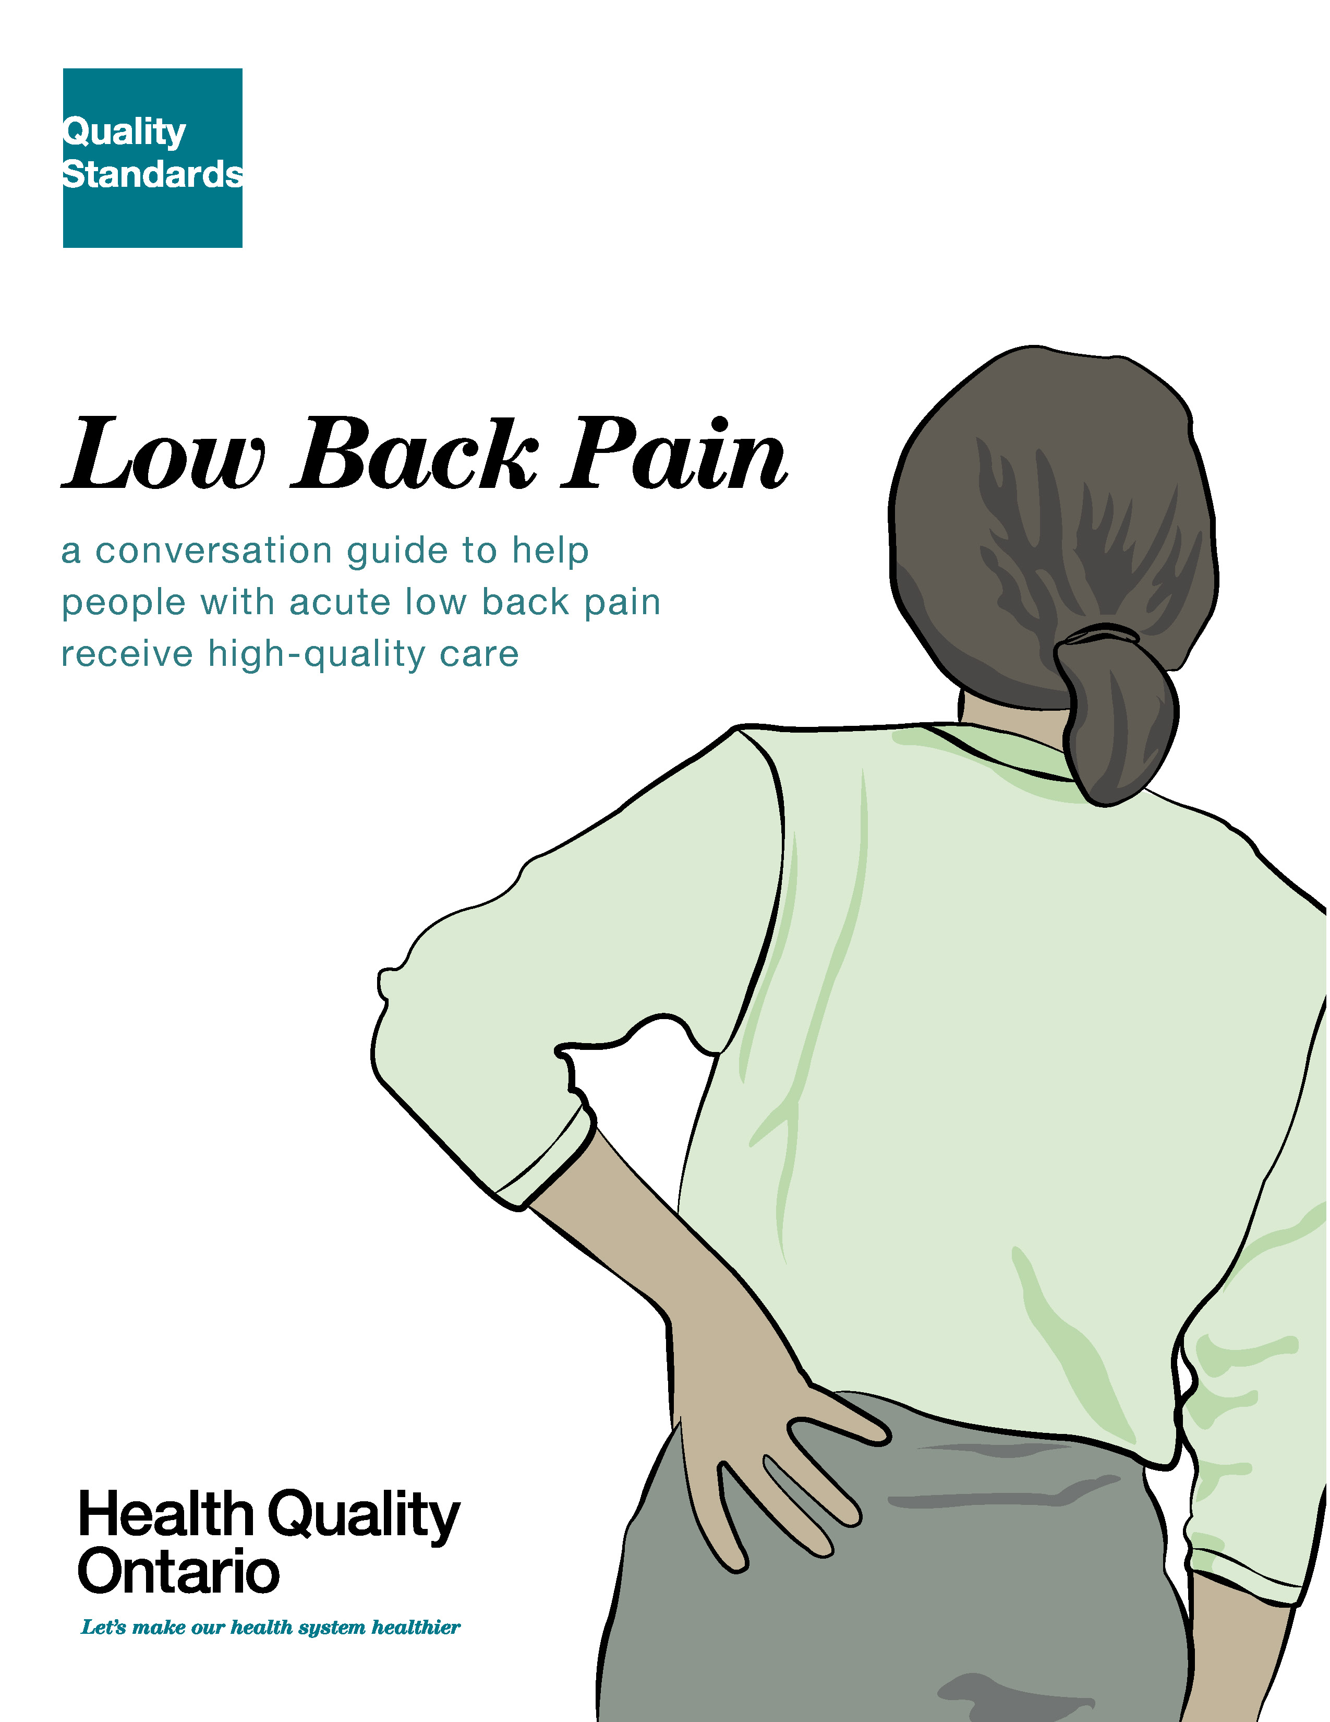

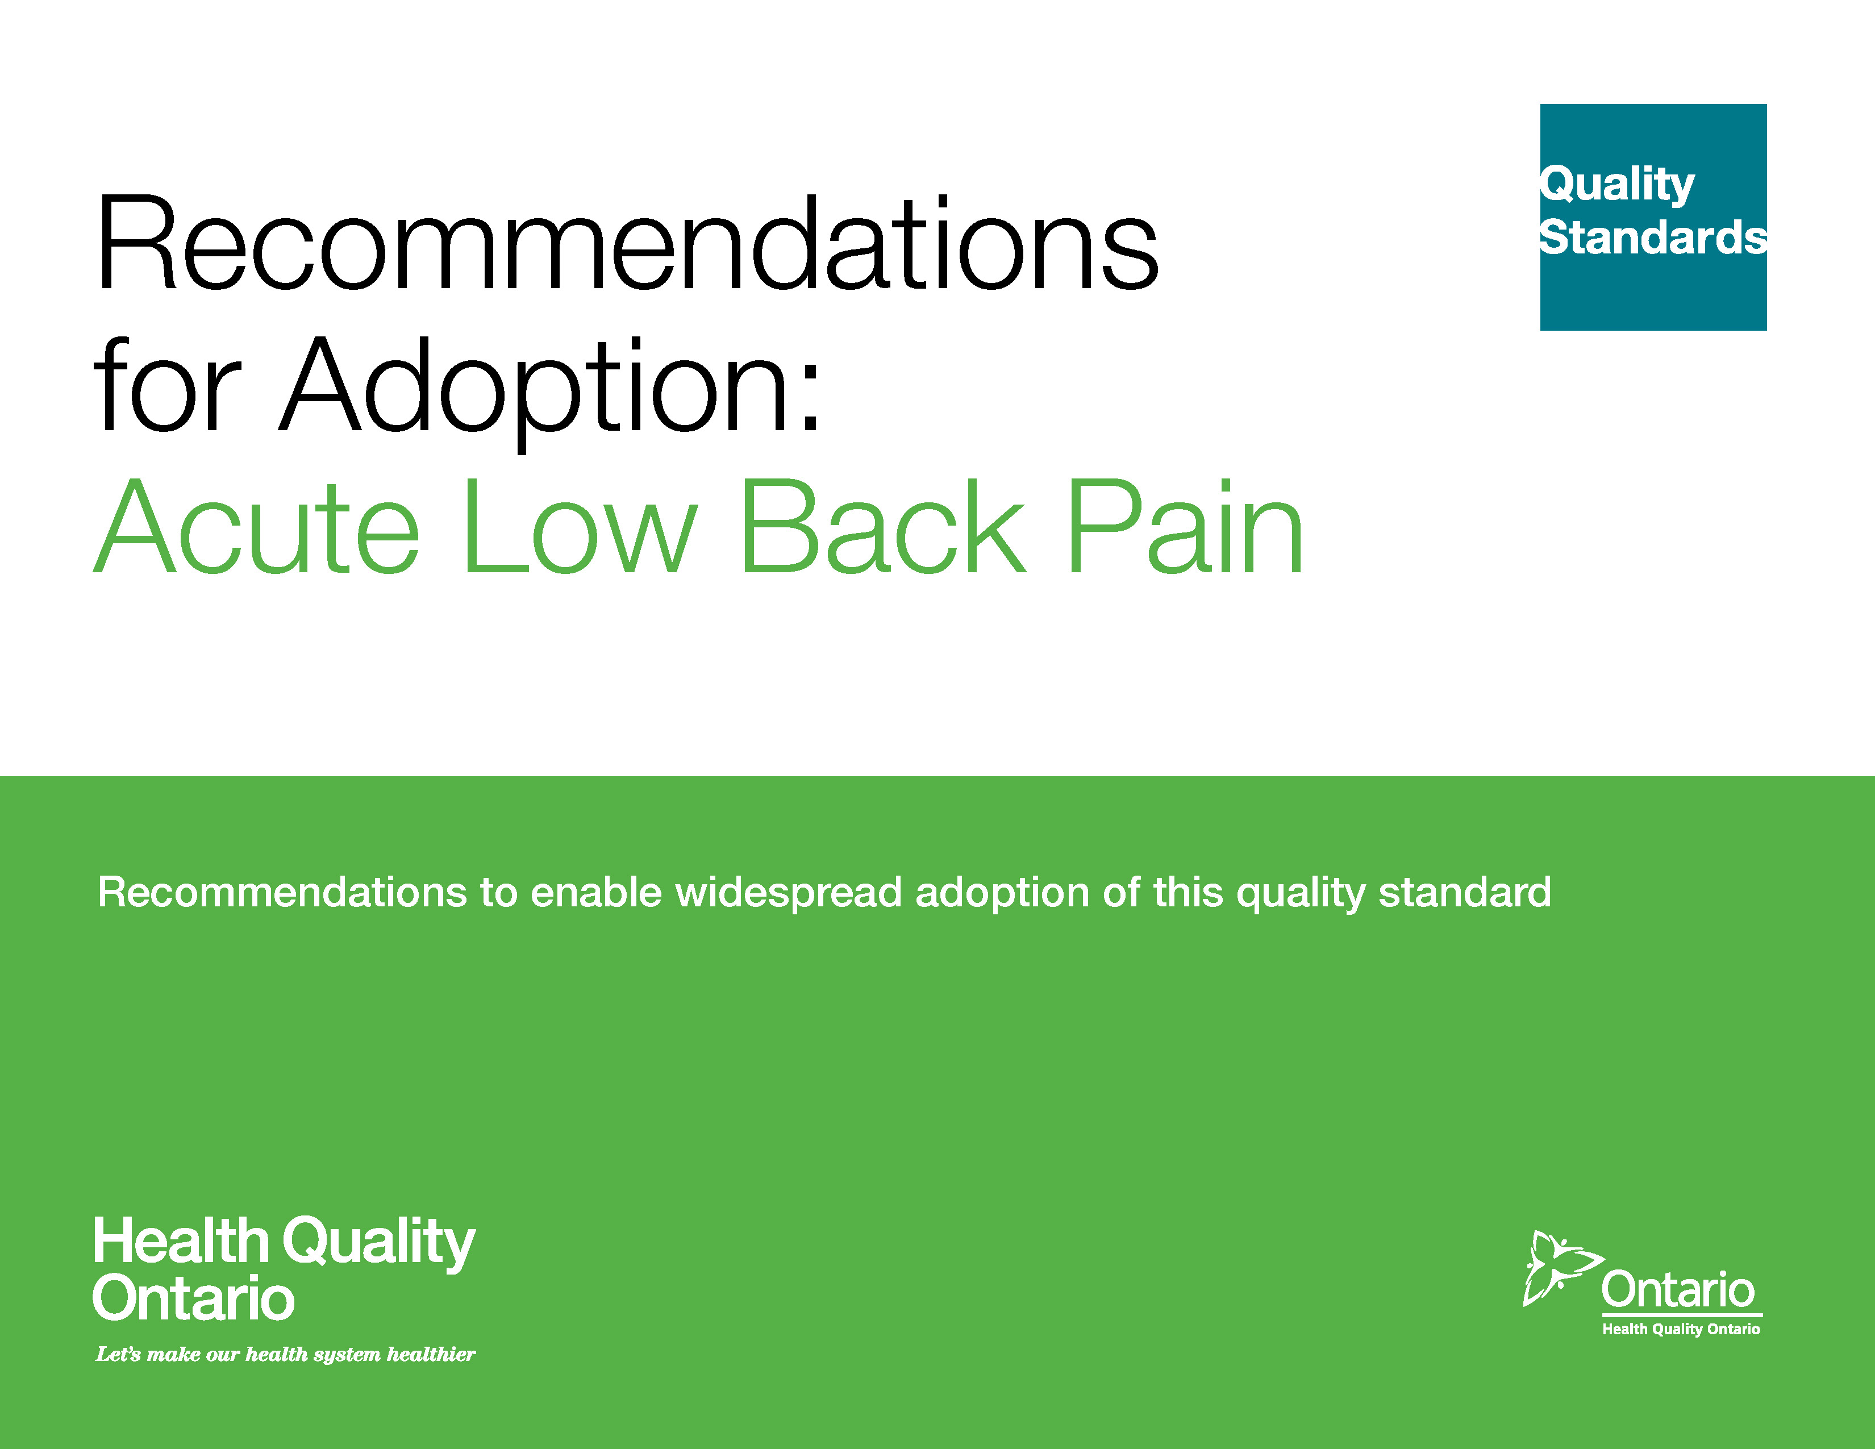
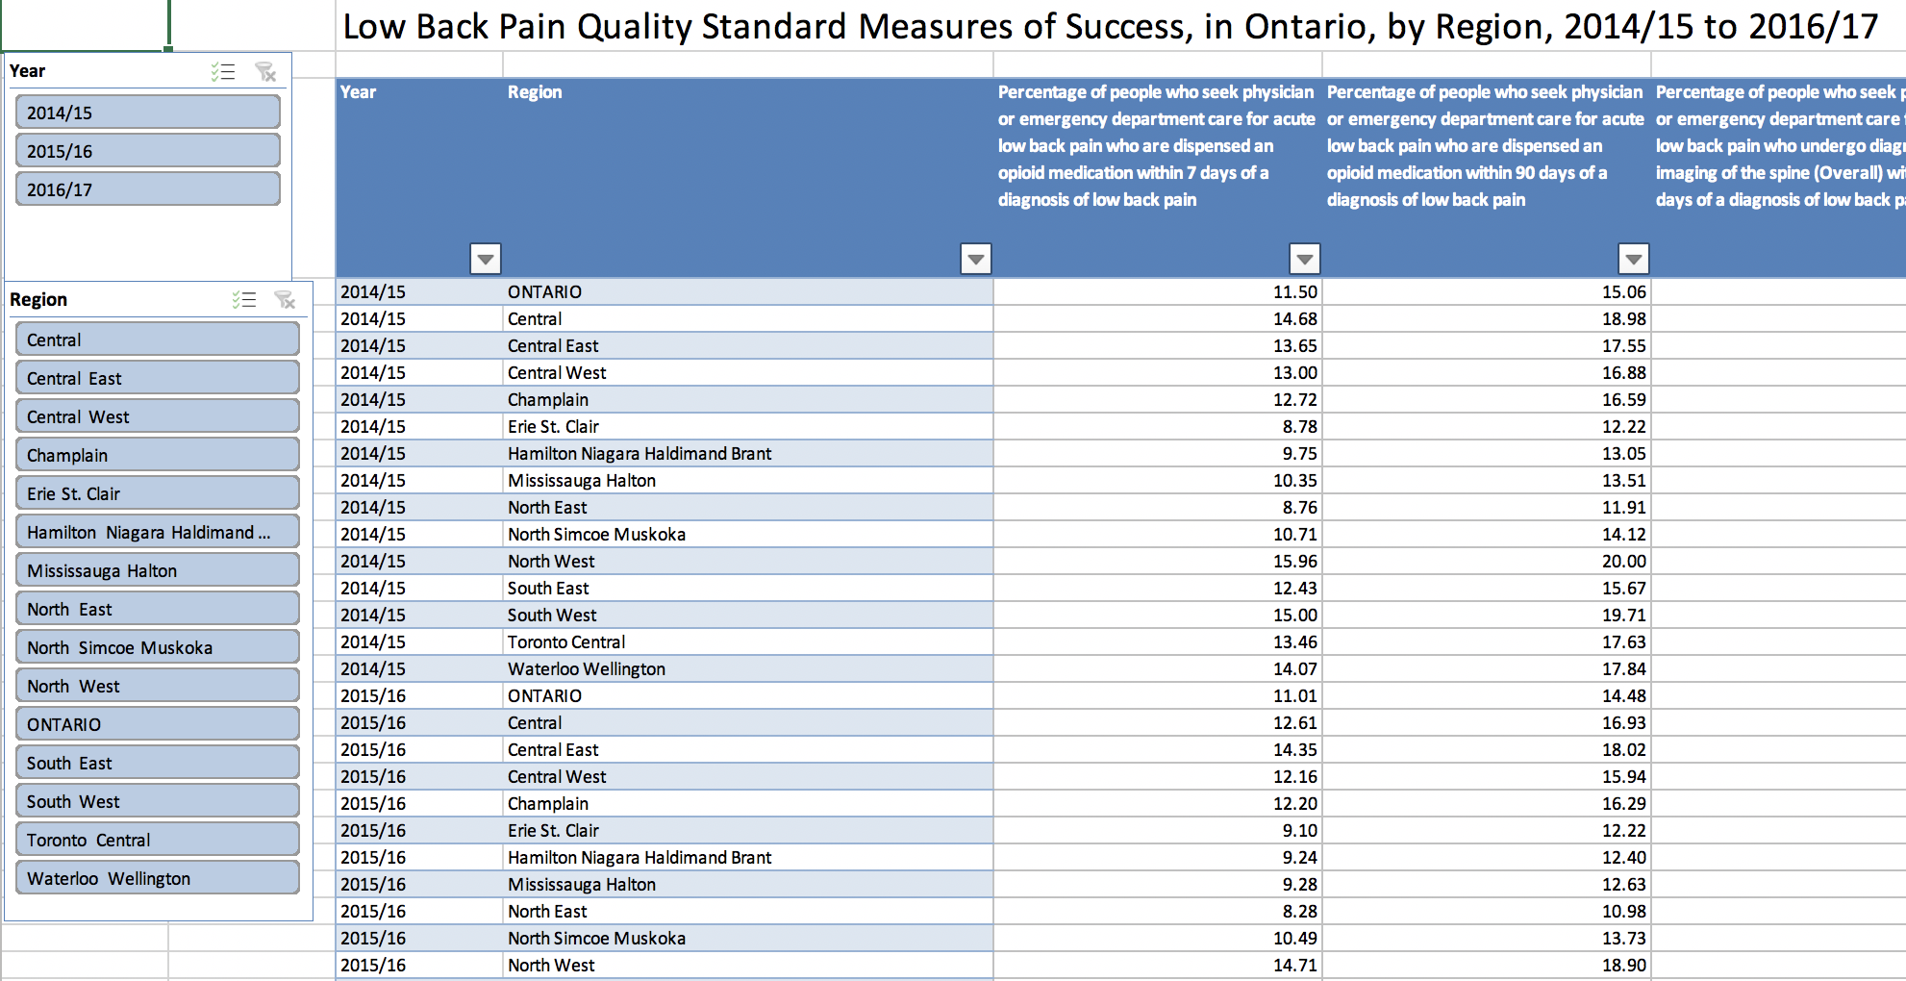
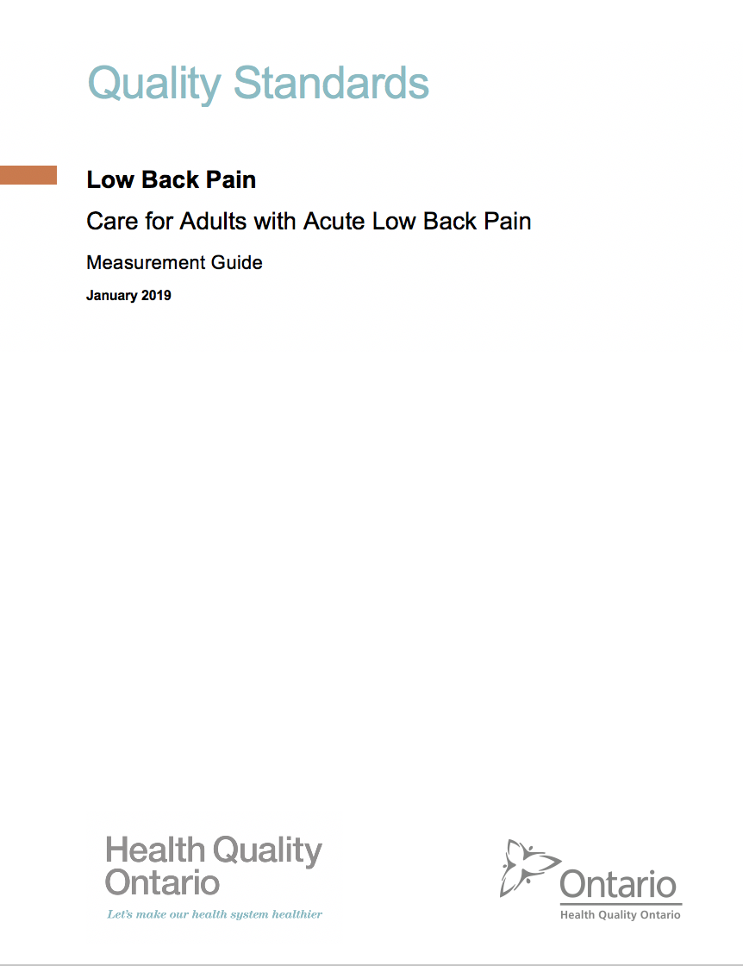
Quality Standard Resources
Quality Standard
Patient Conversation Guide
Getting Started Guide
Recommendations for Adoption
Data Tables
Measurement Guide
Find these resources here: https://hqontario.ca/Evidence-to-Improve-Care/Quality-Standards/View-all-Quality-Standards/Low-Back-Pain
Notes:
Each quality standard focuses on a specific health care issue. The development of each quality standard is accompanied by an assortment of resources.
Through concise, easy-to-understand statements, quality standards outline what quality care looks like for a condition or topic based on the evidence.
Each quality standard is accompanied by:
A patient conversation guide
Recommendations for adoption
A getting started guide
An infographic
A measurement guide
Quality standards provide the blueprint to enable the health care system in Ontario to work better, facilitate smooth transitions, and ensure patients receive the same high-quality care, regardless of where they reside.

Slide 6
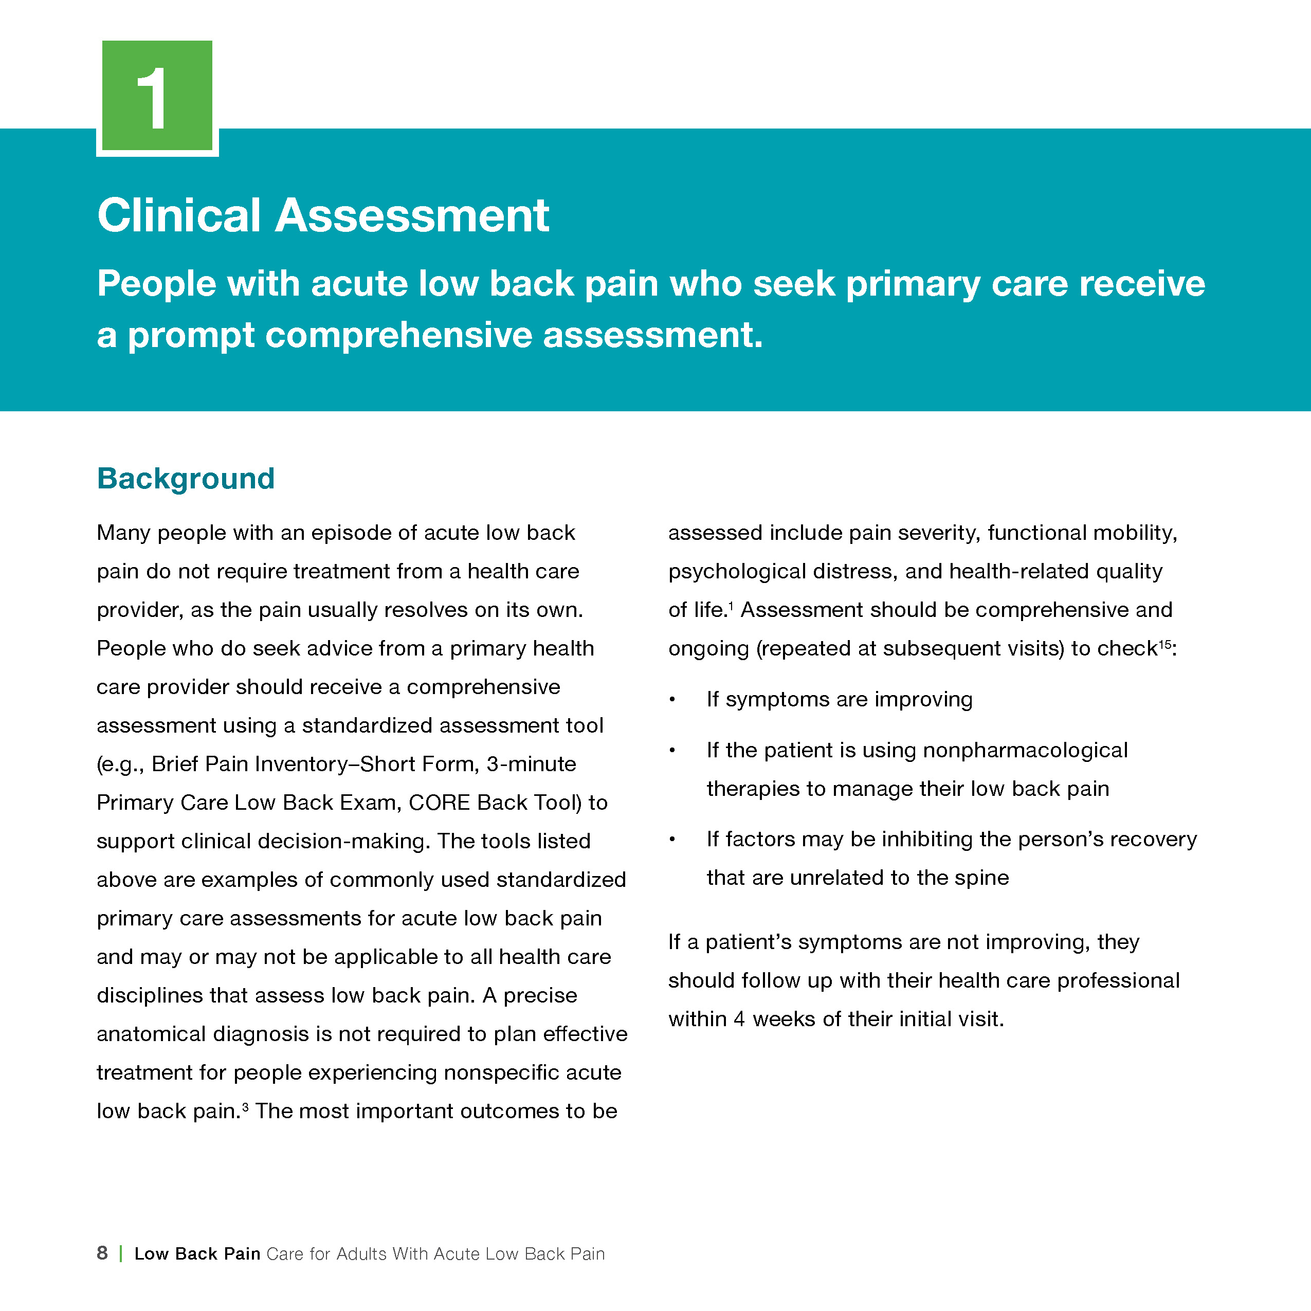
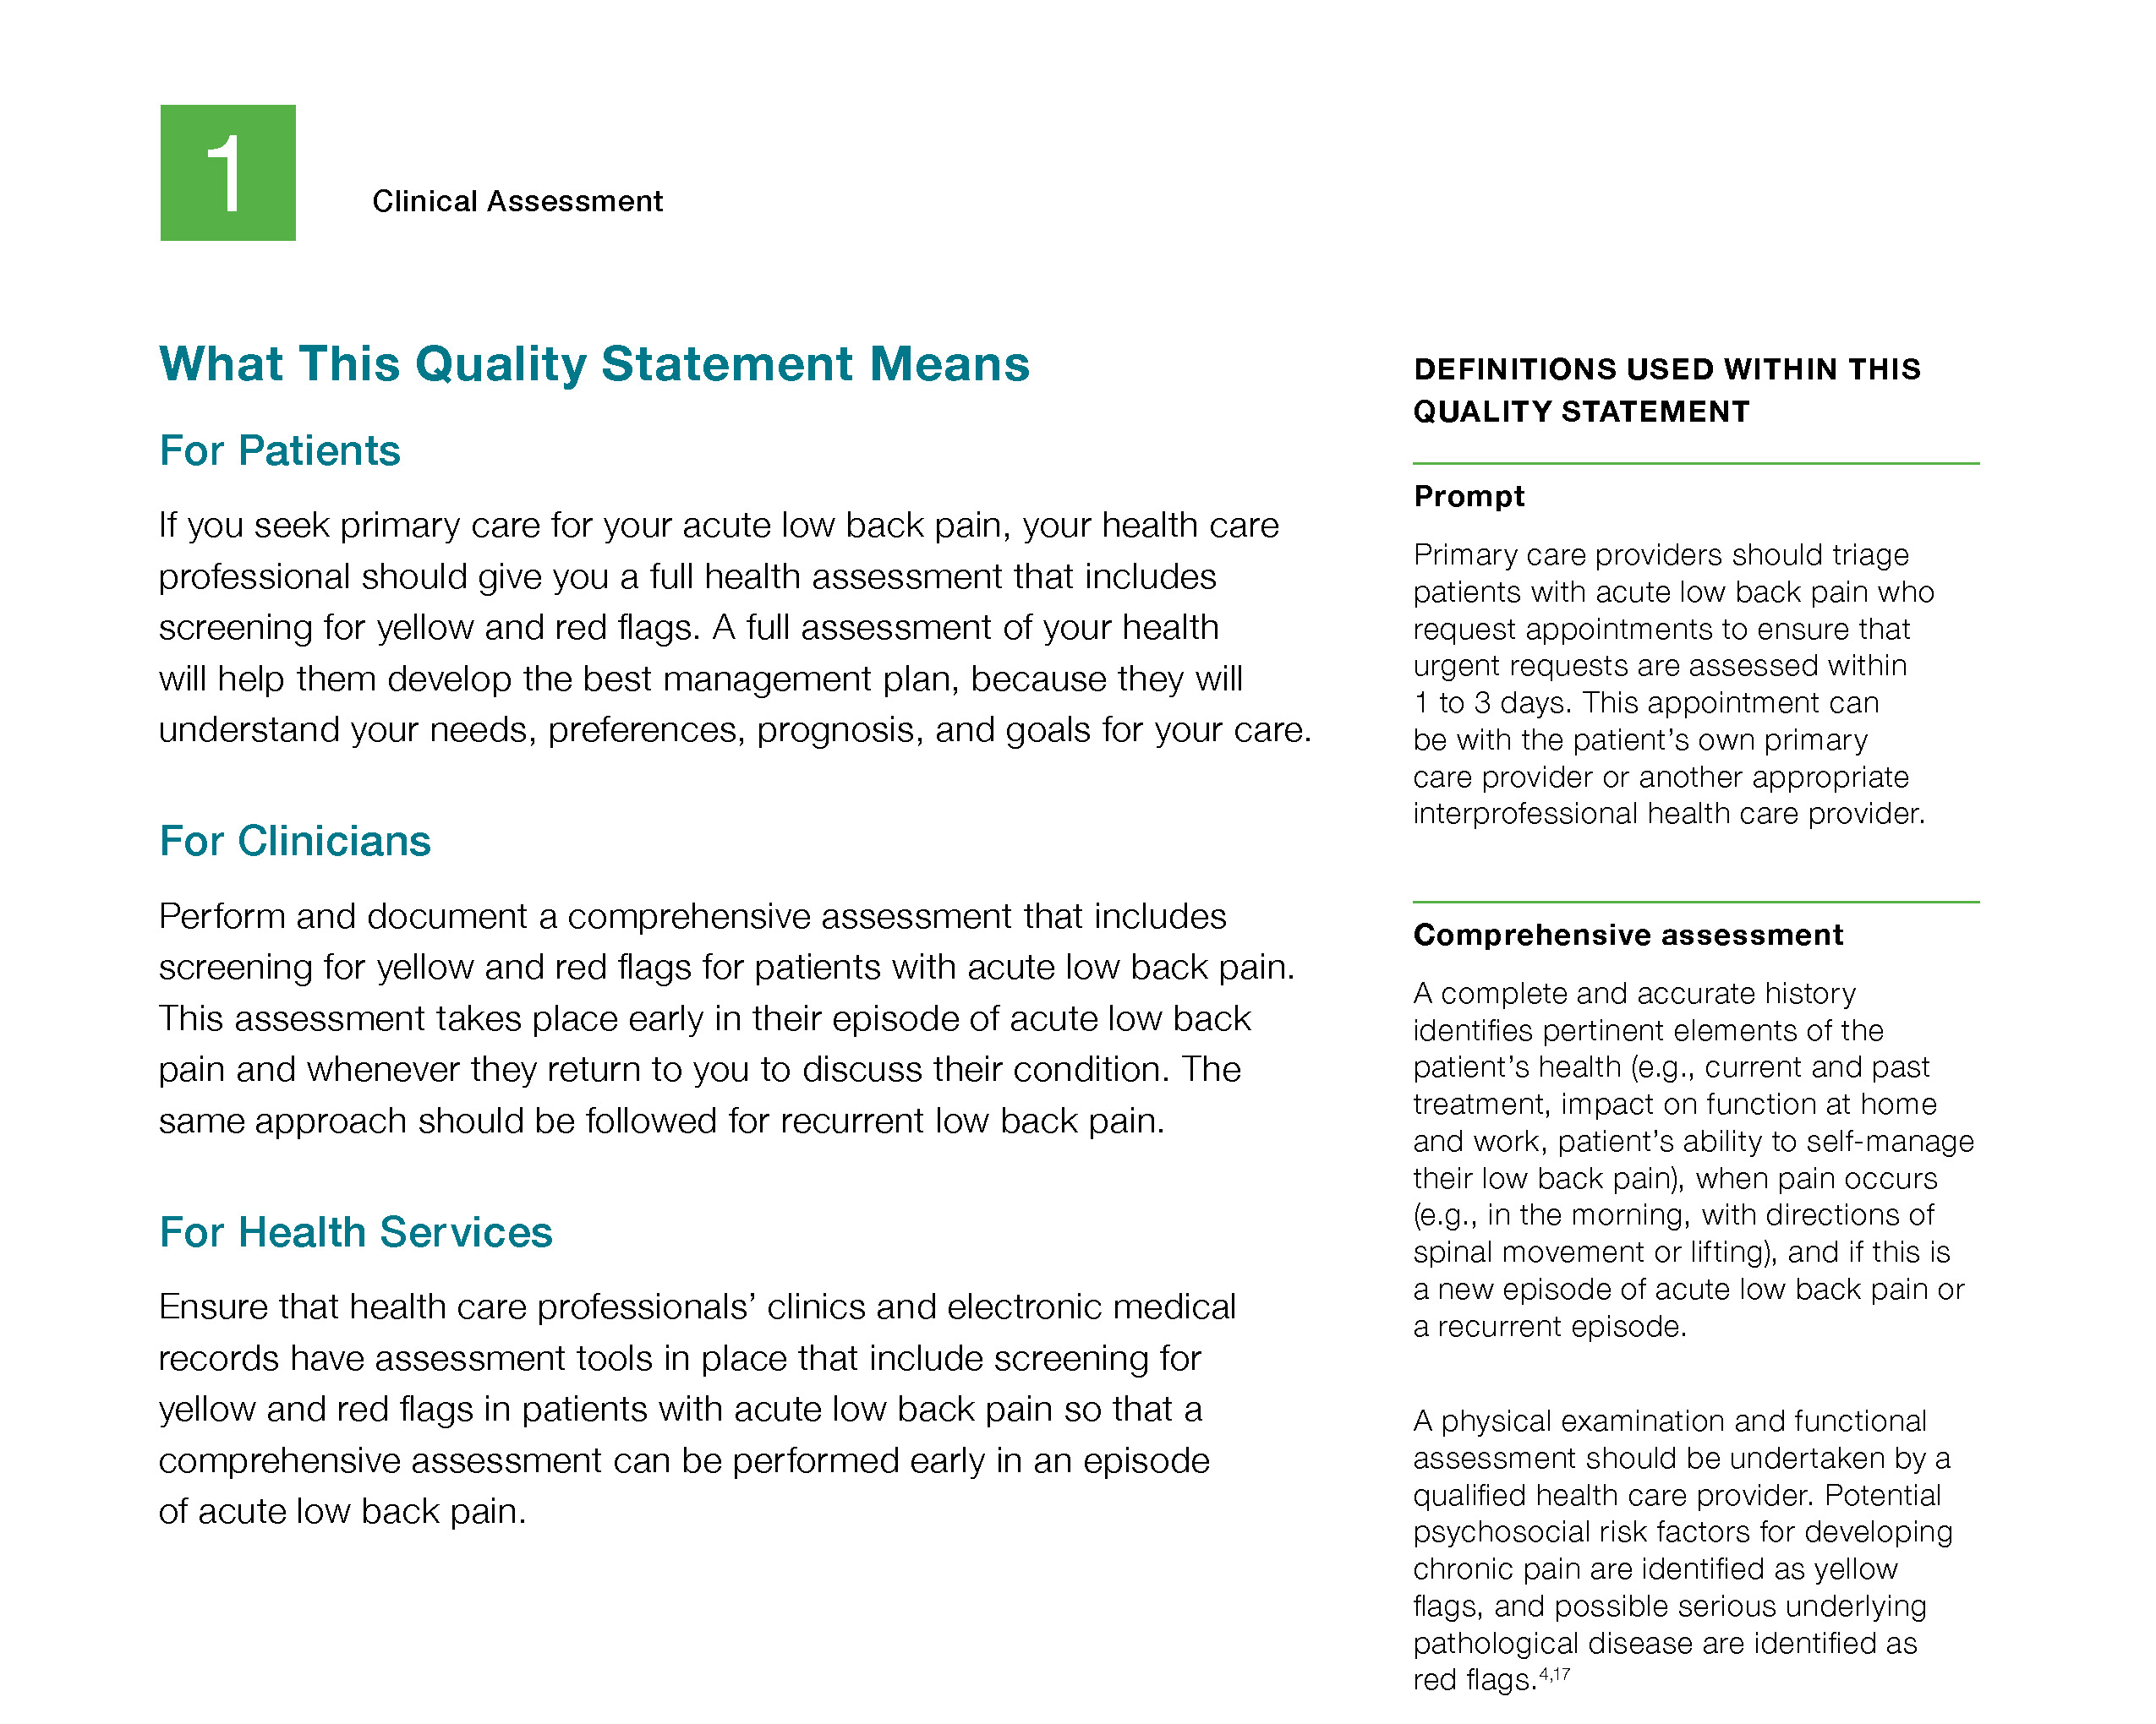
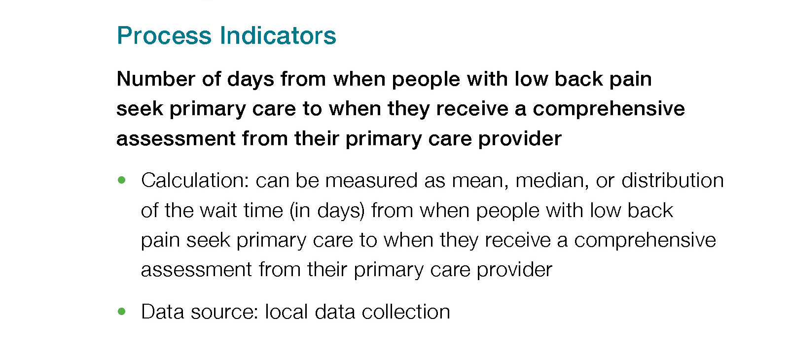
Inside the Quality Standard
The Statement
The Audience
Definitions
The Indicators

Slide 7
Quality Standards: Patient Conversation Guide
The patient conversation guide is designed to give patients information about what quality care looks like for various conditions based on the best evidence, so they can ask informed questions of their health care providers.
Notes:
Every quality standard includes a plain language summary for patients, families, caregivers, and the public called the patient conversation guide.
Patient engagement in Quality Standards:
Membership on advisory committees
Focus groups and key informant interviews on topic specific content (when necessary)
Public comment period for each Quality Standard
Consultations on the Patient Conversation Guide

Slide 8
Quality Standards: Recommendations for Adoption
Recommendations for policy makers, administrators, health care organizations, and professionals have been made that aim to bridge the gaps between current care and care outlined in the quality statements to enable adoption of the quality standard across Ontario.
Notes:
As many aspects of the quality standard represent care that can and should be made available today, it is recognized that there are larger systemic barriers that may impede care delivery as per the standard. This document summarizes the system-wide and regional requirements that are needed to help health care professionals and organizations meet these standards and the time horizon expected to resolve these barriers.

Slide 9
Quality Standards: Implementation Tools
The Getting Started Guide:
Outlines the process for using the quality standard as a resource to deliver high-quality care
Contains evidence-based approaches, as well as useful tools and templates for implementing change ideas at the practice level
Notes:
There are things we can do today despite the larger systemic barriers that may take time to resolve. The Getting Started Guide is a document that outlines a process for using the quality standards as a resource to deliver high-quality care. It compiles a number of resources to support adoption, such as links to implementation and quality improvement resources, examples and activities for reflection as well as templates and documents to support the implementation planning activities. The Getting Started Guide also includes an Action Plan Template and examples on how Quality Improvement Plans can help to advance quality standards.

Slide 10
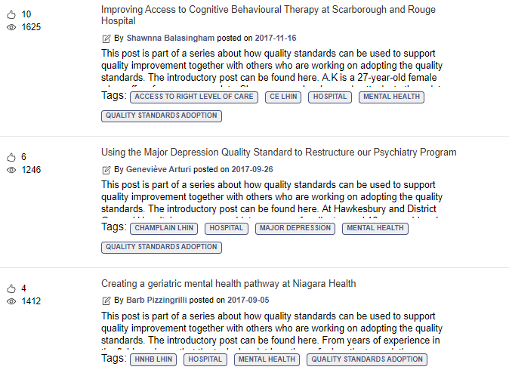
Quality Standards: Quorum
Quorum is an online community dedicated to improving the quality of health care in Ontario.
The Quality Standards Adoption Series highlights efforts in the field to implement changes and close gaps in care related to quality standard topics.
Visit the Quality Standards Adoption Series on Quorum to learn how organizations are implementing quality standards.

Slide 11
Quality Standards: Measurement Guide
The measurement guide has two dedicated sections:
Local measurement: what you can do to assess the quality of care that you provide locally
Provincial measurement: how we can measure the success of the quality standard on a provincial level

Slide 12
Quality Standards: Data Tables
Data tables can be used to examine variations in indicator results across the province. They include data on key indicators:
Over time for Ontario
Across regions in Ontario
For specific measures of equity (age, sex, rurality, and household income)

Slide 13















Quality Standards: Ontario Pain Management Resources
A Partnership to help clinicians support their patients
www.hqontario.ca/PainManagementResources
Notes:
General messaging for this slide:
This is a website where clinicians can find the latest resources to support them as they help their patients manage pain.
Health Quality Ontario and organizations across the province offer a coordinated program of resources to help family doctors, nurse practitioners, and other primary care clinicians manage their patients’ pain, including the appropriate use of opioids.
Partners include: AFHTO, CAMH, the Centre for Effective Practice, Choosing Wisely Canada, the College of Physicians and Surgeons of Ontario, Project ECHO, eHealth, Health Quality Ontario, the Ministry of Health and Long-Term Care, the Nurse Practitioners Association of Ontario, the Ontario College of Family Physicians, the Ontario College of Pharmacists, OntarioMD, and the University of Toronto’s Faculty of Medicine.
This Ontario Pain Management Resource hub sits on the Health Quality Ontario website and provides a one-stop shop of available pain management supports.
And we’re adding to it all the time so it is as current as possible ("we’re" meaning Health Quality Ontario and all of these wonderful partners).
Some examples of its tools include: a machealth opioids clinical primer, CME-accredited webinars on chronic pain, and direct links to medical mentors who can provide timely advice on challenging care issues.

Slide 14
Quality Standards: Ontario Pain Management Resources
A multi-year concerted effort to improve pain management for the people of Ontario through a coordinated approach that aims to:
Augment support for clinicians and patients in the best possible management of pain
Improve connections to services and supports to enhance decision-making
Help clinicians reflect on and assess patients currently being prescribed an opioid and, where appropriate, consider alternatives
Lessen new starts of opioids, where appropriate
Improve the effective management of opioid use disorder
Notes:
General messaging for this slide:
This is a website where clinicians can find the latest resources to support them as they help their patients manage pain.
Health Quality Ontario and organizations across the province offer a coordinated program of resources to help family doctors, nurse practitioners, and other primary care clinicians manage their patients’ pain, including the appropriate use of opioids.
Partners include: AFHTO, CAMH, the Centre for Effective Practice, Choosing Wisely Canada, the College of Physicians and Surgeons of Ontario, Project ECHO, eHealth, Health Quality Ontario, the Ministry of Health and Long-Term Care, the Nurse Practitioners Association of Ontario, the Ontario College of Family Physicians, the Ontario College of Pharmacists, OntarioMD, and the University of Toronto’s Faculty of Medicine.
This Ontario Pain Management Resource hub sits on the Health Quality Ontario website and provides a one-stop shop of available pain management supports
And we’re adding to it all the time so it is as current as possible ("we’re" meaning Health Quality Ontario and all of these wonderful partners).
Some examples of its tools include: a machealth opioids clinical primer, CME-accredited webinars on chronic pain, and direct links to medical mentors who can provide timely advice on challenging care issues.

Slide 15
Why A Quality Standard for Low Back Pain in Ontario?

Slide 16








Eight in 10 people experience acute LBP at least once in their lifetime.
Source: National Institute for Health and Care Excellence. Low back pain and sciatica in over 16s: assessment and management [Internet]. London (UK): The Institute; 2016 [cited 2017 Oct]. Available from: https://www.nice.org.uk/guidance/ng59/resources/low-back-pain-and-sciatica-in-over-16s-assessment-and-management-pdf-183752169363
Bone and Joint Canada. Low back pain. Toronto (ON): 2014 [cited 2018 Dec]. Available from http://boneandjointcanada.com/low-back-pain
Notes:
Among all people diagnosed with low back pain in Ontario in 2016/17, 11.7% were diagnosed a first episode of acute mechanical low back pain.

Slide 17
Across regions in Ontario, there is variation in emergency department visits for people with acute low back pain
Percentage of people aged 16 and older who seek physician or emergency department care for a first episode of acute low back pain who subsequently present to the emergency department for low back pain within 90 days, by region, 2016/17
Note: Age- and sex-standardized rates.
Source: Ontario Health Insurance Plan Claims Database (OHIP), National Ambulatory Care Reporting System (NACRS), Discharge Abstract Database
(DAD), Registered Persons Database (RPDB), provided by the Institute for Clinical Evaluative Sciences (ICES).

Slide 18
Emergency department visits for acute low back pain are higher for people who live in lower-income neighbourhoods
Percentage of people aged 16 and older who seek physician or emergency department care for a first episode of acute low back pain who subsequently present to the emergency department for low back pain within 90 days, by neighbourhood income quintile, 2016/17
Note: Age- and sex-standardized rates.
Source: Ontario Health Insurance Plan Claims Database (OHIP), National Ambulatory Care Reporting System (NACRS), Discharge Abstract Database
(DAD), Registered Persons Database (RPDB), provided by the Institute for Clinical Evaluative Sciences (ICES).

Slide 19

90% of acute LBP is not caused by serious illness. Diagnostic imaging is being used more often than necessary and is not required in the majority of LBP cases.
Source: Back Care Canada. Key facts about back and back-related leg pain [Internet]. Markdale (ON): Canadian Spine Society; 2013 [cited 2017 May 23]. Available from: http://backcarecanada.ca/key-facts-about-back-andor-leg-pain

Slide 20
Across regions in Ontario, there is variation in the use of diagnostic imaging of the spine (x-ray, CT, MRI, bone scan) for people with acute low back pain
Percentage of people aged 16 and older who seek physician or emergency department care for a first episode of acute low back pain who undergo diagnostic imaging of the spine (x-ray, CT, MRI, bone scan) within 180 days, by region, 2016/17
Note: Age- and sex-standardized rates. Excludes diagnostic imaging for red flag conditions (cancer/history of cancer, neurological problems, arthritis, vertebral
compression facture).
Source: Ontario Health Insurance Plan Claims Database (OHIP), National Ambulatory Care Reporting System (NACRS), Discharge Abstract Database
(DAD), Registered Persons Database (RPDB), provided by the Institute for Clinical Evaluative Sciences (ICES).

Slide 21
Diagnostic imaging of the spine (x-ray, CT, MRI, bone scan) for acute low back pain is highest among people who are older
Percentage of people aged 16 and older who seek physician or emergency department care for a first episode of acute low back pain who undergo diagnostic imaging of the spine (any of X-ray, MRI, CT, bone scan) within 180 days, by age group, 2016/17
Note: Age- and sex-standardized rates. Excludes diagnostic imaging for red flag conditions (cancer/history of cancer, neurological problems, arthritis, vertebral
compression facture).
Source: Ontario Health Insurance Plan Claims Database (OHIP), National Ambulatory Care Reporting System (NACRS), Discharge Abstract Database
(DAD), Registered Persons Database (RPDB), provided by the Institute for Clinical Evaluative Sciences (ICES).

Slide 22

Opioid Prescribing for Acute LBP
Acute LBP is the most common reason opioids are prescribed in family medicine and the emergency department.
Source: Borgundvaag B, McLeod S, Khuu W, Varner C, Tadrous M, Gomes T. Opioid prescribing and adverse events in opioid-naive patients treated by emergency physicians versus family physicians: a population-based cohort study. CMAJ Open. 2018;6(1):e110-7.

Slide 23
Across regions in Ontario, there is variation in the percentage of people with acute low back pain who are newly started on an opioid medication
Percentage of people aged 16 and older who seek physician or emergency department care for a first episode of acute low back pain who are newly started on an opioid medication within 90 days, by region, 2016/17
Note: Age- and sex-standardized rates.
Source: Ontario Health Insurance Plan Claims Database (OHIP), National Ambulatory Care Reporting System (NACRS), Discharge Abstract Database
(DAD), Registered Persons Database (RPDB), Narcotics Monitoring System (NMS), provided by the Institute for Clinical Evaluative Sciences (ICES).

Slide 24
The percentage of people with acute low back pain who newly start on an opioid medication is highest among people who are older
Percentage of people aged 16 and older who seek physician or emergency department care for a first episode of acute low back pain who are newly started on an opioid medication within 90 days, by age group, 2016/17
Note: Age- and sex-standardized rates.
Source: Ontario Health Insurance Plan Claims Database (OHIP), National Ambulatory Care Reporting System (NACRS), Discharge Abstract Database
(DAD), Registered Persons Database (RPDB), Narcotics Monitoring System (NMS), provided by the Institute for Clinical Evaluative Sciences (ICES).

Slide 25
“This quality standard offers a unified approach to managing low-back pain for patients across Ontario, and will help health professionals to work as a team to do what’s best for the system and their patients. Moreover, it represents an opportunity for clinicians and patients to refer to the same sources of information, offering a common ground. “Patient education is necessary for engagement – recovery and prevention depend on it. Low back pain is a complicated issue, with many factors at play, and it’s important that when the patient leaves the appointment, they understand the diagnosis and the appropriate next steps, particularly the importance of movement and physical activity, available adjunctive therapies, and the reasons why imaging and pharmacological treatment are usually unnecessary.” – Scott Shallow, LBP Quality Standard Advisory Committee member

Slide 26
Quality Statements in Brief

Slide 27
Scope of the LBP Quality Standard
Acute low back pain is defined as pain localized between the 12th rib and the inferior gluteal folds and is considered nonspecific, characterized by tension, soreness, or stiffness in the low back area
Addresses care for adults 16 years of age or older who have a first episode of acute low back pain, or a recurrent episode of acute low back pain that last less than 12 weeks, with or without leg symptoms
Focuses on the assessment and management, as well as physical activity, education, self-management, and psychosocial support for people with acute low back pain across all health care settings and health care professionals
Does not include chronic low back pain (greater than 12 weeks in duration), back pain in pregnancy, inflammatory conditions, infections, facture, neoplasm, bone disease, non-spinal causes, or surgical interventions
Notes:
Terminology used within the standard:
In this quality standard, the term “health care professional” is used to acknowledge the wide variety of providers who may be involved in the care of people with chronic pain. The term refers to physicians, nurse practitioners, nurses, dentists, pharmacists, and other allied health professionals involved in the assessment, monitoring, and treatment of chronic pain. The term “prescriber” refers to physicians, nurse practitioners, and dentists who are authorized to prescribe opioids.

Slide 28
Acute Low Back Pain Quality Statement Topics
Clinical Assessment
Diagnostic Imaging
Patient Education and Self-Management
Maintaining Usual Activity
Psychosocial Information and Support
Pharmacological Therapies
Additional Nonpharmacological Therapies

Slide 29
Quality Statement 1: Clinical Assessment
People with acute low back pain who seek primary care receive a prompt comprehensive assessment.

Slide 30
Quality Statement 2: Diagnostic Imaging
People with acute low back pain do not receive diagnostic imaging tests unless they present with red flags that suggest serious pathological disease.

Slide 31
Quality Statement 3: Patient Education and Self-Management
People with acute low back pain are offered education and ongoing support for self-management that is tailored to their needs.

Slide 32
Quality Statement 4: Maintaining Usual Activity
People with acute low back pain are encouraged to stay physically active by continuing to perform activities of daily living, with modification if required.

Slide 33
Quality Statement 5: Psychosocial Information and Support
People with acute low back pain who have psychosocial barriers to recovery (yellow flags) identified during their comprehensive assessment are offered further information and support to manage the identified barriers.

Slide 34
Quality Statement 6: Pharmacological Therapies
People with acute low back pain whose symptoms do not adequately improve with physical activity, education, reassurance, and self-management support are offered information on the risks and benefits of nonopioid analgesics to improve mobility and function.

Slide 35
Quality Statement 7: Additional Nonpharmacological Therapies
People with acute low back pain whose symptoms do not adequately improve with physical activity, education, reassurance, and self-management support are offered information on the risks and benefits of additional nonpharmacological therapies to improve mobility and function.

Slide 36
How Success Can Be Measured
Notes:
The Low Back Pain Quality Standard Advisory Committee identified a small number of overarching goals for this quality standard. These have been mapped to indicators that may be used to assess quality of care provincially and locally.

Slide 37
How Success Can Be Measured Provincially
We recommend the following list of potential indicators to monitor the overall success of the standard provincially:
Process Indicators:
Percentage of people who seek physician or emergency department care for acute low back pain who undergo diagnostic imaging (x-ray, CT, MRI, bone scan) of the spine
Percentage of people who seek physician or emergency department care for acute low back pain who are prescribed an opioid medication
Outcome Indicator:
Percentage of people who seek physician or emergency department care for acute low back pain who subsequently present to the emergency department for low back pain

Slide 38
How Success Can Be Measured Locally
We recommend the following list of potential indicators to monitor the overall success of the standard locally:
Percentage of people with acute low back pain who have surgeon or specialist consultations
Percentage of people with acute low back pain who report an improvement in their quality of life
Percentage of people with acute low back pain who rate their interaction with their health care professional as “definitely helping them feel better able to manage their low back pain” (response options: definitely, for the most part, somewhat, not at all)
Notes:
Locally:
In addition, each quality statement within this quality standard is accompanied by one or more indicators.
These indicators are intended to guide measurement of quality improvement efforts related to implementation of the statement.

Slide 39
Connect with us: https://quorum.hqontario.ca
© Queen’s Printer for Ontario, 2019

