Slide 1

Medication Safety
Quality Standard
Guiding evidence-based care for people of all ages who are taking one or more medications in Ontario
Notes:
If you have any questions about the content of this presentation, please contact us at QualityStandards@hqontario.ca

Slide 2
Objectives
Overview of quality standards
What are they? How are they used?​
Why this quality standard is needed
Gaps and variations in quality of care for people taking medications in Ontario
Quality statements to improve care
The key statements in the medication safety quality standard
How to measure overall success
Indicators that can help measure your quality improvement efforts

Slide 3
Quality Standards
Inform clinicians and patients what quality care looks like
Focus on conditions or processes where there are large variations in how care is delivered, or where there are gaps between the care provided in Ontario and the care patients should receive
Are grounded in the best available evidence
Notes:
Quality standards are a smaller set of high impact statements that describe optimal care where identified quality gaps exist in Ontario.
Voluntary and aspirational in nature​.
Designed to “raise the ceiling” with the goal of having the best possible care available to all Ontarians, regardless of where they live in the province.
There are many guidelines, professional standards, and other recommendations that contribute to the evidence ecosystem. Quality standards complement these resources.
Quality standards outline the what of care that should be delivered but are agnostic on who should be delivering it (unlike other CPGs, BPGs).
Quality standards are:
Concise: 5 to 15 strong, evidence-based statements focused on high priority areas for improvement.
Accessible: help clinicians and provider organizations offer the highest-quality care; and patients to know what to discuss with their care providers (compared with CPGs that are quite dense, these are very accessible, also written in plain language).
Measurable: standard include a set of outcome measures for the overall standard.
Implementable: quality improvement tools and resources support each standard, to fuel implementation

Slide 4
Quality Standards
Help health care professionals know what care to offer, based on evidence and expert consensus
Help health care organizations measure, assess, and improve the quality of care they provide
Help ensure consistent,
high-quality care across the province
Help patients, residents, families, and caregivers know what to ask for in their care
Notes:
Patients, caregivers and the public can use quality standards to understand what excellent care looks like, what they should expect from their health care providers, and how to discuss the quality of their care.
Provincial regions and disease agencies can use quality standards to measure health outcomes, hold health service providers accountable for delivering high-quality care, and inform regional improvement strategies.
Provider organizations can use quality standards to measure and audit their quality of care, identify gaps, guide organizational improvement strategies, and inform clinical program investments.
Health care professionals can use quality standards to evaluate their practice and identify areas for personal and organizational quality improvement and can incorporate the evidence-based statements into professional education.
Government can use quality standards to identify provincial priority areas, inform new data collection and reporting initiatives, and design performance indicators and funding incentives.

Slide 5
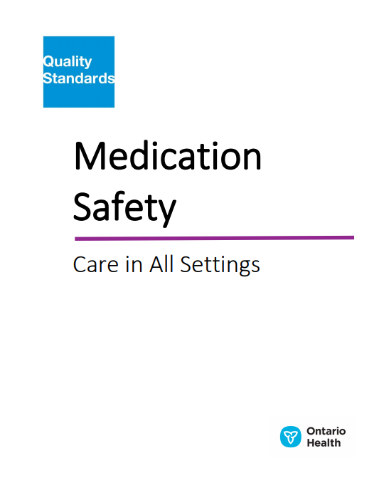
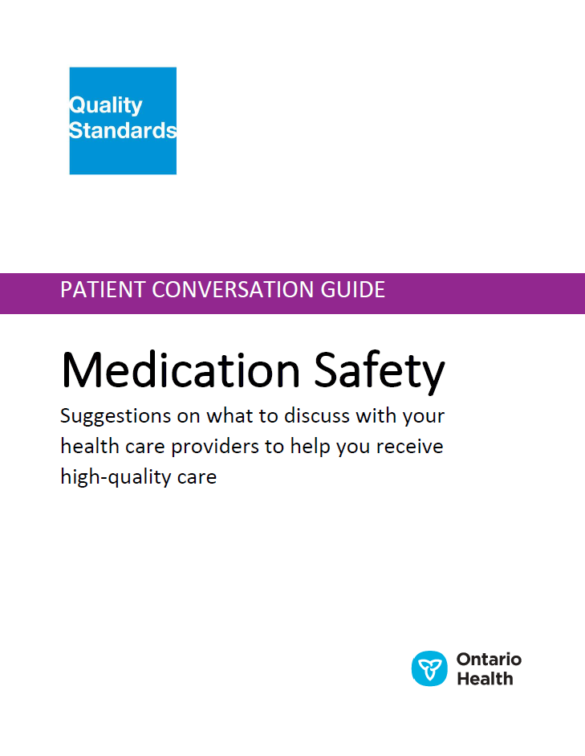
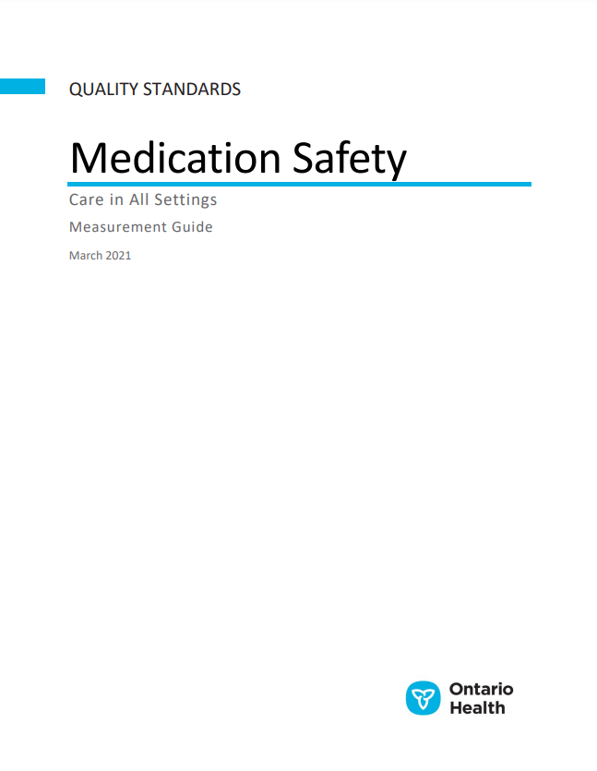
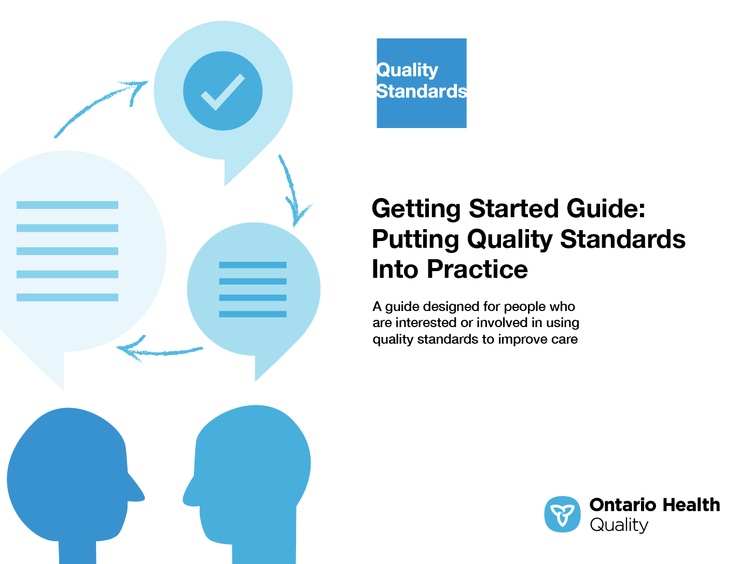
Quality Standard Resources
Quality Standard
Patient Guide
Getting Started Guide
Measurement Guide
Find these resources here:
https://hqontario.ca/evidence-to-improve-care/quality-standards/view-all-quality-standards/medication-safety
Notes:
Each quality standard focuses on a specific health care issue. The development of each quality standard is accompanied by an assortment of resources.
Through concise, easy-to-understand statements, quality standards outline what quality care looks like for a condition or topic based on the evidence.
This quality standard is accompanied by:
A patient guide
A getting started guide
A measurement guide
Quality standards provide the blueprint to enable the health care system in Ontario to work better, facilitate smooth transitions, and ensure patients receive the same high-quality care, regardless of where they reside.

Slide 6
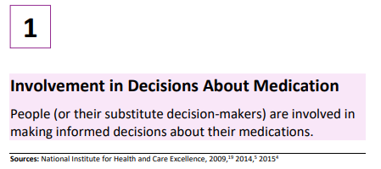
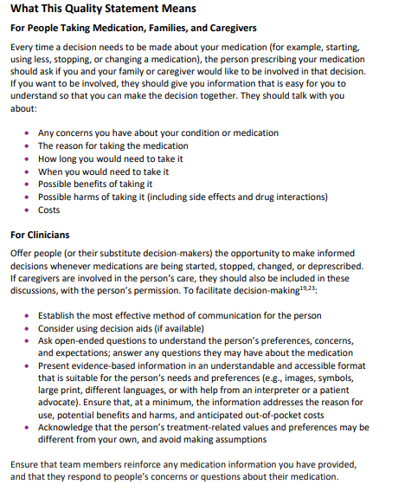
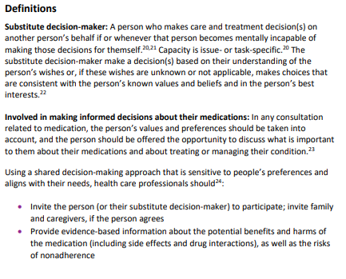
Inside the Quality Standard
The Statement
The Audience Statements
Definitions
*Excerpts are from the medication safety quality standard

Slide 7
Quality Standards:
Patient Guide
The patient guide is designed to give patients information about what quality care looks like for various conditions based on the best evidence, so they can ask informed questions of their health care providers.
Notes:
Every quality standard includes a plain language summary for patients, families, caregivers and the public called the patient guide.
Patient engagement in quality standards:
Membership on advisory committees
Focus groups and key informant interviews on topic-specific content (when necessary)
Public comment period for each quality standard
Consultations on the patient guide

Slide 8
Quality Standards:
How the Health Care System Can Support Implementation
Implementing quality standards can be challenging due to system-level barriers or gaps, many of which have been identified throughout the development of this standard. Ontario Health will work with and support other provincial partners, including the Ministry of Health, to bridge system-level gaps to support the implementation of quality standards.

Slide 9
Quality Standards:
Implementation Tools
The Getting Started Guide:
Outlines the process for using the quality standard as a resource to deliver high-quality care
Contains evidence-based approaches, as well as useful tools and templates for implementing change ideas at the practice level
Notes:
There are things we can do today despite the larger systemic barriers that may take time to resolve. The Getting Started Guide is a document that outlines a process for using the quality standards as a resource to deliver high-quality care. It compiles a number of resources to support adoption, such as links to implementation and quality improvement resources, examples and activities for reflection, and templates and documents to support the implementation planning activities. The Getting Started Guide also includes an Action Plan Template and examples on how Quality Improvement Plans can help to advance quality standards.

Slide 10

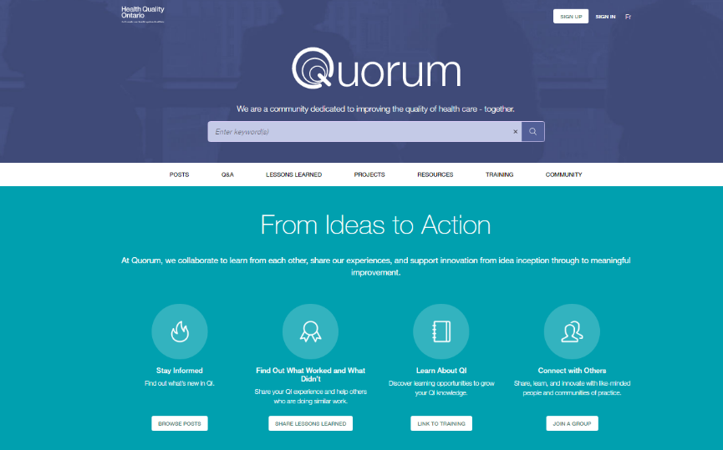
Quality Standards:
Quorum
Quorum is an online community dedicated to improving the quality of health care in Ontario.
The Quality Standards Adoption Series highlights efforts in the field to implement changes and close gaps in care related to quality standard topics.
Visit the Quality Standards Adoption Series on Quorum to learn how organizations are implementing quality standards.
Notes:
The Quality Standards program has highlighted several stories from organizations and groups using various standards and statements within their clinical care settings, organization, or institutions; these are available through posts and discussions on Quorum.
As well, we are working on compiling resources and tools, for both clinicians and patients and families.
The focus is on implementation/adoption stories and how organizations are using quality standards in practice to inform care.
We’d love to hear from you if you are interested in contributing to a post or article.

Slide 11
Quality Standards:
Measurement Guide
The measurement guide has two dedicated sections:
Local measurement: what you can do to assess the quality of care that you provide locally
Provincial measurement: how we can measure the success of the quality standard on a provincial level

Slide 12
Why Do We Need a Quality Standard
for Medication Safety?

Slide 13
“Five years ago, I had a stroke. Thankfully, my recovery went well, but I am now taking five or six different medications to help manage my cardiac function, which was affected by the stroke. When my cardiologist switched one of my prescriptions, she reviewed all of my medications and was very good at telling me what to watch for in terms of side effects and how she would follow up.
“The quality standard will hopefully help everyone understand that having these conversations and giving patients a say in the medications they are taking makes a big difference. It is important for patients to know how to take medications properly, and to be able to ask questions to their health care providers.”
– Jim Prescott, Lived Experience Advisor, Medication Safety Quality Standard Advisory Committee

Slide 14
Seven out of ten Ontarians said their primary care provider reviewed their prescription medications with them
Percentage of people, 16 years or older, who said their primary care provider reviewed their prescription medication(s) with them in the past year, in Ontario, by LHIN region, 2019
Data source: Health Care Experience Survey, provided by the Ministry of Health and Long-Term Care
For more information, please visit ​https://www.hqontario.ca/System-Performance/Primary-Care-Performance/Medication-Review

Slide 15
Nearly 10% of seniors who took at least one drug in Ontario were taking at least 15 different classes of drugs
Percentage of seniors (age 65+) in Ontario by number of drug classes prescribed, 2016
Data source: National Prescription Drug Utilization Information System (NPDUIS), the Canadian Institute for Health Information (CIHI). For more information, please visit https://www.cihi.ca/en/drug-use-among-seniors-in-canada​

Slide 16
In 2018/19, 44% of seniors prescribed medications were taking at least one drug that was potentially inappropriate
Percentage of senior (age 65+) drug claimants in Ontario taking at least one drug from the Beers list, from 2010/11 to 2018/19
Note: This indicator uses the Beers List as a measure of potentially inappropriate medications. The quality standard suggests that additional criteria,
such as STOPP/START, also be considered as a measure of potentially inappropriate medication.
Data source: National Prescription Drug Utilization Information System (NPDUIS), the Canadian Institute for Health Information (CIHI)​
For more information, please visit https://yourhealthsystem.cihi.ca/hsp/indepth?lang=en#/indicator/047/2/C5001/

Slide 17
In 2019, less than 10% of eligible people had a medication review within
7 days of being discharged home from hospital
Percentage of eligible people who had a medication review within 7 days of discharge home from hospital, from 2015 to 2019
Data source: Ontario Drug Benefit (ODB), MOH; Discharge Abstract Database (DAD), the Canadian Institute for Health Information (CIHI)​
For more information, please visit https://www.ocpinfo.com/practice-education/quality-improvement-data-for-pharmacy/quality-indicators-data-resources/

Slide 18
“For the past 30 years, my work has focused on frail older people, and medication management plays a significant role in caring for these individuals. There are often inaccuracies in patient discharge summary medication lists that make it difficult for the primary care physician to figure out exactly what the patient is taking and should be taking. As a result, one of the big problems I see in daily clinical practice is not really knowing what medications a patient is actually on, and having to cobble the list together from a number of sources.
“The quality standard for medication safety can help individual providers and provincial and regional groups start to work toward the goal of improving outcomes. I think it will allow organizations and individual practitioners to determine what their local and system strategies are for medication management. The quality standard addresses a number of important areas, including the emphasis that medication prescribing should involve an informed process between prescribers and patients that takes into account a person’s individual goals and their other health issues.”
– Dr. Christopher Frank

Slide 19
Quality Statements to Improve Care

Slide 20
Scope of the Medication Safety Quality Standard
This quality standard addresses care for people of all ages who are taking one or more medications. It applies to all settings.
This quality standard is intended to complement other quality standards with medication-related content, such as Transitions Between Hospital and Home, Opioid Prescribing for Acute Pain, Opioid Prescribing for Chronic Pain, and condition-specific quality standards.
Notes:
Scope of This Quality Standard
This quality standard addresses care for people of all ages who are taking one or more medications.
It focuses on care in all settings relevant to medication safety, including primary health care, specialist health care, long-term care, and home and community care.
Although the quality standard addresses care for people of all ages who are taking medications, there may be additional medication safety considerations for certain groups (e.g., weight-based dosing for infants and children, medication overtreatment for frail older people) that are not addressed in the standard.
This quality standard is intended to complement other quality standards with medication-related content, such as Transitions Between Hospital and Home, Opioid Prescribing for Acute Pain, Opioid Prescribing for Chronic Pain, and condition-specific quality standards.

Slide 21
Quality Statement Topics
Patient Involvement in Decisions About Medication
Prescribing Practices
Accurate and Up-to-Date Medication List
Structured Medication Review
Medication-Related Patient Safety Incidents
Notes:
Quality Statement 1: Involvement in Decisions About Medication
People (or their substitute decision-makers) are involved in making informed decisions about their medications.
Quality Statement 2: Prescribing Practices
Prescriptions are sent to the dispensing pharmacy via e-prescribing software embedded in the patient’s electronic medical record, which allows for two-way communication between the prescriber and the pharmacist. Effective clinical decision support systems are used to aid prescribing.
Quality Statement 3: Accurate and Up-to-Date Medication List
An accurate and up-to-date list of medications is available to people taking medication (and their families and caregivers, as appropriate) and to relevant health care professionals.
Quality Statement 4: Structured Medication Review
People taking medication have structured medication reviews, especially during health care visits when medications are a major component of their care, or as clinically indicated.
Quality Statement 5: Medication-Related Patient Safety Incidents
Patients, caregivers, health care providers, and organizations recognize, report, and learn from medication-related patient safety incidents. Health care providers and organizations support a patient safety culture that is person-centred, just, and trusting.

Slide 22
Quality Statement 1:
Involvement in Decisions About Medication
People (or their substitute decision-makers) are involved in making informed decisions about their medications.
Notes:
Quality Statement 1: Involvement in Decisions About Medication
People (or their substitute decision-makers) are involved in making informed decisions about their medications.

Slide 23
Quality Statement 2:
Prescribing Practices
Prescriptions are sent to the dispensing pharmacy via e-prescribing software embedded in the patient’s electronic medical record, which allows for two-way communication between the prescriber and the pharmacist. Effective clinical decision support systems are used to aid prescribing.
Notes:
Quality Statement 2: Prescribing Practices
Prescriptions are sent to the dispensing pharmacy via e-prescribing software embedded in the patient’s electronic medical record, which allows for two-way communication between the prescriber and the pharmacist. Effective clinical decision support systems are used to aid prescribing.

Slide 24
Quality Statement 3:
Accurate and Up-to-Date Medication List
An accurate and up-to-date list of medications is available to people taking medication (and their families and caregivers, as appropriate) and to relevant health care professionals.
Notes:
Quality Statement 3: Accurate and Up-To-Date Medication List
An accurate and up-to-date list of medications is available to people taking medication (and their families and caregivers, as appropriate) and to relevant health care professionals.

Slide 25
Quality Statement 4:
Structured Medication Review
People taking medication have structured medication reviews, especially during health care visits when medications are a major component of their care, or as clinically indicated.
Notes:
Quality Statement 4: Structured Medication Review
People taking medication have structured medication reviews, especially during health care visits when medications are a major component of their care, or as clinically indicated.

Slide 26
Quality Statement 5:
Medication-Related Patient Safety Incidents
Patients, caregivers, health care providers, and organizations recognize, report, and learn from medication-related patient safety incidents. Health care providers and organizations support a patient safety culture that is person-centred, just, and trusting.
Notes:
Quality Statement 5: Medication-Related Patient Safety Incidents
Patients, caregivers, health care providers, and organizations recognize, report, and learn from medication-related patient safety incidents. Health care providers and organizations support a patient safety culture that is person-centred, just, and trusting.

Slide 27
How to Measure Overall Success
Notes:
The Medication Safety Quality Standard Advisory Committee identified some overarching goals for this quality standard. These goals were mapped to indicators that can be used to assess quality of care provincially and locally.

Slide 28
Indicators That Can Be Measured Using Provincial Data
Percentage of people who take one or more prescription medications and who report that their care provider has reviewed and discussed their medications with them in the previous 12 months
Percentage of people who are eligible for the Ontario Drug Benefit program (i.e., who are aged 65 years or older) who have a MedsCheck medication review within 7 days of being discharged home from hospital
Percentage of people aged 65 years and older who take prescription medication and who are prescribed medication that appears in the Screening Tool of Older Persons’ Prescriptions (STOPP) and Screening Tool to Alert to Right Treatment (START) or Beers Criteria for Potentially Inappropriate Medication Use in Older Adults
Percentage of people discharged from hospital to home who have a drug-related emergency department visit within 30 days after discharge
Percentage of people discharged from hospital to home who have a drug-related hospital readmission within 30 days after discharge

Slide 29
Indicator That Can Be Measured Using Only Local Data
Percentage of people in hospital who are taking one or more medications and
who have a medication-related patient safety incident

Slide 30

Thank you.
LET’S CONTINUE THE CONVERSATION
HQOntario.ca | OntarioHealth.ca
@OntarioHealthOH
Ontario Health
@OntarioHealthOH
Ontario Health

