Slide 1

Palliative Care
QUALITY STANDARDS
Guiding evidence-based care for people in Ontario
Notes:
If you have any questions about the content of this presentation, please contact us at QualityStandards@OntarioHealth.ca

Slide 2
Objectives
Overview of quality standards: What are they? How are they used?​
Why this quality standard is needed: Gaps and variations in quality of care for people with a serious illness in Ontario
Quality statements to improve care: The key statements in the palliative care quality standard
Measures to support improvement: Indicators that can help measure your quality improvement efforts
2

Slide 3
Quality standards
Inform clinicians and patients what quality care looks like
Focus on conditions or processes where there are large variations in how care is delivered, or where there are gaps between the care provided in Ontario and the care patients should receive
Are grounded in the best available evidence
3
Notes:
Quality standards are a small set of high impact statements that describe optimal care where identified quality gaps exist in Ontario.
Voluntary and aspirational in nature​.
Designed to “raise the ceiling” with the goal of having the best possible care available to all Ontarians, regardless of where they live in the province.
There are many guidelines, professional standards, and other recommendations that contribute to the evidence ecosystem. Quality standards complement these resources.
Quality standards outline the what of care that should be delivered but are agnostic on who should be delivering it (unlike other CPGs, BPGs).
Quality standards are:
Concise: 5 to 15 strong, evidence-based statements focused on high-priority areas for improvement.
Accessible: help clinicians and provider organizations offer the highest-quality care; and patients to know what to discuss with their care providers (compared with CPGs that are quite dense, these are very accessible, also written in plain language).
Measurable: each statement is accompanied by 1 or more quality indicators (structure, process, or outcome), with a set of outcome measures for the overall standard.
Implementable: quality improvement tools and resources support each standard, to fuel adoption.

Slide 4
Quality standards
Help patients, residents, families, and care partners know what to ask for in their care
Help health care professionals know what care to offer, based on evidence and expert consensus
Help health care organizations measure, assess, and improve the quality of care they provide
Help ensure consistent,
high-quality care across
the province
4
Notes:
Patients, care partners and the public can use quality standards to understand what excellent care looks like, what they should expect from their health care providers, and how to discuss the quality of their care.
Provincial regions and disease agencies can use quality standards to measure health outcomes, hold health service providers accountable for delivering high-quality care, and inform regional improvement strategies.
Provider organizations can use quality standards to measure and audit their quality of care, identify gaps, guide organizational improvement strategies, and inform clinical program investments.
Health care professionals can use quality standards to evaluate their practice and identify areas for personal and organizational quality improvement and can incorporate the evidence-based statements into professional education.
Government can use quality standards to identify provincial priority areas, inform new data collection and reporting initiatives, and design performance indicators and funding incentives.

Slide 5
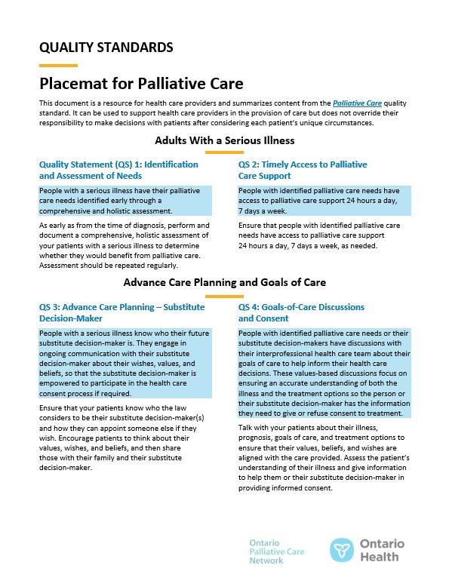

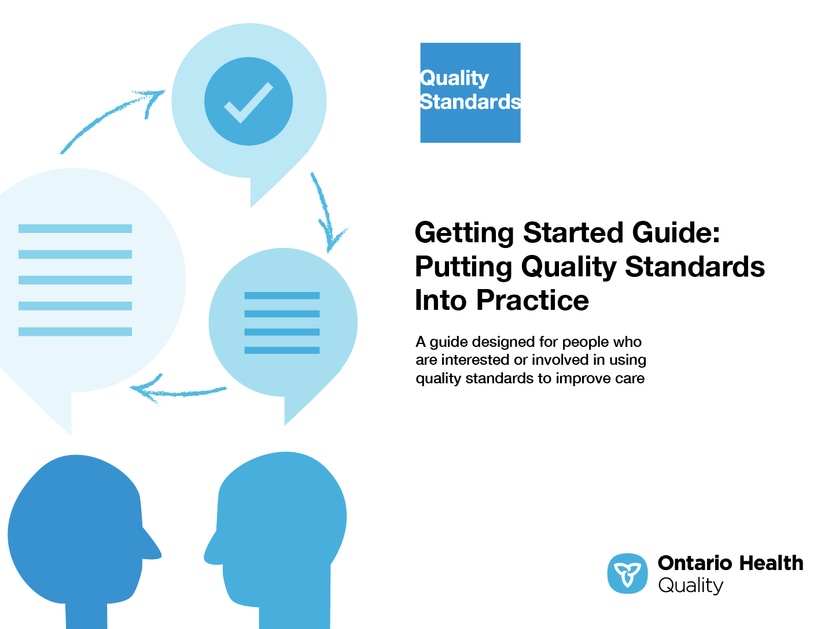
Quality standard resources
Quality Standard
Patient Guide
Placemat
Measurement Guide
Technical Specifications
Getting Started Guide
5
Find these resources here: https://www.hqontario.ca/evidence-to-improve-care/quality-standards/view-all-quality-standards/palliative-care
Notes:
Each quality standard focuses on a specific health care issue. The development of each quality standard is accompanied by an assortment of resources.
Through concise, easy-to-understand statements, quality standards outline what quality care looks like for a condition or topic based on the evidence.
Each quality standard is accompanied by a:
Patient guide
Placemat
Measurement guide
Technical specifications
Quality standards provide the blueprint to enable the health care system in Ontario to work better, facilitate smooth transitions, and ensure patients receive the same high-quality care, regardless of where they reside.

Slide 6
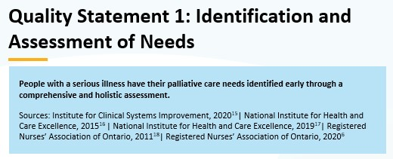
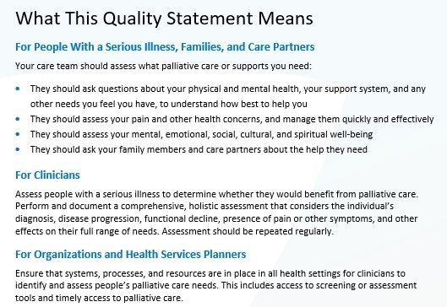
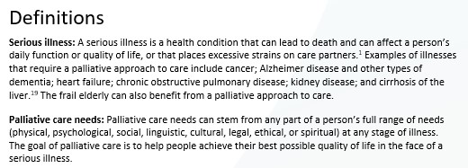
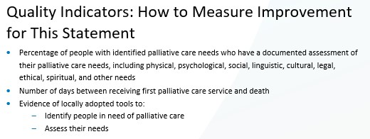
Inside the quality standard
The Quality Statement
The Audience Statements
The Definitions
The Indicators
6

Slide 7
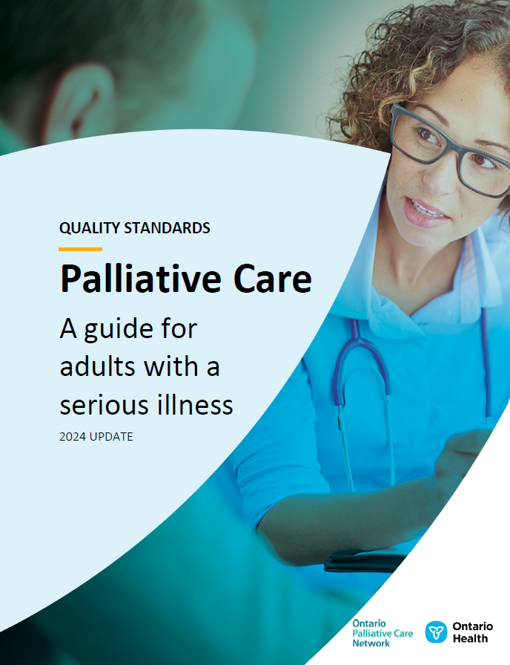
Patient guide
Quality standards
The patient guide is designed to give patients information about what quality care looks like for various conditions based on the best evidence, so they can ask informed questions of their health care providers.
7
Notes:
Every quality standard includes a plain language summary for patients, families, care partners and the public called the patient guide.
Patient engagement in quality standards:
Membership on advisory committees
Focus groups and key informant interviews on topic-specific content (when necessary)
Public comment period for each quality standard
Consultations on the patient guide

Slide 8
Placemat
Quality standards
The placemat is a quick-reference resource
for clinicians that summarizes the quality standard and includes links to helpful resources and tools.
8

Slide 9
How the health care system can support implementation
Quality standards
Implementing quality standards can be challenging owing to
system-level barriers or gaps, many of which have been identified throughout the development of this standard
Ontario Health will work with and support other provincial partners, including the Ministry of Health, to bridge system-level gaps to support the implementation of quality standards
9

Slide 10
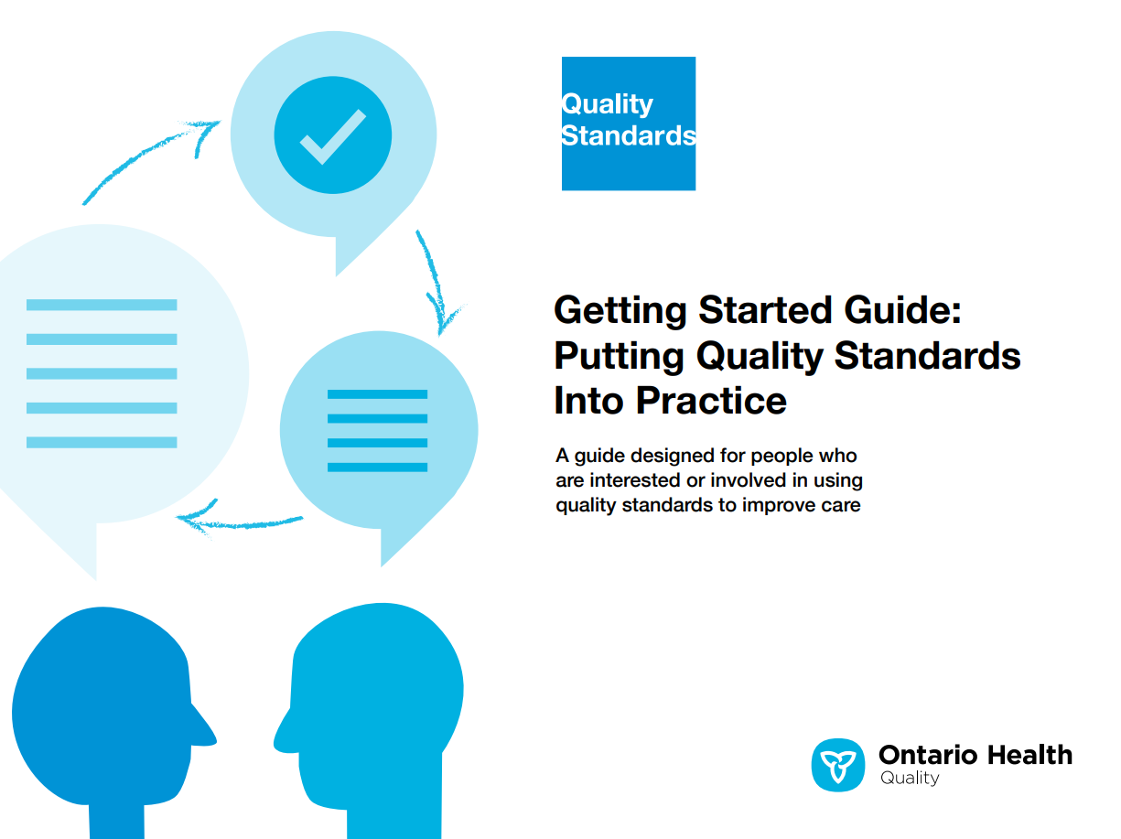
Implementation tools
Quality standards
The Getting Started Guide:
Outlines the process for using the
quality standard as a resource to
deliver high-quality care
Contains evidence-based approaches,
as well as useful tools and templates for implementing change ideas at the
practice level
10
Notes:
There are things we can do today despite the larger systemic barriers that may take time to resolve. The Getting Started Guide is a document that outlines a process for using the quality standards as a resource to deliver high-quality care. It compiles a number of resources to support adoption, such as links to implementation and quality improvement resources, examples and activities for reflection, and templates and documents to support the implementation planning activities. The Getting Started Guide also includes an Action Plan Template and examples on how Quality Improvement Plans can help to advance quality standards.

Slide 11

Quorum
Quality standard adoption tools
Quorum is an online community dedicated to improving the quality of health care in Ontario.
The Quality Standards Adoption Series highlights efforts in the field to implement changes and close gaps in care related to quality standard topics.
11
https://quorum.hqontario.ca
Notes:
The Quality Standards program has highlighted several stories from organizations and groups using various standards and statements within their clinical care settings, organization, or institutions; these are available through posts and discussions on Quorum.
As well, we are working on compiling resources and tools, for both clinicians and patients and families.
The focus is on implementation/adoption stories and how organizations are using quality standards in practice to inform care.
We’d love to hear from you if you are interested in contributing to a post or article.

Slide 12

Measurement guide
Quality standards
The measurement guide describes:
The measurement principles behind the quality indicators included in quality standards
The types of indicators included in quality standards
How local and provincial data are collected and measured
12

Slide 13

Technical specifications
Quality standards
The technical specifications report outlines
2 types of measurement:
Provincial measurement: how we can monitor the progress being made to improve care on a provincial level
Local measurement: what you can do
to assess the quality of care that you
provide locally
13

Slide 14
Why do we need a quality standard for palliative care?

Slide 15
Areas for improvement in palliative care
Despite the clear benefits of palliative care, there are many gaps in its delivery in Ontario, including access to palliative care services
Of the 103,400 community-dwelling people who died in Ontario
in 2021/22:
          Approximately 67,700 (65%) received palliative care services on at least
          1 occasion in their last 12 months of life
          A third (33.8%) received physician home visits, palliative home care,
          or both in their last 90 days of life
15
Source: Regional Profiles Tool and Performance Summary Report, Ontario Palliative Care Network, 2023.

Slide 16
Although the number of people in Ontario who received home care service visits in their last 30 days of life has increased over time, the percentage of people receiving these visits has remained stable
Percentage of people who received home care service visits in their last 30 days of life in Ontario
Notes: Crude rates. Only people who were not institutionalized are included in this indicator (i.e., those who were not in hospital or long-term care for the entirety of the 30 days prior to death).
Sources: Home Care Database, Resident Assessment Instrument (RAI)–Contact Assessment, RAI–Palliative Care, RAI–Home Care, National Ambulatory Care Reporting System, Continuing Care Reporting System and Ontario Health Insurance Plan; accessed via the Ontario Palliative Care Network.
16

Slide 17
Areas in Ontario with increased material deprivation (a dimension of marginalization) are associated with lower rates of physician home visits and palliative home care in people’s last 90 days of life
Percentage of community-dwelling people who died and who received physician home visits and/or palliative home care in their last 90 days of life, by material deprivation quintile, 2022/23
Material deprivation quintile
Percentage who received physician home visits and/or palliative home care
Notes: Crude rates. Based on the average of 4 fiscal quarters. Material deprivation is measured at a geographic level and can reflect marginalization within a neighbourhood.
Sources: Registered Persons Database, Discharge Abstract Database, National Ambulatory Care Reporting System, Continuing Care Reporting System and Ontario Health Insurance Plan, National Rehabilitation Reporting System, Ontario Mental Health Reporting System, Ontario Marginalization Index; accessed via the Ontario Palliative Care Network.
17

Slide 18
Considerable variation exists in the percentage of community-dwelling people who died and who received physician home visit(s) and/or palliative home care in their last 90 days of life across Ontario Health Regions
Percentage of community-dwelling people who died and who received physician home visit(s) and/or palliative home care in their last 90 days of life, by Ontario Health Region in 2022/23
Note: Crude rates.
Sources: Home Care Database, Resident Assessment Instrument (RAI)–Contact Assessment, RAI–Palliative Care, RAI–Home Care, National Ambulatory Care Reporting System, Continuing Care Reporting System and Ontario Health Insurance Plan; accessed via the Ontario Palliative Care Network.
18

Slide 19
The percentage of people who died in hospital has been decreasing over time, with a more notable decrease in 2020/21
Percentage of people who died in hospital in Ontario
In surveys of patients and care partners, most say they would prefer to die at home.^{1,2} However, of the approximately 117,400 people who died in 2021/22 in Ontario, half of deaths (49.2%) were still occurring in hospital.³
Notes: Crude rates. Hospital setting includes deaths in acute inpatient care and in emergency departments.
Sources: Home Care Database, Resident Assessment Instrument (RAI)–Contact Assessment, RAI–Palliative Care, RAI–Home Care, National Ambulatory Care Reporting System, Continuing Care Reporting System and Ontario Health Insurance Plan; accessed via Ontario Palliative Care Network.
References:
1. Health Quality Ontario. Palliative care at the end of life [Internet]. Toronto (ON): Queen’s Printer for Ontario; 2016 [cited 2016 Aug 19]. Available from: http://www.hqontario.ca/Portals/0/documents/system-performance/palliative-care-report-en.pdf
2. Tanuseputro P, Beach S, Chalifoux M, Wodchis W, Hsu A, Seow H, et al. Associations between physician home visits for the dying and place of death: a population-based retrospective cohort study. PLoS One. 2018;13(2):e0191322.
3. Ontario Palliative Care Network, Performance Summary Report, 2023.
19

Slide 20
A slight decrease over time is visible in the percentage of people who had 1 or more unplanned emergency department visits in their last 30 days of life
Percentage of people who had 1 or more unplanned emergency department visits
in their last 30 days of life
Notes: Crude rates. People included in this indicator were community-dwelling or in long-term care; hospitalized individuals were excluded.
Sources: Home Care Database, Resident Assessment Instrument (RAI)–Contact Assessment, RAI–Palliative Care, RAI–Home Care, National Ambulatory Care Reporting System, Continuing Care Reporting System and Ontario Health Insurance Plan; accessed via Ontario Palliative Care Network.
20

Slide 21
38% of care partners rated the care received in the last 90 days of life as excellent
Care-partner-rated satisfaction with the overall care received in
the person’s last 90 days of life, 2020/21
Rating of care
Note: Crude rates.
Source: CaregiverVoice survey, accessed via the Ontario Palliative Care Network.
21
Notes:
A similar trend was visible in the previous 4 fiscal years.

Slide 22
”
“It should not be a privilege to receive quality palliative care. Yet, the support and delivery of palliative care varies from rural to urban centres and even within a city depending on the catchment area. Early access to palliative care is critical to supporting quality of life for patients and their caregivers. It focuses on the physical, spiritual, and mental health needs of the patent and provides the necessary supports to caregivers as they journey with their loved one.
My father was fortunate to be a patient of one of the few programs that provides comprehensive palliative care to those living with advanced congestive heart failure. In addition to symptom management and advanced care planning, the program facilitated the coordination of support services to allow my father to remain in his home, ensured smooth transitions of care, and partnered with the community palliative nurse practitioner and his family physician. Through an integrated care team and my commitment to his care, my dad’s anticipated 6 months were actually 21 months, with quality of life surrounded by his family.
Unfortunately, the journey for many is not as positive, but it could be with the palliative care quality standard. The impact the standard could have on transitions of care, aligning the journey with the patient’s goals and quality of life, is significant and should not be underestimated.”
– Brenda Albuquerque-Boutilier, Lived Experience Advisor, Palliative Care Quality Standard
Working Group
22

Slide 23
Quality statements to improve care

Slide 24
Scope of this quality standard
This quality standard addresses palliative care for adults with a serious illness, and for their family and care partners
The goal of palliative care is to relieve pain and suffering, and to improve a person’s quality of life
This quality standard focuses on care in all health settings, for all health disciplines and in all health sectors
This quality standard does not address medical assistance in dying, although people who choose medical assistance in dying should receive high-quality palliative care
24
Notes:
Scope of This Quality Standard
This quality standard addresses palliative care for adults with a serious illness, and for their family and care partners. It focuses on palliative care in all health settings, for all health disciplines, and in all health sectors. It includes information about general palliative care that applies to all health conditions. Palliative care can benefit individuals and their care partners as early as at the time of diagnosis of a serious illness through the end of life and bereavement.
A serious illness is a health condition that can lead to death and can affect a person’s daily function or quality of life, or that places excessive strains on care partners. The goal of palliative care is to relieve pain and suffering, and to improve a person’s quality of life.
Other condition-specific quality standards address palliative care, including those on heart failure and chronic obstructive pulmonary disease. Although this quality standard includes information that could apply to infants, children, and youth, a separate palliative care quality standard is being considered for these populations.
This document does not address medical assistance in dying, although people who choose medical assistance in dying should receive high-quality palliative care. Health care professionals are expected to manage all requests for medical assistance in dying in accordance with the expectations set out by their regulatory colleges. Health care professionals should refer to their regulatory colleges for more information and guidance on medical assistance in dying.

Slide 25
Quality statement topics
Identification and assessment of needs
Timely access to palliative care support
Advance care planning – substitute decision-maker
Goals-of-care discussions and consent
Individualized, person-centred care plan
Management of pain and other symptoms
Psychosocial aspects of care
Education for people with a serious illness, substitute decision-makers, families, and care partners
Care partner support
Transitions in care
Setting of care and place of death
Interprofessional team-based care
Education for health care providers and volunteers
25

Slide 26
Identification and assessment of needs
Quality statement 1:
People with a serious illness have their palliative care needs identified early through a comprehensive and holistic assessment.
26

Slide 27
Timely access to palliative care support
Quality statement 2:
People with identified palliative care needs have access to palliative care support 24 hours a day,
7 days a week.
27

Slide 28
Advance care planning – substitute decision-maker
Quality statement 3:
People with a serious illness know who their future substitute decision-maker is. They engage in ongoing communication with their substitute decision-maker about their wishes, values, and beliefs, so that the substitute decision-maker is empowered to participate in the health care consent process if required.
28

Slide 29
Goals-of-care discussions and consent
Quality statement 4:
People with identified palliative care needs or their substitute decision-makers have discussions with their interprofessional health care team about their goals of care to help inform their health care decisions. These values-based discussions focus on ensuring an accurate understanding of both the illness and treatment options so the person or their substitute decision-maker has the information they need to give or refuse consent to treatment.
29

Slide 30
Individualized, person-centred care plan
Quality statement 5:
People with identified palliative care needs collaborate with their primary care provider and other health care professionals to develop an individualized, person-centred care plan that is reviewed and updated regularly.
30

Slide 31
Management of pain and other symptoms
Quality statement 6:
People with identified palliative care needs have their pain and other symptoms managed effectively, in a timely manner.
31

Slide 32
Psychosocial aspects of care
Quality statement 7:
People with identified palliative care needs receive timely psychosocial support to address their mental, emotional, social, cultural, and spiritual needs.
32

Slide 33
Education for people with a serious illness, substitute decision-makers, families, and care partners
Quality statement 8:
People with a serious illness, their future substitute decision-maker, their family, and their care partners are offered education about palliative care and information about available resources and supports.
33

Slide 34
Care partner support
Quality statement 9:
Families and care partners of people with identified palliative care needs are offered ongoing assessment of their needs, and are given access to resources, respite care, and grief and bereavement support, consistent with their preferences.
34

Slide 35
Transitions in care
Quality statement 10:
People with identified palliative care needs experience seamless transitions in care that are coordinated effectively among settings and health care providers.
35

Slide 36
Setting of care and place of death
Quality statement 11:
People with identified palliative care needs, their substitute decision-maker, their family, and their care partners have ongoing discussions with their health care professionals about their preferred setting of care and place of death.
36

Slide 37
Interprofessional team-based care
Quality statement 12:
People with identified palliative care needs receive integrated care from an interprofessional team, which includes volunteers.
37

Slide 38
Education for health care providers and volunteers
Quality statement 13:
People receive palliative care from health care providers and volunteers who possess the appropriate knowledge and skills to deliver high-quality palliative care.
38

Slide 39
Measures to support improvement
Notes:
The Palliative Care Quality Standard Working Group identified a set of overarching goals for this quality standard. These have been mapped to indicators that may be used to assess quality of care provincially.

Slide 40
Indicators that can be measured using provincial data
Percentage of people who receive care in their last 12 months, 3 months, and 1 month of life:
  Home care services (any home care and palliative-specific home care)
  Health care provider home visits (currently, only physician home visits are measurable)
  Hospice care (currently not provincially measurable; locally measurable)
Percentage of people who had 1 or more unplanned emergency department visits in their last 12 months,
3 months, and 1 month of life
Percentage of deaths that occurred in:
  Hospitals
    Acute inpatient care
    Emergency department
    Complex continuing care
    Inpatient rehabilitation
    Palliative care beds (currently not provincially measurable; locally measurable)
  Long-term care homes
  The community (may include home, hospice residence, retirement home, or assisted-living home)
Percentage of people who receive palliative care (or their care partners) who rated the overall care received in their last 12 months, 3 months, and 1 month of life as excellent
40

Slide 41
Data sources and acknowledgement
The data used in this presentation were provided by the Ontario Palliative Care Network. The opinions, results, and conclusions included in this presentation are those of the authors and are independent from the funding sources.
Some of the data sources used in the analyses are provided by the Canadian Institute for Health Information (CIHI). However, the analyses, conclusions, opinions, and statements expressed herein are those of the authors, and not necessarily those of CIHI.
41

Slide 42
Thank you

