Slide 1

Surgical Site Infections
Quality Standard
Guiding evidence-based care for people in Ontario
Notes:
If you have any questions about the content of this presentation, please contact us at QualityStandards@OntarioHealth.ca

Slide 2
Objectives
Overview of quality standards: What are they? How are they used?​
Why this quality standard is needed: Gaps and variations in quality of care for people having surgery in Ontario
Quality statements to improve care: The key statements in the surgical site infections quality standard
Measures to support improvement: Indicators that can help measure your quality improvement efforts

Slide 3
Quality standards
Inform clinicians and patients what quality care looks like
Focus on conditions or processes where there are large variations in how care is delivered, or where there are gaps between the care provided in Ontario and the care patients should receive
Are grounded in the best available evidence
Notes:
Quality standards are a small set of high impact statements that describe optimal care where identified quality gaps exist in Ontario.
Voluntary and aspirational in nature​.
Designed to “raise the ceiling” with the goal of having the best possible care available to all Ontarians, regardless of where they live in the province.
There are many guidelines, professional standards, and other recommendations that contribute to the evidence ecosystem. Quality standards complement these resources.
Quality standards outline the what of care that should be delivered but are agnostic on who should be delivering it (unlike other CPGs, BPGs).
Quality standards are:
Concise: 5 to 15 strong, evidence-based statements focused on high-priority areas for improvement.
Accessible: help clinicians and provider organizations offer the highest-quality care; and patients to know what to discuss with their care providers (compared with CPGs that are quite dense, these are very accessible, also written in plain language).
Measurable: each statement is accompanied by one or more quality indicators (structure, process, or outcome), with a set of outcome measures for the overall standard.
Implementable: quality improvement tools and resources support each standard, to fuel adoption.

Slide 4
Quality standards
Help health care professionals know what care to offer, based on evidence and expert consensus
Help health care organizations measure, assess, and improve the quality of care they provide
Help ensure consistent,
high-quality care across the province
Help patients, residents, families, and caregivers know what to ask for in their care
Notes:
Patients, caregivers and the public can use quality standards to understand what excellent care looks like, what they should expect from their health care providers, and how to discuss the quality of their care.
Provincial regions and disease agencies can use quality standards to measure health outcomes, hold health service providers accountable for delivering high-quality care, and inform regional improvement strategies.
Provider organizations can use quality standards to measure and audit their quality of care, identify gaps, guide organizational improvement strategies, and inform clinical program investments.
Health care professionals can use quality standards to evaluate their practice and identify areas for personal and organizational quality improvement, and can incorporate the evidence-based statements into professional education.
Government can use quality standards to identify provincial priority areas, inform new data collection and reporting initiatives, and design performance indicators and funding incentives.

Slide 5
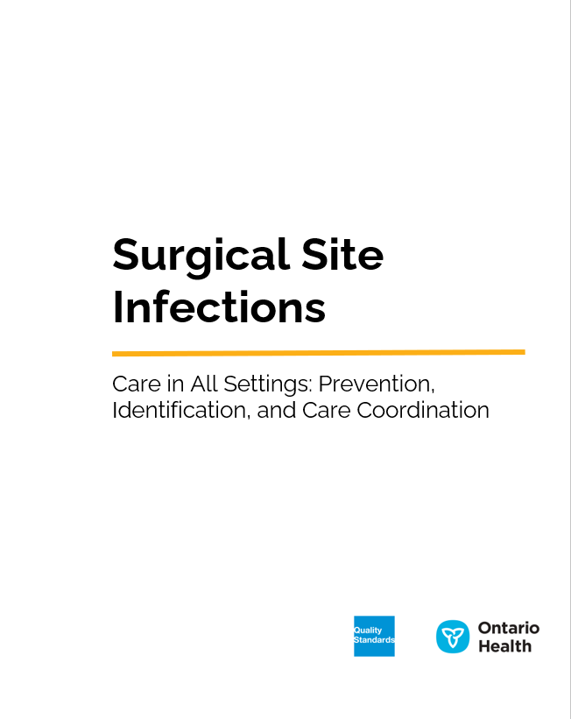
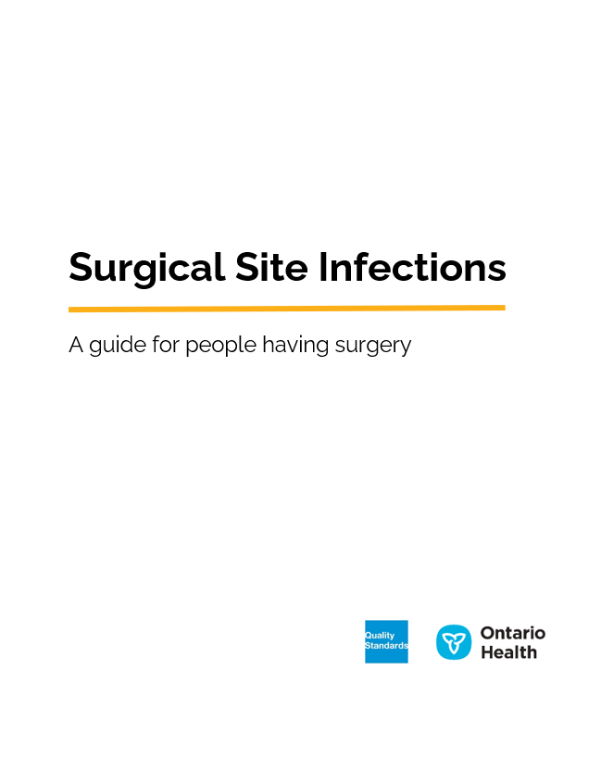
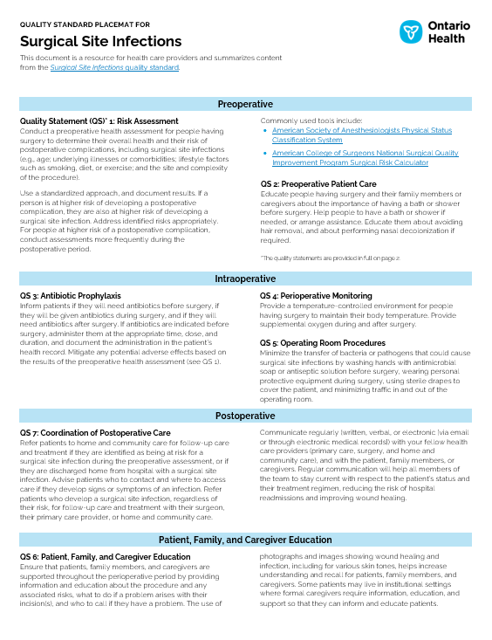
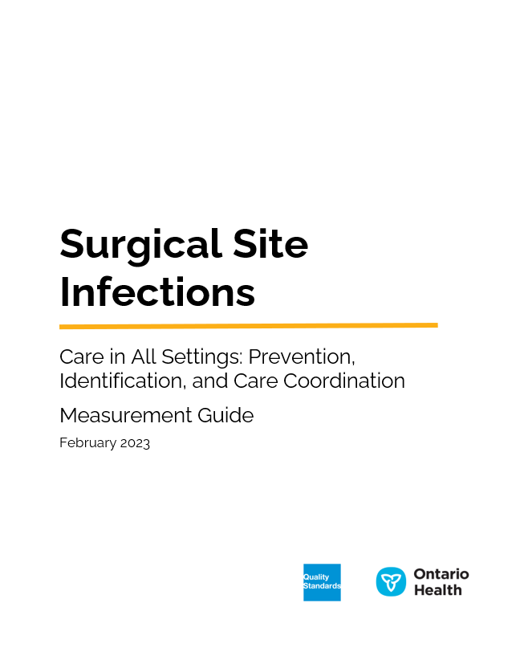
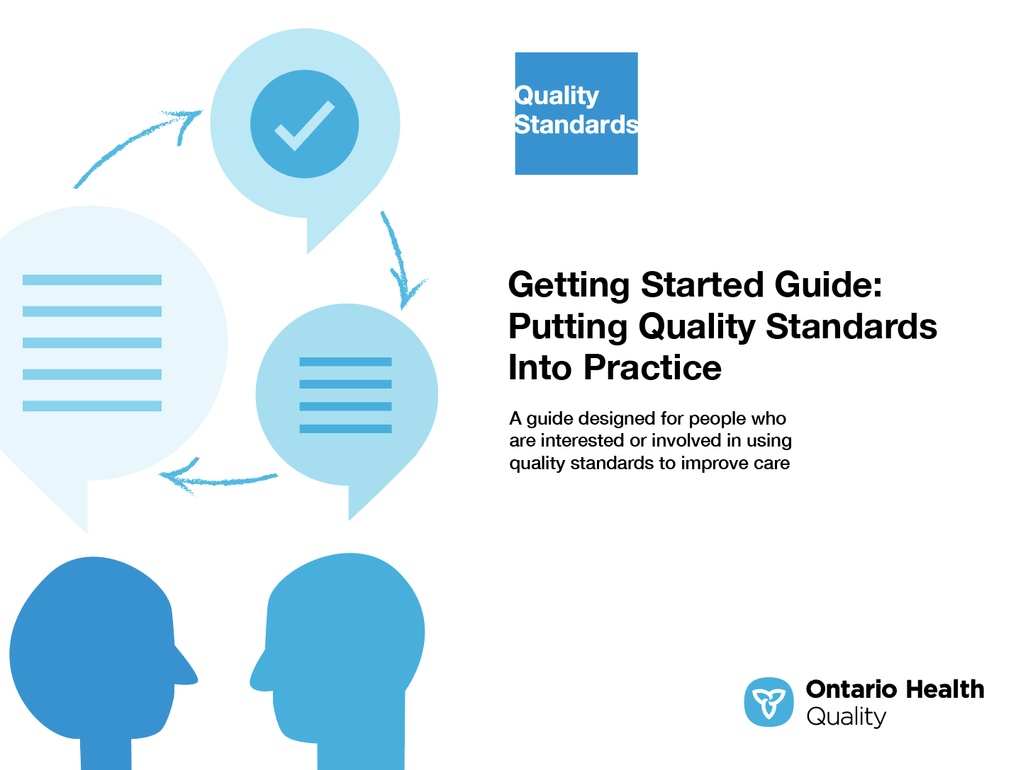
Quality standard resources
Quality Standard
Patient Guide
Placemat
Getting Started Guide
Measurement Guide
Find these resources here:
https://www.hqontario.ca/evidence-to-improve-care/quality-standards/view-all-quality-standards/surgical-site-infections
Notes:
Each quality standard focuses on a specific health care issue. The development of each quality standard is accompanied by an assortment of resources.
Through concise, easy-to-understand statements, quality standards outline what quality care looks like for a condition or topic based on the evidence.
Each quality standard is accompanied by a:
Patient conversation guide
Getting started guide
Placemat
Measurement guide
Quality standards provide the blueprint to enable the health care system in Ontario to work better, facilitate smooth transitions, and ensure patients receive the same high-quality care, regardless of where they reside.

Slide 6
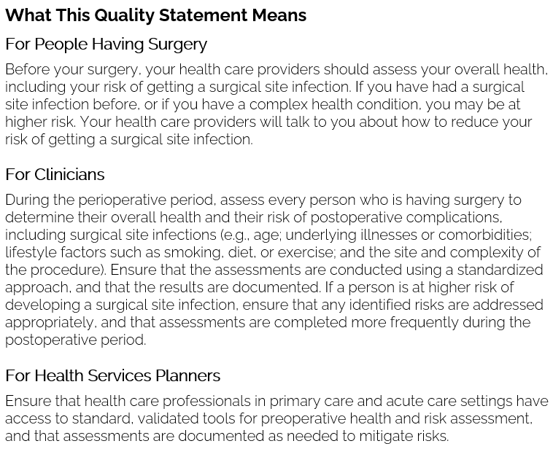
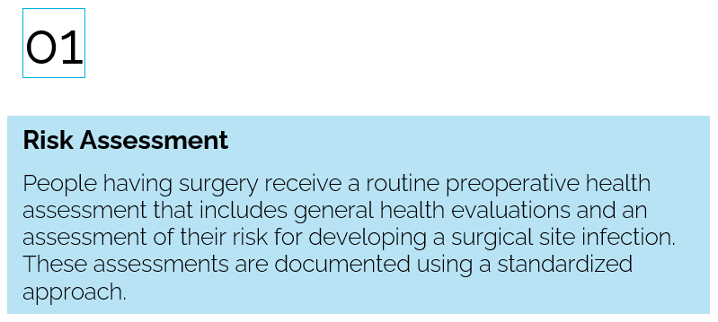
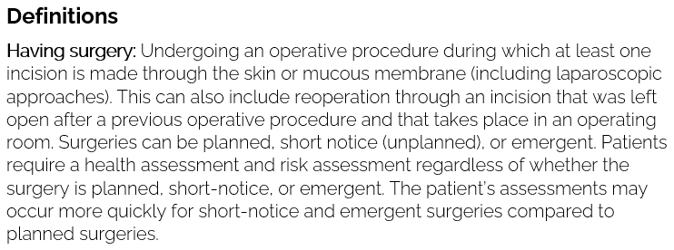
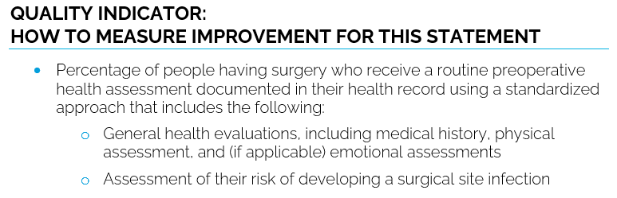
Inside the quality standard
The Audience Statements
The Quality Statement
The Definitions
The Indicators

Slide 7
Quality standards
Patient guide
The patient guide is designed to give patients information about what quality care looks like for various conditions based on the best evidence, so they can ask informed questions of their health care providers.
Notes:
Every quality standard includes a plain language summary for patients, families, caregivers and the public called the patient guide.
Patient engagement in quality standards:
Membership on advisory committees
Focus groups and key informant interviews on topic-specific content (when necessary)
Public comment period for each quality standard
Consultations on the patient guide

Slide 8
Quality standards
How the health care system can support implementation
Implementing quality standards can be challenging owing to system-level barriers or gaps, many of which have been identified throughout the development of this standard
Ontario Health will work with and support other provincial partners, including the Ministry of Health, to bridge system-level gaps to support the implementation of quality standards

Slide 9
Quality standards
Implementation tools
The Getting Started Guide:
Outlines the process for using the quality standard as a resource to deliver high-quality care
Contains evidence-based approaches, as well as useful tools and templates for implementing change ideas at the practice level
Notes:
There are things we can do today despite the larger systemic barriers that may take time to resolve. The Getting Started Guide is a document that outlines a process for using the quality standards as a resource to deliver high-quality care. It compiles a number of resources to support adoption, such as links to implementation and quality improvement resources, examples and activities for reflection, and templates and documents to support the implementation planning activities. The Getting Started Guide also includes an Action Plan Template and examples on how Quality Improvement Plans can help to advance quality standards.

Slide 10


Quality standard adoption tools
Quorum
Quorum is an online community dedicated to improving the quality of health care in Ontario.
The Quality Standards Adoption Series highlights efforts in the field to implement changes and close gaps in care related to quality standard topics.
quorum.hqontario.ca
Notes:
The Quality Standards program has highlighted several stories from organizations and groups using various standards and statements within their clinical care settings, organization, or institutions; these are available through posts and discussions on Quorum.
As well, we are working on compiling resources and tools, for both clinicians and patients and families.
The focus is on implementation/adoption stories and how organizations are using quality standards in practice to inform care.
We’d love to hear from you if you are interested in contributing to a post or article.

Slide 11
Quality standards
Measurement guide
The measurement guide has two dedicated sections:
Local measurement: what you can do to assess the quality of care that you provide locally
Provincial measurement: how we can monitor the progress being made to improve care on a provincial level

Slide 12
Quality standards
Placemat
The placemat is a quick-reference resource for clinicians that summarizes the quality standard and includes links to helpful resources and tools.

Slide 13
Why do we need a
quality standard for surgical site infections?

Slide 14
Half a million surgeries are performed each year in Ontario.
Of all health care visits with a surgical site infection (SSI) in FY 2020, 91% occurred in primary care settings.
The volume of SSI visits was higher from FY 2017 to FY 2019 than in FY 2020, but the proportion of visits by health care setting was similar across all years.
Abbreviation: FY, fiscal year.
Notes: Includes all SSI cases regardless of time elapsed since surgery. OHIP data available only up to FY 2020.
Sources: Discharge Abstract Database (DAD), National Ambulatory Care Reporting System (NACRS), Ontario Health Insurance Plan Claims Database (OHIP), 2017/18 to 2021/22; accessed via IntelliHealth​.

Slide 15
Volumes of hospitalizations with an SSI decreased between FY 2017 and FY 2021, but rates of hospitalizations with an SSI within 30 days post-surgery increased in FY 2020
*Trend line =
rate per 1,000 surgeries; numbers = volumes
Surgical volumes decreased by 45% between FY2019 Q4 and FY 2020 Q1, largely because of the medical directive in March 2020 to reduce the number of elective surgeries performed. Hospitalizations with an SSI decreased by a smaller magnitude (28%). The resulting rate increased in FY 2020 Q1 to 6.2 per 1,000 surgeries.
Sources: DAD, 2017/18 to 2021/22, accessed via IntelliHealth; Government of Ontario, “Ontario Hospitals Asked to Take a Planned Approach to Ramping Down Elective Surgeries,” March 15, 2020, https://news.ontario.ca/en/statement/56328/ontario-hospitals-asked-to-take-a-planned-approach-to-ramping-down-elective-surgeries.
Notes:
By FY 2020 Q2, the surgical volume had resumed to 95% of that of FY 2019 Q2. The quarterly SSI rates in Q2−Q4 of FY 2020 were between 4.7 and 5.5 hospitalizations per 1,000 surgeries.

Slide 16
In FY 2021, the highest rate of hospitalization with an SSI within 30 days post-surgery was among people aged 65 years and older. The lowest rate was among people aged 18 to 44 years. The SSI hospitalization rate was slightly higher among males than females
(5.4 vs. 4.8 per 1,000 surgeries).
Sources: DAD, NACRS, 2021/22; accessed via IntelliHealth​.

Slide 17



In FY 2021, 63.5% of hospitalizations with an SSI came through the emergency department (ED). About one-third were directly admitted to the hospital.
SSI was the most responsible diagnosis in almost half of all hospital admissions through the ED and in a quarter of all direct admissions.
Note: Includes all SSI cases regardless of time elapsed since surgery.
Source: DAD, 2021/22, accessed via IntelliHealth​.

Slide 18
The volume of ED visits with an SSI decreased between FY 2017 and FY 2020 but greatly increased in FY 2021. Rates of ED visits within 30 days post-surgery followed similar trends.
*Trend line =
rate per 1,000 surgeries; numbers = volumes
Total surgical volumes decreased by 45% between FY2019 Q4 and FY 2020 Q1, largely because of the medical directive in March 2020 to reduce the number of elective surgeries. The number of ED visits with an SSI also decreased in FY 2020 but increased in FY 2021.
Sources: NACRS, 2017/18 to 2021/22, accessed via IntelliHealth​; Government of Ontario, “Ontario Hospitals Asked to Take a Planned Approach to Ramping Down Elective Surgeries,” March 15, 2020, https://news.ontario.ca/en/statement/56328/ontario-hospitals-asked-to-take-a-planned-approach-to-ramping-down-elective-surgeries.

Slide 19
In FY 2021, the highest rate of ED visits with an SSI within 30 days post-surgery was among people aged 18 to 44 years; in contrast, the highest rate of hospitalizations with an SSI was highest among people aged 65 years and older. The rate of ED visits with an SSI was higher among females than males
(17.5 vs. 14.2 per 1,000 surgeries).
Sources: DAD, NACRS, 2021/22, accessed via IntelliHealth.

Slide 20
In FY 2021, 1 in 5 ED visits with an SSI resulted in a hospital admission.
Half of all ED visits were assigned a triage level of high acuity and discharged home.
Disposition/triage levels of ED visit
Other dispositions/triage levels
Abbreviation: CTAS, Canadian Triage and Acuity Scale.
Notes: Includes all SSI ED visits regardless of time elapsed since surgery. Excludes transfers to another facility, deaths, and unknown triage levels (7%).
Sources: Canadian Institute for Health Information (CIHI), 2022; NACRS, Emergency Department Visits and Length of Stay by Province/Territory, 2021–2022; NACRS, 2021/22, accessed via IntelliHealth.
Notes:
Admitted cases include patients who were admitted to the reporting facility and do not include patients who were transferred to another facility. CTAS level I–III (discharged) cases include patients with a triage level of resuscitation, emergent or urgent, and a visit disposition of discharged home. CTAS level IV–V (discharged) cases include patients with a triage level of less urgent or nonurgent and a visit disposition of discharged home. All data shown exclude patients who were transferred to another facility, who died, or whose triage level was unknown.

Slide 21

North West:
29.7 SSI visits per 1,000 surgeries
North East:
28.4 SSI visits per 1,000 surgeries
In FY 2021, the rates of ED visits and hospitalizations with an SSI within 30 days post-surgery were highest in the North Regions and lowest in the Central Region.
East:
21.6 SSI visits per 1,000 surgeries
Central:
18.0 SSI visits per 1,000 surgeries
West:
22.1 SSI visits per 1,000 surgeries
Toronto:
20.1 SSI visits per 1,000 surgeries
Note: Based on the Ontario Health regions of the hospitals where surgeries were performed.
Sources: DAD, NACRS, 2021/22; accessed via IntelliHealth.

Slide 22
The rate of SSI visits after lymphatic-system surgeries was also high, at 30 per 1,000 surgeries. The rate ranged from 24.4 visits per 1,000 surgeries in Toronto to 67.0 per 1,000 surgeries in the North West Region.
In FY 2021, abdominal-cavity surgeries had the highest rate of ED visits and hospitalizations with an SSI within 30 days post-surgery.
Note: Based on the Ontario Health regions of the hospitals where the surgeries were performed.
Sources: DAD, NACRS, 2021/22; accessed via IntelliHealth.
Notes:
Abdominal surgeries are generally considered to be “contaminated” surgeries, i.e., a procedure that involves open, fresh, or accidental wounds, along with breaks in sterile technique or spillage from the gastrointestinal tract during surgery. It can also include procedures where acute, nonpurulent inflammation is encountered (e.g., necrotic tissue without evidence of purulent drainage).
Abdominal-cavity surgeries include those on the digestive and hepatobiliary tracts and other sites within the abdominal cavity not elsewhere classified.

Slide 23
In FY 2021, home-care transitions post-surgery varied by region
16% of people who had surgery in their region were discharged with home care, compared to 12% who had surgery outside their region.
Notes: Based on the Ontario Health regions of the people having surgery. Home care is defined as “discharge to private home, condo, apt with support service/referral,” based on discharge status in DAD and disposition status in NACRS.
Sources: DAD, NACRS, 2021/22; accessed via IntelliHealth.

Slide 24
“An SSI quality standard could have helped me to have a conversation with my surgeon about my risk of developing an SSI and what signs and symptoms to look out for. I hope this standard and patient guide will raise awareness about SSIs among patients undergoing surgery and their caregivers and support them in asking informed questions of their health care providers.”
– Cheryl Chui, Lived Experience Advisor, Surgical Site Infections Quality Standard Advisory Committee

Slide 25
“Requiring surgery can be stressful enough without the worry of developing an infection and the potential implications for one’s health and recovery. The standards are particularly important not only to enhance the quality of care through standardized, evidence-informed practice but also to provide peace of mind for patients that their care teams are communicating effectively.”
– Jillian Brooke, Senior Director, Occupational Health, Wellness, Safety and Integration, SE Health; Surgical Site Infections Quality Standard Advisory Committee

Slide 26
Quality statements to improve care

Slide 27
Scope of this quality standard
This quality standard addresses care for people of all ages who have a surgical procedure involving an incision (a cut through the skin)
The standard identifies what can be done to prevent a surgical site infection
It applies to all care settings where surgical care is provided and surgical wounds are managed
It does not address specific treatment modalities for surgical site infections
Notes:
Scope of This Quality Standard
This quality standard addresses care for people of all ages who have a surgical procedure that requires an incision (a cut through the skin). The standard identifies what can be done to prevent a surgical site infection when a surgery is planned; however, many of the statements also apply to unplanned or emergency surgeries when decisions are made quickly. The standard outlines the best methods for communication among patients, family members, caregivers, and the health care team; it does not address specific treatment modalities. It applies to care for people in all settings where surgical care is provided and surgical wounds are managed, including acute care, primary care, emergency departments, hospital outpatient care, home and community care, rehabilitation, and long-term care.

Slide 28
Quality statement topics
Risk assessment
Preoperative patient care
Antibiotic prophylaxis
Perioperative monitoring
Operating room procedures
Patient, family, and caregiver education
Coordination of postoperative care

Slide 29
Quality statement 1:
Risk assessment
People having surgery receive a routine preoperative health assessment that includes general health evaluations and an assessment of their risk for developing a surgical site infection. These assessments are documented using a standardize approach.

Slide 30
Quality statement 2:
Preoperative patient care
People having surgery are advised to have (or are helped to have) a shower, bath, or bed bath on the day before or the day of surgery. If hair removal is required, it is performed immediately before surgery. Nasal decolonization may be performed if indicated.

Slide 31
Quality statement 3:
Antibiotic prophylaxis
If antibiotic prophylaxis is indicated prior to surgery, people receive appropriate medication based on the type of surgery—at the appropriate time, dose, and postoperative duration. This includes repeat intraoperative doses when indicated.

Slide 32
Quality statement 4:
Perioperative monitoring
People having surgery have their body temperature and oxygen levels optimized during the perioperative period.

Slide 33
Quality statement 5:
Operating room procedures
People having surgery receive care from an operating room team that minimizes the transfer of microorganisms during the procedure. Specific safety measures are required for operating room personnel, equipment, and patients, as well as for the management of traffic in and out of the operating room.

Slide 34
Quality statement 6:
Patient, family, and caregiver education
People having surgery, as well as their family members and caregivers, receive information, education, and support for all stages of their care. This includes the results of the risk assessment, how to prevent and recognize an infection, and who to contact if they have concerns about wound healing.

Slide 35
Quality statement 7:
Coordination of postoperative care
People who have had surgery are given an appropriate referral for follow-up care and treatment, if required. All members of the care team use regular written, verbal, or electronic communications to share information about the patient’s status and treatment regimen.

Slide 36
Measures to support improvement
Notes:
The Surgical Site Infections Quality Standard Advisory Committee identified a set of overarching goals for this quality standard. These have been mapped to indicators that may be used to assess quality of care provincially and locally.

Slide 37
Indicators that can be measured using provincial data
Rate of surgical site infections within 7, 30, or 90 days after surgery (cut-off depends on the type of surgery)
Rate of emergency department visits with a surgical site infection within 30 days after surgery
Rate of hospital admissions with a surgical site infection within 30 days after surgery

Slide 38
Indicator that can be measured using only local data
Percentage of people with a surgical site infection (and their families and caregivers) who report being satisfied with the care they received

Slide 39
Ontario Surgical Quality Improvement Network (ON-SQIN)
ON-SQIN is a community of practice that includes surgical teams and specialties from across Ontario aimed at improving surgical care using clinical reporting data. Data from ON-SQIN suggest that the rate of surgical site infections for all procedures decreased from 2019 to 2021 but increased to 3.48% in 2022. Data captured by the ON-SQIN network can continued to be leveraged by participating hospitals to measure and improve rates of surgical site infections.
Source: NSQIP Ontario Collaborative. American College of Surgeons National Surgical Quality Improvement Program collaborative report. Chicago: The College; 2022.

Slide 40

Thank you.
LET’S CONTINUE THE CONVERSATION
HQOntario.ca | OntarioHealth.ca
@OntarioHealthOH
Ontario Health
@OntarioHealthOH
Ontario Health

