Slide 1


Transitions Between Hospital and Home
Quality Standard
Guiding evidence-based care for people of all ages living in Ontario
Notes:
If you have any questions about the content of this presentation, please contact us at QualityStandards@hqontario.ca

Slide 2
Objectives
Overview of quality standards
What are they? How are they used?​
Why this quality standard is needed
Gaps and variations in quality of care for people transitioning between hospital and home in Ontario
How success can be measured
Indicators that can help measure your quality improvement efforts
Quality statements in brief
The key statements in the transitions between hospital and home quality standard

Slide 3


Quality Standards
Inform clinicians and patients what quality care looks like
Focus on conditions or processes where there are large variations in how care is delivered, or where there are gaps between the care provided in Ontario and the care patients should receive
Are grounded in the best available evidence
Notes:
Quality standards are a smaller set of high impact statements that describe optimal care where identified quality gaps exist in Ontario.
Voluntary and aspirational in nature​.
Designed to “raise the ceiling” with the goal of having the best possible care available to all Ontarians, regardless of where they live in the province.
There are many guidelines, professional standards, and other recommendations that contribute to the evidence ecosystem. Quality standards complement these resources.
Quality standards outline the what of care that should be delivered but are agnostic on who should be delivering it (unlike other CPGs, BPGs).
Quality standards are:
Concise: 5 to 15 strong, evidence-based statements focused on high priority areas for improvement.
Accessible: help clinicians and provider organizations offer the highest-quality care; and patients to know what to discuss with their care providers (compared with CPGs that are quite dense, these are very accessible, also written in plain language).
Measurable: each statement is accompanied by one or more quality indicators (structure, process, or outcome), with a set of outcome measures for the overall standard.
Implementable: quality improvement tools and resources support each standard, to fuel adoption.

Slide 4
Quality Standards
Help health care professionals know what care to offer, based on evidence and expert consensus
Help health care organizations measure, assess, and improve the quality of care they provide
Help ensure consistent,
high-quality care across the province
Help patients, residents, families, and caregivers know what to ask for in their care
Notes:
Patients, caregivers, and the public can use quality standards to understand what excellent care looks like, what they should expect from their health care providers, and how to discuss the quality of their care.
Provincial regions and disease agencies can use quality standards to measure health outcomes, hold health service providers accountable for delivering high-quality care, and inform regional improvement strategies.
Provider organizations can use quality standards to measure and audit their quality of care, identify gaps, guide organizational improvement strategies, and inform clinical program investments.
Health care professionals can use quality standards to evaluate their practice and identify areas for personal and organizational quality improvement; they can also incorporate the evidence-based statements into professional education.
Government can use quality standards to identify provincial priority areas, inform new data collection and reporting initiatives, and design performance indicators and funding incentives.

Slide 5
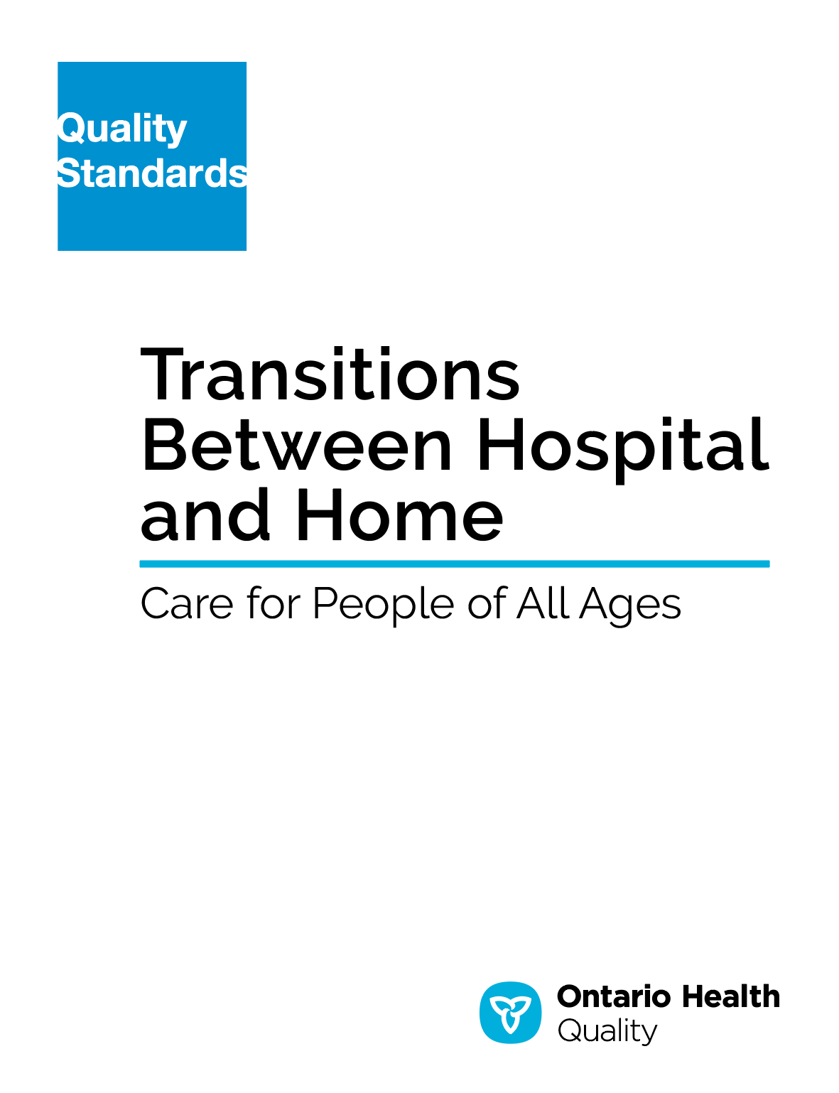
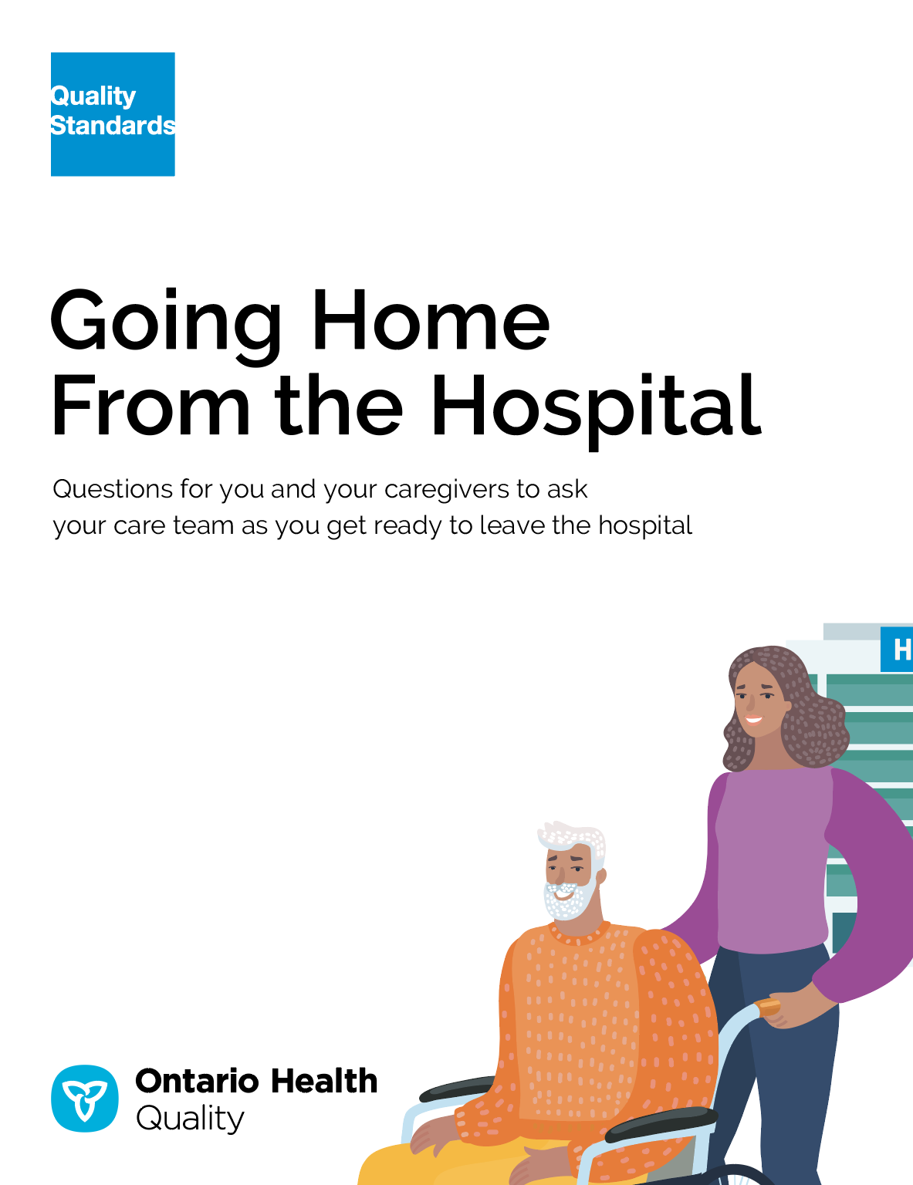

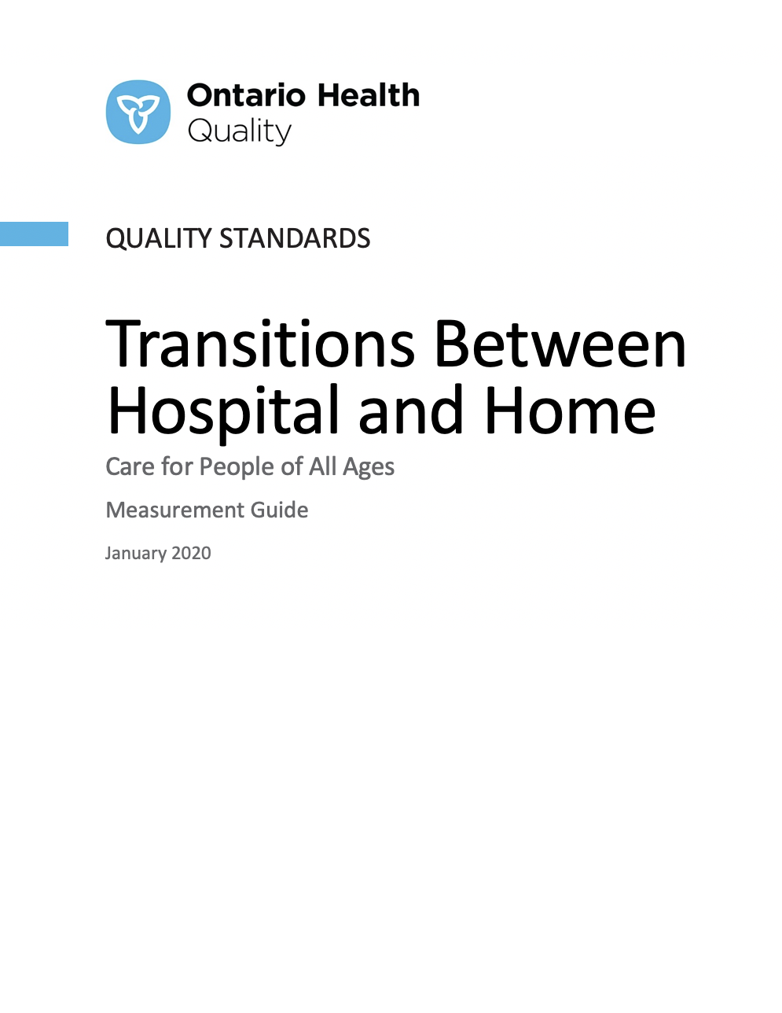
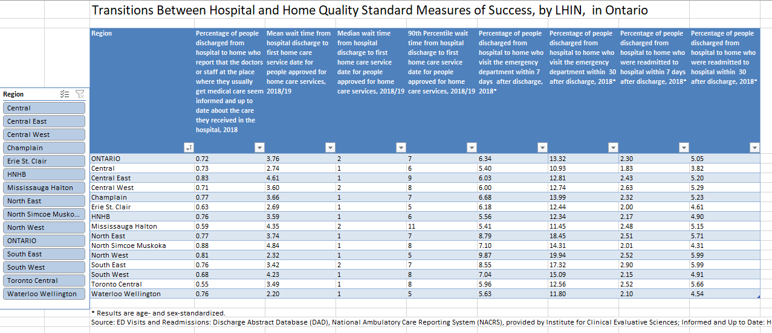
Quality Standard Resources
Quality Standard
Patient Conversation Guide
Getting Started Guide
Data Tables
Measurement Guide
Find these resources here:
https://hqontario.ca/evidence-to-improve-care/quality-standards/view-all-quality-standards/transitions-between-inpatient-mental-health-settings-and-home
Notes:
Each quality standard focuses on a specific health care issue. The development of each quality standard is accompanied by an assortment of resources.
Through concise, easy-to-understand statements, quality standards outline what quality care looks like for a condition or topic based on the evidence.
Each quality standard is accompanied by:
A patient conversation guide
Recommendations for adoption (note: this is included within the quality standard, Appendix 1: How the Health Care System Can Support Implementation)
A getting started guide
Data tables
A measurement guide
Quality standards provide the blueprint to enable the health care system in Ontario to work better, facilitate smooth transitions, and ensure patients receive the same high-quality care, regardless of where they reside.

Slide 6
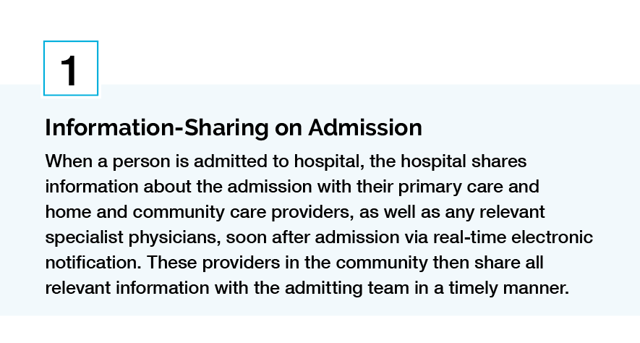
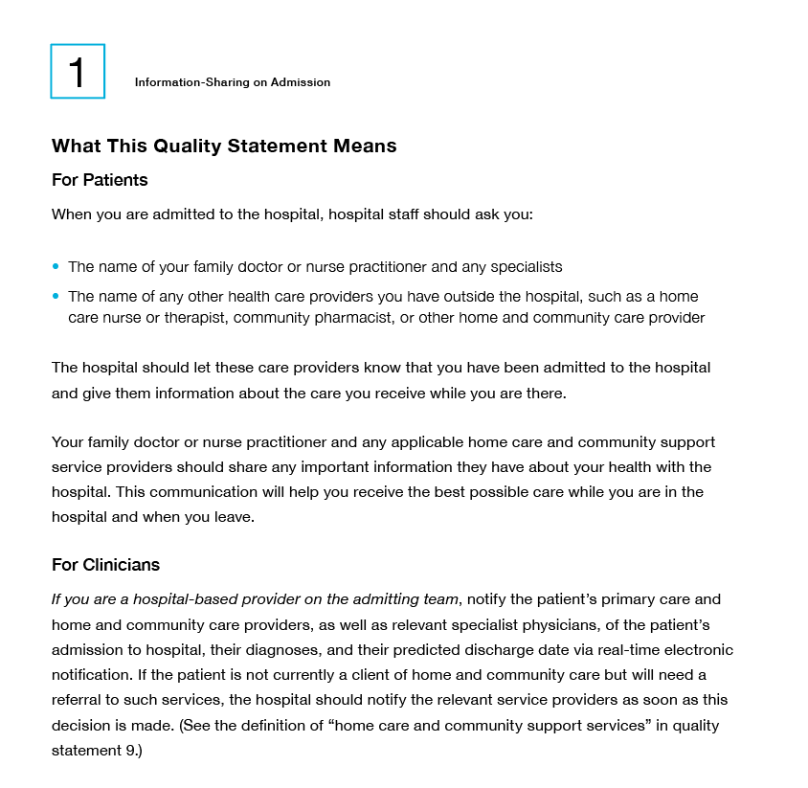
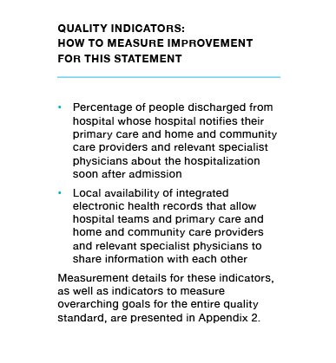
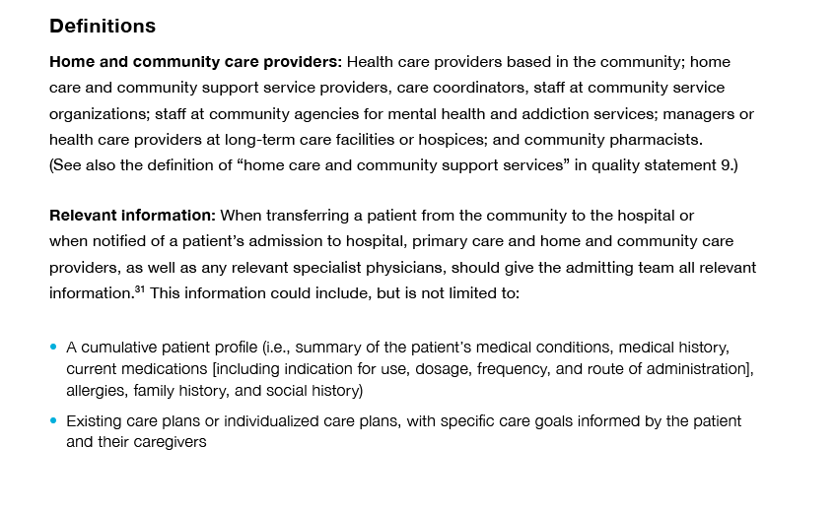
Inside the Quality Standard
The Statement
The Audience
Definitions
The Indicators

Slide 7
Quality Standards:
Patient Conversation Guide
The patient conversation guide is designed to give patients information about what quality care looks like for various conditions based on the best evidence, so they can ask informed questions of their health care providers.
Notes:
Every quality standard includes a plain language summary for patients, families, caregivers, and the public called the patient conversation guide.
Patient engagement in quality standards:
Membership on advisory committees
Focus groups and key informant interviews on topic specific content (when necessary)
Public comment period for each quality standard
Consultations on the patient conversation guide

Slide 8
Quality Standards:
Recommendations for Adoption
Recommendations for policy makers, administrators, health care organizations, and professionals have been made that aim to bridge the gaps between current care and care outlined in the quality statements to enable adoption of the quality standard across Ontario.
Notes:
As many aspects of the quality standard represent care that can and should be made available today, it is recognized that there are larger systemic barriers that may impede care delivery as per the standard. This document summarizes the system-wide and regional requirements that are needed to help health care professionals and organizations meet these standards and the time horizon expected to resolve these barriers.

Slide 9

Quality Standards:
Implementation Tools
The Getting Started Guide:
Outlines the process for using the quality standard as a resource to deliver high-quality care
Contains evidence-based approaches, as well as useful tools and templates for implementing change ideas at the practice level
Notes:
There are things we can do today despite the larger systemic barriers that may take time to resolve. The Getting Started Guide is a document that outlines a process for using the quality standards as a resource to deliver high-quality care. It compiles a number of resources to support adoption, such as links to implementation and quality improvement resources, examples and activities for reflection, and templates and documents to support the implementation planning activities. The Getting Started Guide also includes an Action Plan Template and examples on how Quality Improvement Plans can help to advance quality standards.

Slide 10
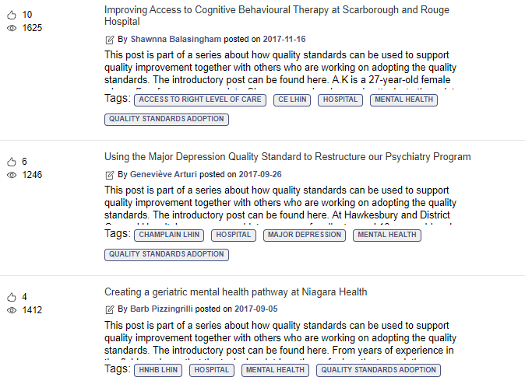
Quality Standards:
Quorum
Quorum is an online community dedicated to improving the quality of health care in Ontario.
The Quality Standards Adoption Series highlights efforts in the field to implement changes and close gaps in care related to quality standard topics.
Visit the Quality Standards Adoption Series on Quorum to learn how organizations are implementing quality standards.

Slide 11
Quality Standards:
Measurement Guide
The measurement guide has two dedicated sections:
Local measurement: what you can do to assess the quality of care that you provide locally
Provincial measurement: how we can measure the success of the quality standard on a provincial level

Slide 12
Quality Standards:
Data Tables
Data tables can be used to examine variations in indicator results across the province. They include data on key indicators:
Over time for Ontario
Across regions in Ontario
For specific measures of equity (age, sex, rurality, and household income)

Slide 13
Why Do We Need a Quality Standard for Transitions Between Hospital and Home?

Slide 14
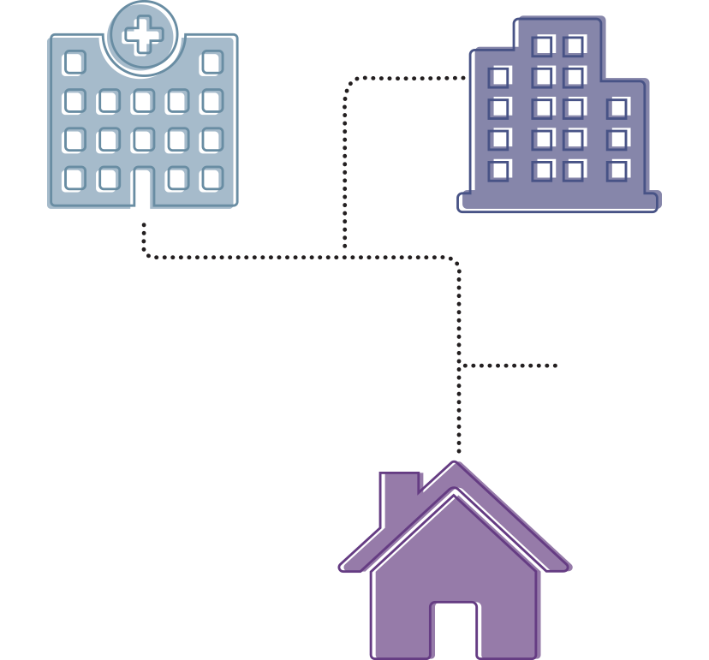
Care Transitions
When patients transfer between different care settings (e.g., hospital, primary care, community care) and between different health care providers during the course of an acute or chronic illness, these transfers are critical and vulnerable points in the provision of health care.
Source: Naylor M, Keating SA. Transitional care: Moving patients from one care setting to another. Am J Nurs. 2008;108(9 Suppl):58-63.

Slide 15
We [my husband and I] had 10 discharges from hospital to home, and at no time did anyone acknowledge my role as the caregiver or give us an idea of how we were going to manage at home. I felt like I was pushed off a cliff and had to manage and figure things out on my own. I think [leaving the hospital] should be seen as a relay race — handing the baton safely to the next person, rather than just dropping it. Leaving the hospital is not a ‘discharge’, it’s a transition.
This quality standard will help health care providers understand the important role of the caregiver, and how much patients and their caregivers take on when they leave hospital. I think it will help patients and caregivers understand not just their responsibilities, but also that they have rights, that they have access to services, that they should be asking questions and what questions to ask, and that they should be seeking out education and support before they go home.
– Carole Ann Alloway, Cofounder, Family Caregivers Voice; Lived Experience Advisor

Slide 16
There were over 1,000,000 hospitalizations in Ontario in 2017/18
Source: Canadian Institute for Health Information. Quick Stats: Inpatient Hospitalization, Surgery and Newborn Statistics, 2017–2018. https://www.cihi.ca/en/quick-stats

Slide 17

In 2018, 66% of people who had been hospitalized reported their provider involved them in decisions about their care and treatment as much as they wanted to be
Source: Canadian Patient Experiences Reporting System, provided by the Canadian Institute for Health Information.

Slide 18

In 2018, 72% of people who had been hospitalized reported that their regular care provider was informed and up to date about the care they received in hospital
Source: Health Care Experience Survey 2018, provided by the Ministry of Health and Long-Term Care.

Slide 19
The percentage of people who reported that the doctors or staff at the place where they usually get medical care seemed informed about their hospital discharge varied across regions
Percentage of adults (aged 16 and older) in Ontario who reported that the doctors or staff at the place where they usually get medical care seemed informed following discharge from hospital, by region, 2018
Source: Health Care Experience Survey 2018, provided by the Ministry of Health and Long-Term Care.

Slide 20
The percentage of people who reported that the doctors or staff at the place where they usually get medical care seemed informed about their hospital discharge was higher in rural areas
Percentage of adults (aged 16 and older) in Ontario who reported that the doctors or staff at the place where they usually get medical care seemed informed following discharge from hospital, by urban/rural status, January 2018 to December 2018
Source: Health Care Experience Survey 2018, provided by the Ministry of Health.

Slide 21
In 2018, of the over 1,000,000 hospital admissions:
5% of people returned to the hospital within 30 days of discharge
13% of people went to the emergency department within 30 days of discharge
Source: Discharge Abstract Database (DAD) and National Ambulatory Care Reporting System (NACRS), provided by the Institute for Clinical Evaluative Sciences (ICES).

Slide 22
Readmissions and Emergency Department visits post-discharge were highest in medical patients
Percentage of people in Ontario who were readmitted to any hospital or visited the emergency department within 30 days of discharge, 2018
Note: Rates are age and sex standardized.
Source: Discharge Abstract Database (DAD) and National Ambulatory Care Reporting System (NACRS), provided by the Institute for Clinical Evaluative Sciences (ICES).

Slide 23
Readmissions to hospital were consistent across regions in the province. Emergency department visits after a hospitalization showed more variation across regions.
Percentage of people in Ontario who were readmitted to any hospital or visited the emergency department within 30 days of discharge, 2018
Note: Rates are age and sex standardized.
Source: Discharge Abstract Database (DAD) and National Ambulatory Care Reporting System (NACRS), provided by the Institute for Clinical Evaluative Sciences (ICES).

Slide 24
Wait times for a first home care visit after a hospital discharge varied across the province
Median number of days that new patients of home care waited from hospital discharge to their first home
visit, for either nursing and personal support services for complex needs, in Ontario, 2018/19
Data Source: Data source: Home Care Database provided by the Ministry of Health. For more information please visit HQO Home Care Reporting.

Slide 25
Quality Statements to Improve Care

Slide 26
Scope of the Transitions Between Hospital and Home Quality Standard
This quality standard addresses care for people of all ages transitioning (moving) between hospital and home after a hospital admission. This includes people who have been admitted as inpatients to any type of hospital, including complex continuing care facilities and rehabilitation hospitals. “Home” is broadly defined as a person’s usual place of residence and may include personal residences, retirement residences, assisted-living facilities, long-term care facilities, hospices, and shelters.
This standard includes all clinical populations, including groups that often face challenges with transitions, such as people with complex care, mental health issues, addictions, palliative care, or end-of-life care needs. The scope also includes all health care providers.
Notes:
Although many of the statements may apply to them, this quality standard does not address the specifics of:
Transitions between inpatient mental health settings and home
Transitions from the emergency department to home
Postnatal care for healthy, stable mothers and infants returning home
Patients with an Alternate Level of Care (ALC) designation
This quality standard does not address:
Transitions from children’s to adults’ services
Inter- and intra-hospital transitions

Slide 27










Quality Statement Topics
Information-Sharing on Admission
Comprehensive Assessment
Patient, Family, and Caregiver Involvement in Transition Planning
Patient, Family, and Caregiver Education, Training, and Support
Transition Plans
Coordinated Transitions
Medication Review and Support
Coordinated Follow-Up Medical Care
Appropriate and Timely Support for Home and Community Care
Out-of-Pocket Costs and Limits of Funded Services
Notes:
.

Slide 28
Quality Statement 1:
Information-Sharing on Admission
When a person is admitted to hospital, the hospital shares information about the admission with their primary care and home and community care providers, as well as any relevant specialist physicians, soon after admission via real-time electronic notification. These providers in the community then share all relevant information with the admitting team in a timely manner.​

Slide 29
Quality Statement 2:
Comprehensive Assessment
People receive a comprehensive assessment of their current and evolving health care and social support needs. This assessment is started early upon admission, and is updated regularly throughout the hospital stay, to inform the transition plan and optimize the transition process.

Slide 30
Quality Statement 3:
Patient, Family, and Caregiver Involvement in Transition Planning
People transitioning from hospital to home are involved in transition planning and developing a written transition plan. If people consent to include them in their circle of care, family members and caregivers are also involved.

Slide 31
Quality Statement 4:
Patient, Family, and Caregiver Education,
Training, and Support
People transitioning from hospital to home, and their families and caregivers, have the information and support they need to manage their health care needs after the hospital stay. Before transitioning from hospital to home, they are offered education and training to manage their health care needs at home, including guidance on community-based resources, medications, and medical equipment.

Slide 32
Quality Statement 5:
Transition Plans
People transitioning from hospital to home are given a written transition plan, developed by and agreed upon in partnership with the patient, any involved caregivers, the hospital team, and primary care and home and community care providers before leaving hospital. Transition plans are shared with the person’s primary care and home and community care providers and any relevant specialist providers within 48 hours of discharge.

Slide 33
Quality Statement 6:
Coordinated Transitions
People admitted to hospital have a named health care professional who is responsible for timely transition planning, coordination, and communication. Before people leave hospital, this person ensures an effective transfer of transition plans and information related to people’s care.

Slide 34
Quality Statement 7:
Medication Review and Support
People transitioning between hospital and home have medication reviews on admission, before returning home, and once they are home. These reviews include information regarding medication reconciliation, adherence, and optimization, as well as how to use their medications and how to access their medications in the community. People’s ability to afford out-of-pocket medication costs are considered, and options are provided for those unable to afford these costs.

Slide 35
Quality Statement 8:
Coordinated Follow-Up Medical Care
People transitioning from hospital to home have follow-up medical care with their primary care provider and/or a medical specialist coordinated and booked before leaving hospital. People with no primary care provider are provided with assistance to find one.

Slide 36
Quality Statement 9:
Appropriate and Timely Support for Home and Community Care
People transitioning from hospital to home are assessed for the type, amount, and appropriate timing of home care and community support services they and their caregivers need. When these services are needed, they are arranged before people leave hospital and are in place when they return home.

Slide 37
Quality Statement 10:
Out-of-Pocket Costs and Limits of Funded Services
People transitioning from hospital to home have their ability to pay for any out-of-pocket health care costs considered by the health care team, and information and alternatives for unaffordable costs are included in transition plans. The health care team explains to people what publicly funded services are available to them and what services they will need to pay for.

Slide 38
Setting standards at the provincial level really changes the conversation of the importance of transitions in care and sets the direction for quality. This quality standard can set a pathway for Ontario Health Teams to make sure we see the transition from hospital to home and community as one continuous journey. We need to prepare and involve every person who participates in the handover/transition points with patients and caregivers upon entry to hospital and anticipate the family and caregiver’s needs as much as we can. It is important to take a much more holistic view that considers the personal and financial resources a patient might have, as well, and what then the system is responsible for. As family doctors, we never really discharge patients from our care, so every transition point contains critical quality of care elements.
– Thuy-Nga (Tia) Pham, Physician Lead, South East Toronto Family Health Team

Slide 39
How to Measure Overall Success
Notes:
The Transitions Between Hospital and Home Quality Standard Advisory Committee identified a set of overarching goals for this quality standard. These have been mapped to indicators that may be used to assess quality of care provincially and locally.

Slide 40
Indicators That Can Be Measured
Using Provincial Data
Percentage of people discharged from hospital to home who report feeling that they were involved in decisions about their care and treatment as much as they wanted to be
Percentage of people discharged from hospital to home who report that the doctors or staff where they usually get medical care seem informed and up to date about the care they received in hospital
Percentage of people discharged from hospital to home who received home care and community support services who report that their home care started when they needed it
Median and mean wait times from hospital discharge to first home care service date for people newly approved for home care services
Percentage of people discharged from hospital whose primary informal caregiver reports feeling prepared for the role of caregiving (measurable for caregivers of home care clients only)
Percentage of people discharged from hospital to home who visit the emergency department within 7 or 30 days after discharge
Percentage of people discharged from hospital to home who are readmitted to hospital within 7 or 30 days after discharge
Notes:
In addition to the above provincially measurable indicators, each quality statement within this quality standard is accompanied by one or more indicators.
These indicators are intended to guide measurement of quality improvement efforts related to implementation of the statement.

Slide 41
Indicator That Can Be Measured
Using Only Local Data
Percentage of people discharged from hospital for whom discharge summaries are delivered to primary care providers within 48 hours after discharge from hospital
Notes:
In this section, we list indicators that can be used to monitor the overall success of the standard provincially, given currently available data. If additional data sources are developed, other indicators could be added.

Slide 42
Connect with us:
https://quorum.hqontario.ca

