Slide 1

Health Links: Excerpts from the 2016-17 Q1 Report
09-Sept-2016
Health Quality Ontario
The provincial advisor on the quality of health care in Ontario

Slide 2
Health Links: Improving integrated care for patients with multiple conditions and complex needs

Slide 3
Supporting the Advanced Health Links Model
Health Links Improving integrated care for patients with multiple conditions and complex needs
MOHLTC | LHIN
Sets the strategic direction for Health Links Provides overall funding to the LHINs Oversees the overall performance of the Health Links initiative to guide strategy Facilitates operational success by implementing provincial level tools and supports | Sets regional priorities for Health Links and ensure alignment with provincial priorities Funds Health Links in accordance with priorities Maintains overall accountability for Health Links performance, LHIN by LHIN Drives operations through implementation of plans and support for adoption of provincial tools Identifies and implements regional supports and tools as required
Health Quality Ontario
Support data collection, timely reports and analysis Lead systematic identification of emerging innovations and best practices Increase rate of progress through standardization of best practices across all Health Links Support inter-Health Link sharing of lessons learned on regional or pan-provincial basis Connect LHIN Health Link Leads with other relevant provincial quality initiatives

Slide 4
Getting Started—Q1 Update
Health Links progressing from planning to recruiting patients
100 Health Links are planned in order to expand coverage to include all geographic areas
79 of 100 Health Links were actively recruiting patients by the end of Q1; The remaining Health Links continued with their planning
Data Source: Health Quality Ontario’s Quality Improvement Reporting and Analysis Platform (QIRAP) – self-reported by Health Links

Slide 5
Health Links at a Glance – Q1 Update
 | Number of HLs actively recruiting patients | Number of Coordinated Care Plans (CCPs) completed | Number of patients connected to a Primary Care Provider (PCP)
2015-16 Q4 | 80 | 4,549* (reported by 76 of 80 Health Links) | 5,711* (reported by 72 of 80 Health Links)
2016-17 Q1 | 79** | 3,782 (reported by 78 of 80 Health Links) | 3,668 (reported by 76 of 80 Health Links)
Cumulative total to date | 79** | 22,707 | 33,614
*Note: This number was adjusted in Q1: CCPs previously recorded as 4,622; PCP previously recorded as 5,713. Adjusted due to error corrections.
**Note: This number was adjusted to reflect updated information from the ESC LHIN

Slide 6
Rob’s Story
About Rob:
54 years old, developmentally delayed, history of hypertension, high cholesterol, diabetes, and multiple heart attacks
Difficulty self-managing his health and medication
Has lived alone since his mother passed away
In a three month period (July 21 to October 24, 2014), Rob made 16 visits to the Emergency Department, resulting in 6 admissions
His last admission was from October 25, 2014 to March 23, 2015 (13 acute days + 137 alternate level of care days)
Rob was referred to Developmental Supports Ontario (DSO) and the Hamilton West Health Link in March 2015, and a Coordinated Care Plan was initiated

Slide 7
Rob’s Story
Discharge Planning (prior to discharge):
Cognitive testing was completed and health literacy issues were identified
A home environmental safety assessment was performed (over three visits), Rob’s use of his glucometer was monitored, and a contact list was created for Rob to use at home
The Health Link coordinated care for Rob with:
Developmental Services Ontario
Community Living Hamilton
Southern Network of Specialized Care
a CCAC Director
St. Joseph’s Home Care (which provided care in a nearby hub)
Catholic Family Services
March of Dimes
City of Hamilton/Public Health
his family physician
Rob’s friend
the superintendent of his apartment to help develop the plan to support Rob in his apartment

Slide 8
Rob’s Story
Post-Discharge from Hospital:
A Health Link team member continues to accompany Rob to appointments including:
The lab for blood work (Rob may have skipped blood work in the past)
His family physician appointments (to discuss discharge medications and follow-up plans due to late discharge notes from hospital)
The cardiologist, where the team member helped Rob describe the frequency of his chest pain and medication issues (his medication doses were then able to be adjusted as a result)
The nuclear medicine lab for a test ordered by Cardiologist
The Hamilton Niagara Haldimand Brant CCAC completed his application for subsidized housing
The Health Links team:
Connected Rob to diabetes education sessions at Wesley Urban Core for ongoing support
Continued to advocate for Rob with Developmental Services Ontario for Passport Program funding, which was approved in February 2016
Accompanied Rob to a local charity (Good Shepherd) for financial trustee services which will remain in place until finances are sorted out for Rob

Slide 9
Rob’s Story
Results of a Support System for Rob:
Rob is still able to live in his own apartment and his quality of life has greatly improved, and has been able to adopt a pet budgie, is attending social events with DSO funding, and was recently assigned an Adult Protection Services Worker
Since being discharged in March 2015, Rob had a total of three ED visit in 2015, all occurring on weekend/holidays when support was not available
Rob had 2 admissions in 2016 one for chest pain in April 2016 for 6 days and another for a heart attack and was admitted for 2 days in May 2016
With the help of his team, he is currently doing well with his medications and the management of his chronic conditions. Having the support he needed already in place when was he discharged in March 2015 helped decreased his length of stay during both admissions in 2016

Slide 10
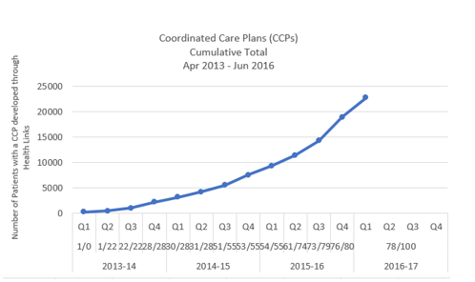
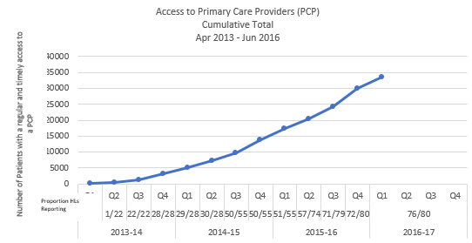
Impact of Health Links – Q1 Update
Coordinated Care Plans
Access to Primary Care
22,707 complex patients have been provided with coordinated care plans through Health Links
33,614 Health Links patients have been connected to regular and timely access to Primary Care
Data Source: Health Quality Ontario’s Quality Improvement Reporting and Analysis Platform (QIRAP) – self-reported by Health Links
Notes:
“Health Links will encourage greater collaboration and co-ordination between a patient's different health care providers as well as the development of personalized care plans. This will help improve patient transitions within the system and help ensure patients receive more responsive care that addresses their specific needs with the support of a tightly knit team of providers” Announcement of the Health Links Initiative (Dec-2012)
The indicator used in QIRAP is the Number of Health Link patients with a coordinated plan of care developed through the Health Link during the past Quarter.
To be included, the CCP must 1) be developed with the patient/ caregiver and two (2) or more health care professionals AND 2) contain a plan for one (1) or more health issues.
*************************************************
Regular and timely access to primary care for complex patients. A central goal of Health Links continues to be the regular and timely access to primary care providers. As most patients first interaction with the health care system is through their primary care provider, ensuring patients are attached to primary care providers is essential to the effective provision of coordinated care for all of Ontario’s complex patients. ~ Excerpt from Advanced Health Links Guide
The indicator used in QIRAP is the Number of patients with regular and timely access to a Primary Care Provider (PCP).
There are three options for data collection, with the aggregate reported in QIRAP. In most cases, a single Health Link will only choose to use one target/actual pair.

Slide 11
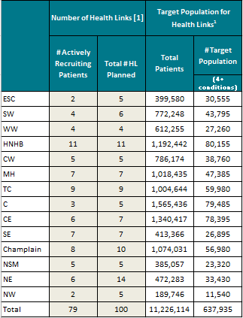
Target Population by LHIN
*Additional Health Links are in the early planning stages

Slide 12
Progress by LHIN – Q1 Update
Quarterly and Cumulative Data from QI RAP (Self-reported by each Health Link)
 |  | # Coordinated Care Plans completed |  |  | # Patients with regular and timely access to a Primary Care Provider
 | LHIN Fiscal Quarterly Target | # HL Reporting | Q1 | Cumulative Total | # HL Reporting | Q1 | Cumulative Total
 |  |  | Actual | Actual |  | Actual | Actual
ESC | 0 | 2 | 69 | 304 | 2 | 72 | 195
SW | 169 | 4 | 168 | 441 | 4 | 132 | 3,248
WW | 0 | 4 | 221 | 2,724 | 4 | 221 | 3,111
HNHB | 0 | 11 | 145 | 1,125 | 10 | 142 | 2,105
CW | 0 | 5 | 783 | 4,278 | 5 | 783 | 5,351
MH | 0 | 7 | 161 | 589 | 7 | 153 | 589
TC | 1,132 | 9 | 783 | 5,399 | 9 | 743 | 10,650
C | 0 | 3 | 245 | 1,378 | 3 | 245 | 1,574
CE | 0 | 6 | 416 | 1,671 | 6 | 410 | 2,260
SE | 465 | 7 | 317 | 2,678 | 7 | 309 | 2,602
Champlain | 180 | 8 | 105 | 472 | 8 | 100 | 426
NSM | 166 | 5 | 245 | 1,141 | 5 | 232 | 1,012
NE | 0 | 5 | 99 | 355 | 4 | 101 | 315
NW | 0 | 2 | 25 | 152 | 2 | 25 | 176
Total | 2,112 | 78 of 100 | 3,782 | 22,707 | 76 of 100 | 3,668 | 33,614
Targets are set by the Health Link and LHIN, and reflect the maturity of the Health Link (i.e., new Health Links have more modest targets to allow time to establish processes).
Data Source: Health Quality Ontario’s Quality Improvement Reporting and Analysis Platform (QIRAP) – self-reported by Health Links

Slide 13
Susan.Taylor@hqontario.ca
www.HQOntario.ca
FOLLOW@HQOntario

