Slide 1
Health Links: Excerpts from the Q3 Report
16-Mar-2016
Health Quality Ontario
The provincial advisor on the quality of health care in Ontario

Slide 2
Health Links: Improving integrated care for patients with multiple conditions and complex needs

Slide 3
Provincial and Regional Accountabilities within the Health Links Model
MOHLTC | LHIN
Sets the strategic direction for Health Links Provides overall funding to the LHINs Oversees the overall performance of the Health Links initiative to guide strategy Facilitates operational success by implementing provincial level tools and supports | Sets regional priorities for Health Links and ensure alignment with provincial priorities Funds Health Links in accordance with priorities Maintains overall accountability for Health Links performance, LHIN by LHIN Drives operations through implementation of plans and support for adoption of provincial tools Identifies and implements regional supports and tools as required
Health Quality Ontario
Support data collection, timely reports and analysis Lead systematic identification of emerging innovations and best practices Increase rate of progress through standardization of best practices across all Health Links Support inter-Health Link sharing of lessons learned on regional or pan-provincial basis Connect LHIN HL Leads with other relevant provincial quality initiatives

Slide 4
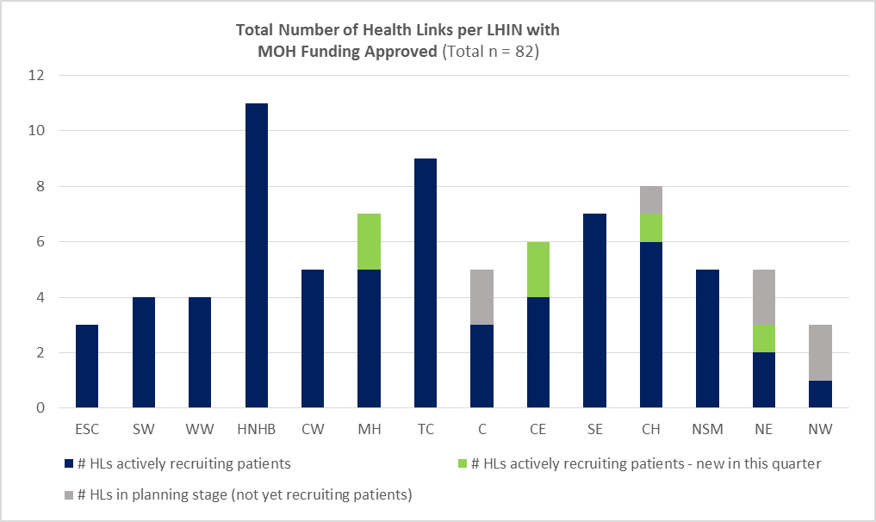
Getting Started – Q3 Update
Health Links progressing from planning to recruiting patients
75 of 82 Health Links were actively recruiting patients by the end of Q3
The remaining Health Links continued with their planning
In addition to the 82 Health Links funded by the MOHLTC, some LHINs have started planning additional geographies
Data Source: Health Quality Ontario’s Quality Improvement Reporting and Analysis Platform (QIRAP) – self-reported by Health Links

Slide 5
Health Links at a Glance – Q3 Update

Slide 6
Impact to Patients: Terry’s Story
“I saw Terry today and wanted to send total kudos to you and the Health Link team. She is truly a new woman – she is positive, optimistic and really engaged in making her life better,” said Dr. Kim Morrison, Chief of Staff, Lennox & Addington County General Hospital. “She credits the walker and bath supports now in place to enjoying bathing and is really liking getting outside to walk. She reports her mood is better and is looking forward to meeting the social worker, she is happy to be off meds. Many thanks for all your assistance & excellent results in making a real difference for this woman and her family.”
“We believe strongly in this model of care and it is one of the reasons the South East LHIN continues to support Health Links across the region,” said Paul Huras, CEO of the South East LHIN. “We are hearing incredible stories of real patient outcomes.”

Slide 7
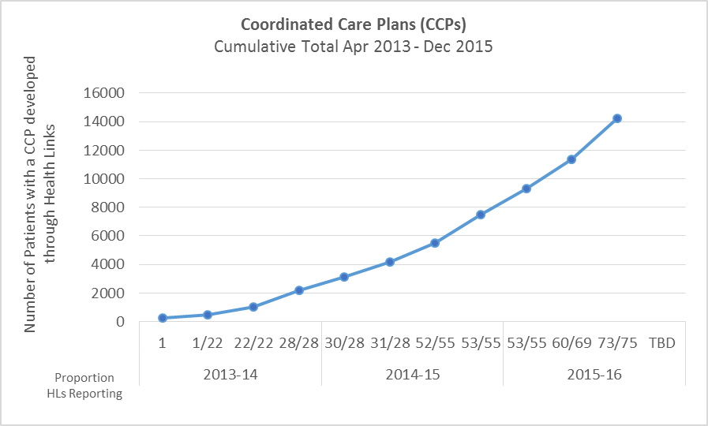
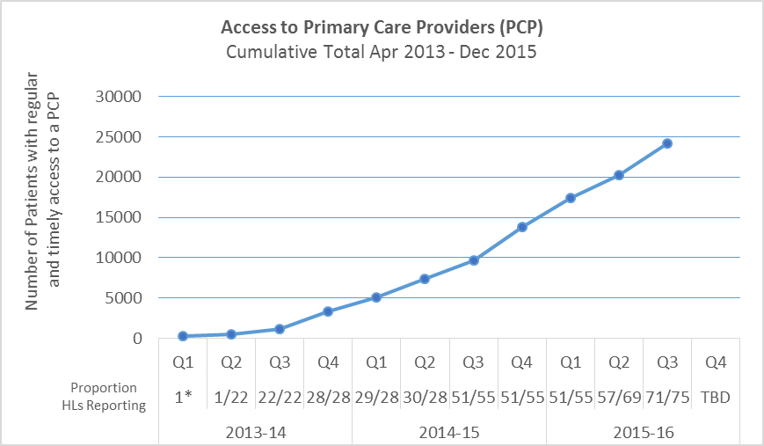
Impact of Health Links – Q3 Update
Coordinated Care Plans
Access to Primary Care
14,251 complex patients have been provided with coordinated care plans through Health Links
24,195 Health Links patients have been connected to regular and timely access to Primary Care
Data Source: Health Quality Ontario’s Quality Improvement Reporting and Analysis Platform (QIRAP) – self-reported by Health Links
Notes:
“Health Links will encourage greater collaboration and co-ordination between a patient's different health care providers as well as the development of personalized care plans. This will help improve patient transitions within the system and help ensure patients receive more responsive care that addresses their specific needs with the support of a tightly knit team of providers” Announcement of the Health Links Initiative (Dec-2012)
The indicator used in QIRAP is the Number of Health Link patients with a coordinated plan of care developed through the Health Link during the past Quarter.
To be included, the CCP must 1) be developed with the patient/ caregiver and two (2) or more health care professionals AND 2) contain a plan for one (1) or more health issues.
*************************************************
Regular and timely access to primary care for complex patients. A central goal of Health Links continues to be the regular and timely access to primary care providers. As most patients first interaction with the health care system is through their primary care provider, ensuring patients are attached to primary care providers is essential to the effective provision of coordinated care for all of Ontario’s complex patients. ~ Excerpt from Advanced Health Links Guide
The indicator used in QIRAP is the Number of patients with regular and timely access to a Primary Care Provider (PCP).
There are three options for data collection, with the aggregate reported in QIRAP. In most cases, a single Health Link will only choose to use one target/actual pair.

Slide 8
Target Population by LHIN
 | Number of Health Links |  | Target Population for Approved Health Links
 | # Actively Recruiting Patients | Total # HL Planned | Total Patients | # Target Population (4+ conditions)
ESC | 3 | 3 | 209,038 | 15,715
SW | 4 | 4 (+2) | 608,021 | 36,880
WW | 4 | 4 | 611,083 | 28,990
HNHB | 11 | 11 | 1,186,745 | 82,470
CW | 5 | 5 | 767,887 | 37,010
MH | 7 | 7 | 999,925 | 47,790
TC | 9 | 9 | 992,355 | 62,875
C | 3 | 5 | 1,528,556 | 78,695
CE | 6 | 6 (+1) | 1,046,945 | 69,155
SE | 7 | 7 | 416,301 | 29,860
Champlain | 7 | 8 (+2) | 838,179 | 48,300
NSM | 5 | 5 | 377,852 | 24,120
NE | 3 | 5 (+2) | 276,063 | 21,035
NW | 1 | 3 (+2) | 144,272 | 10,955
Total | 75 | 82 (+9) | 10,172,667 | 603,785
*Additional Health Links are in the early planning stages (operational funding not yet approved by MOHLTC)
Notes:
In brackets - Additional Health Links (Not included in total of 82)

Slide 9
Progress by LHIN – Q3 Update
 | # Coordinated Care Plans completed |  |  |  |  | # Patients with regular and timely access to a Primary Care Provider
 | # HL Reporting | Q3 |  | Cumulative Total |  | # HL Reporting | Q3 |  | Cumulative Total
 |  | Actual | Target¹ | Actual | Target¹ |  | Actual | Target¹ | Actual | Target¹
ESC | 1 | 53 | 30 | 172 | 153 | 0 | No data | No data | 123 | 78
SW | 4 | 59 | 45 | 106 | 150 | 4 | 54 | 45 | 2,957 | 3,995
WW | 4 | 256 | 206 | 2,242 | 1,432 | 4 | 278 | 234 | 2,645 | 1,597
HNHB | 11 | 156 | 169 | 884 | 908 | 10 | 138 | 133 | 1,873 | 753
CW | 5 | 374 | 1,566 | 2,089 | 5,060 | 5 | 374 | 1,566 | 3,030 | 5,799
MH | 7 | 95 | 105 | 309 | 394 | 7 | 106 | 89 | 319 | 311
TC | 9 | 662 | 482 | 3,717 | 2,673 | 9 | 1,759 | 1,030 | 7,894 | 4,699
C | 3 | 228 | 151 | 895 | 1,034 | 3 | 215 | 175 | 1,093 | 1,081
CE | 6 | 353 | 333 | 746 | 922 | 6 | 345 | 332 | 1,349 | 1,768
SE | 7 | 340 | 441 | 1,964 | 2,324 | 7 | 337 | 371 | 1,884 | 2,188
Champlain | 7 | 113 | 86 | 212 | 179 | 7 | 82 | 82 | 179 | 161
NSM | 5 | 143 | 110 | 717 | 627 | 5 | 149 | 116 | 602 | 688
NE | 3 | 2 | 0 | 112 | 157 | 3 | 71 | 50 | 137 | 154
NW | 1 | 26 | 33 | 86 | 149 | 1 | 26 | 33 | 110 | 119
Total | 73 of 75 | 2,860 | 3,757 | 14,251 | 16,162 | 71 of 75 | 3,934 | 4,256 | 24,195 | 23,391
^{[1]} Targets are set by the Health Link and LHIN, and reflect the maturity of the Health Link (i.e., new Health Links have more modest targets to allow time to establish processes).
Data Source: Health Quality Ontario’s Quality Improvement Reporting and Analysis Platform (QIRAP) – self-reported by Health Links

Slide 10
Susan.Taylor@hqontario.ca
www.HQOntario.ca
FOLLOW@HQOntario

