Slide 1

Health Links: Excerpts from the 2016-17 Q3 Report
10-Mar-2017
Health Quality Ontario
The provincial advisor on the quality of health care in Ontario

Slide 2
Health Links: Improving integrated care for patients with multiple conditions and complex needs

Slide 3
Supporting the Advanced Health Links Model
Health Links Improving integrated care for patients with multiple conditions and complex needs
MOHLTC | LHIN
Sets the strategic direction for Health Links Provides overall funding to the LHINs Oversees the overall performance of the Health Links initiative to guide strategy Facilitates operational success by implementing provincial level tools and supports | Sets regional priorities for Health Links and ensures alignment with provincial priorities Funds Health Links in accordance with priorities Maintains overall accountability for Health Links performance Drives operations through implementation of plans and support for adoption of provincial tools Identifies and implements regional supports and tools as required
Health Quality Ontario
Support data collection, timely reports and analysis Lead systematic identification of emerging innovations and best practices Increase rate of progress through standardization of best practices across all Health Links Support inter-Health Link sharing of lessons learned on regional and/or provincial basis Connect LHIN Health Link Leads with other relevant provincial quality initiatives
Source: “Guide to the Advanced Health Links Model Guide” Ministry of Health Long-Term Care, November 12, 2015

Slide 4
Health Links at a Glance – Q3 Update
 | No. of Heath Links Actively Recruiting Patients | No. of Coordinated Care Plans Completed | No. of Patients Connected to a Primary Care Provider
2016/17 Q2 | 79 | 3,670 | 3,787
2016/17 Q3 | 78* | 4,025 | 3,948
Cumulative Fiscal Total 2016/2017 | 78 | 11,612 | 11,423
Cumulative Total to Date | 78 | 30,580 | 41,235
*Note: Toronto Central LHIN merged their nine Health Links into 5 to align with sub-region. Three new Health Links reporting the quarter, two in Central LHIN one in Central East LHIN
Notes:
Carol update numbers in graph

Slide 5
Patient Story
About the Client The client was identified by St. Joseph’s Health Care (SJHC), who referred them to the West Toronto Health Link. The client declined all supports and refused to leave hospital; previous services from West Toronto Support Services (WTSS) and the Community Care Access Centre (CCAC) had to be halted due to issues with hoarding (home unsafe for workers), and the client refused to undertake an extreme clean. After several visits to the emergency department (ED), the client was admitted to the general medical floor at SJHC. Emergency medical services (EMS) were engaged, and a community paramedic visited with client in hospital.
Notes:
Add in the patient story

Slide 6
Patient Story
Health Link Supports The client agreed to have an EMS paramedic do a home visit. The community paramedic escorted the patient home, assisted with picking up medications, and ensured his safe entry into the home. In the interim, the hospital had made a referral to Crisis Outreach Service for Seniors (COSS). The COSS case manager provided almost daily support, ensuring the client had access to food and medication, and performed safety checks. The CCAC Transitional Care Coordinator (TCC) became involved as well; she was able to get the client to agree to an extreme clean, obtained funding to purchase him a new fridge, and worked with a primary care physician (who performed home visits) to obtain the client's consent to have a Personal Support Worker (PSW) and physiotherapy services initiated in his home.
Notes:
Add in the patient story

Slide 7
Patient Story
Today It is due to this tremendous effort and collaboration that this client has not returned to hospital or ED since his discharge (more than 11 weeks at time of this report) and has been able to fulfill his goal of being able to remain in his home. This client scenario demonstrates the value of coordination and collaboration across partners, of front loading support, and of working as a team to improve the health outcomes and quality of life for our most vulnerable and complex clients in West Toronto.
Notes:
Add in the patient story

Slide 8
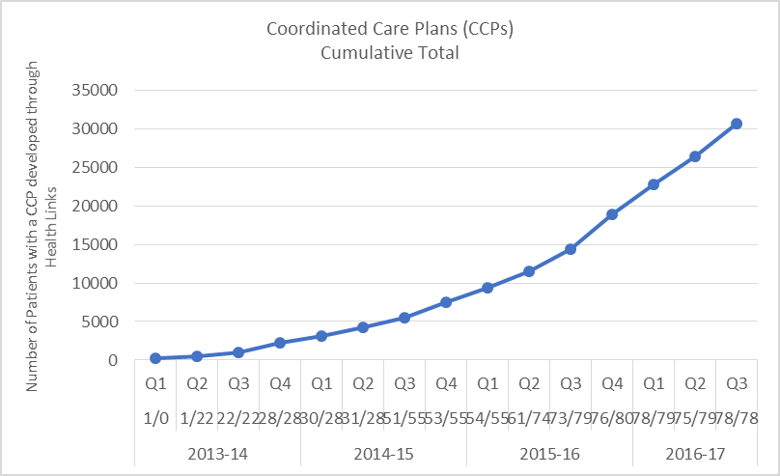
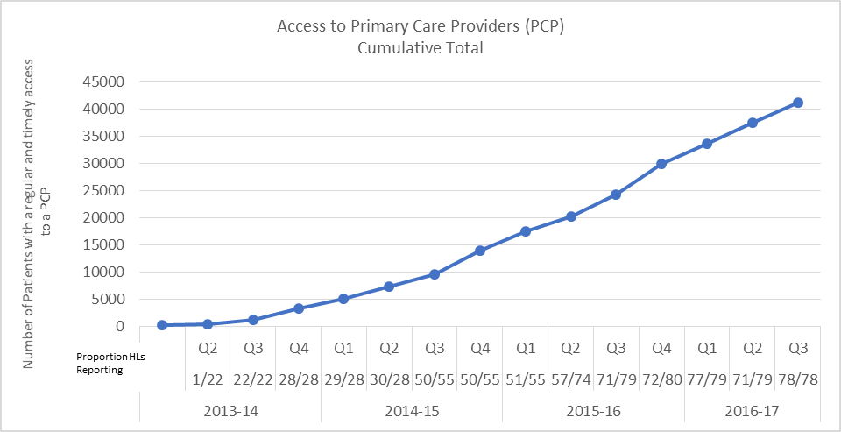
Impact of Health Links – Q3 Update
Coordinated Care Plans
Access to Primary Care
30,580 complex patients have been provided with coordinated care plans through Health Links
41,235 Health Links patients have been connected to regular and timely access to primary care
Data Source: Health Quality Ontario’s Quality Improvement Reporting and Analysis Platform (QIRAP) – self-reported by Health Links
Notes:
“Health Links will encourage greater collaboration and co-ordination between a patient's different health care providers as well as the development of personalized care plans. This will help improve patient transitions within the system and help ensure patients receive more responsive care that addresses their specific needs with the support of a tightly knit team of providers” Announcement of the Health Links Initiative (Dec-2012)
The indicator used in QIRAP is the Number of Health Link patients with a coordinated plan of care developed through the Health Link during the past Quarter.
To be included, the CCP must 1) be developed with the patient/ caregiver and two (2) or more health care professionals AND 2) contain a plan for one (1) or more health issues.
*************************************************
Regular and timely access to primary care for complex patients. A central goal of Health Links continues to be the regular and timely access to primary care providers. As most patients first interaction with the health care system is through their primary care provider, ensuring patients are attached to primary care providers is essential to the effective provision of coordinated care for all of Ontario’s complex patients. ~ Excerpt from Advanced Health Links Guide
The indicator used in QIRAP is the Number of patients with regular and timely access to a Primary Care Provider (PCP).
There are three options for data collection, with the aggregate reported in QIRAP. In most cases, a single Health Link will only choose to use one target/actual pair.

Slide 9
Quarterly and Cumulative Data
^{[1]} The “Total Patients” refers to all patients who used these services in the 2013/14 fiscal year. Note that “Total Patients” and the population in an area are NOT the same. The analysis identified the presence of 55 conditions/interventions within any diagnosis field in any clinical record during the fiscal year. The conditions selected were those that can be identified within administrative datasets and that: affect a large number of patients, are risk factors for other chronic conditions, or contribute to significant length of hospital stay and/or cost in one or more health care sector.
^{[2]} The TC LHIN is in the process of aligning nine Health Links to five LHIN sub-regions. Business processes are transitioning and Q2 data was reported in the revised structure of five Health Links.
Notes:
Carol ensure this chart is the latest one

Slide 10
hlhelp@hqontario.ca
www.HQOntario.ca
FOLLOW@HQOntario

