Slide 1

Health Links: Excerpts from the 2017/18 Q3 Report
MARCH 2018

Slide 2
Health Links: Improving Integrated Care for Patients with Multiple Chronic Conditions and Complex Needs

Slide 3
The Health Links Quarterly Report
Provides a summary of data reported by Health Links in each quarter
Two quality indicators measured: number of patients with a coordinated care plan and number of patients connected to a primary care provider
Offers a deeper understanding of Health Links practices across the province and progress to date
Highlights patients who are benefiting from a Health Links approach to care
Reviewed by Health Link leads from all 14 LHINs and Health Quality Ontario Regional Quality Improvement Specialists
Circulated to Health Link teams, LHINs, Health Quality Ontario, and the Ministry of Health and Long-Term Care
Used to share observations, identify areas of interest, and guide conversations and planning

Slide 4
Highlights from this Quarter
Compared with last year's Q3, there was a 47% increase in numbers of CCPs created (6,126 from 5,650) and a 66% increase in number of Health Links patients attached to a PCP (6,523 from 3,925), showing significant year-over-year progress in spread and scale
A Health Links Measurement Task Group has been created to develop the parameters for new indicators and to provide recommendations on measurement and data collection
A draft of technical specifications for the new measures has been submitted to the LHINs and other stakeholders for feedback and recommendations
The measures are set to be approved by March 2018, with implementation of the new indicators beginning in Q1 of 2018/19

Slide 5
Highlights from this Quarter
Health Links are developing strategies to address barriers faced by marginalized populations that contribute to poor health outcomes. These strategies focus on:
Creating care plans with patients from marginalized populations, identifying those at risk, building trust, and developing relationships.
Collecting, analyzing, and using data on equity, disparity, and the social determinants of health to inform key processes.
Developing resource hubs that house services and education materials to enable self-management, information sharing, and improved access.
Planning for the 2018 leadership summit is underway
Attendees will include patients, families, caregivers, and Health Link providers identified by each of the 14 LHIN’s, along with system partners
When planning for the day, Health Quality Ontario will engage system partners from the LHINs and Health Links

Slide 6
Numbers at a Glance – Q3 Update
Fiscal Year, Quarter | No. of Health Links Actively Recruiting Patients | No. of Patients with a Completed Coordinated Care Plan | No. of Patients Connected to a Primary Care Provider
2016/17, Q1 | 79 | 3,832 | 3,697
2016/17, Q2 | 79 | 3,723 | 3,776
2016/17, Q3 | 78 | 4,180 | 3,925
2016/17, Q4 | 84 | 6,035 | 6,023
2017/18, Q1 | 79 | 6,469 | 6,443
2017/18, Q2 | 86 | 5,650 | 5,959
2017/18 Q3 | 86 | 6,129 | 6,523
Cumulative Total to Date | 86 | 54,940 | 63,333

Slide 7
Patient Story: Mary
Thank you to the Hamilton Niagara Haldimand Brant LHIN for sharing this story
Background
Mary* started to work with her local Health Link, she had polysubstance abuse, high emergency department and admissions to acute care for serious infections related to drug use. Mary had been homeless for the past 2 years after being evicted from an apartment. Prior legal involvement included a jail sentence and probation period, and the 2 years she was given to complete a court-ordered anger management class or return to custody was coming to a close.
Trust is a challenge for Mary and as we worked with Mary and developed a trusting relationship with her, we were able to engage providers and develop a care plan that addressed her needs.
With respect to her drug use, the critical role of inviting and engaging the patient† and gathering information—meeting the patient where they are at— before initiating the care plan was particularly important to consider. The Health Link stepped in to ensure and facilitate communication with her care providers by conferring with them about Mary’s wishes for her care.
_________________
*Not her real name.
†For further information, see the innovative practices on coordinated care management.

Slide 8
Patient Story (continued)
Health Links Support
Mary has stopped taking Dilaudid and now takes methadone responsibly. She has reduced her other drug use to once weekly rather than multiple times daily, and more recently she has been abstinent and is working towards this as a new goal.
Mary has a great sense of humor, and increasingly those around her are impressed by her ability to handle challenging situations.
She has expressed that she is starting to make something of her life and that the Health Link has helped in this process: “The Health Link showed me how to first accept and love myself as a person.”
We truly all benefit from Mary’s discovery.
To read the full patient story, visit the Health Links Community of Practice on Quorum.

Slide 9
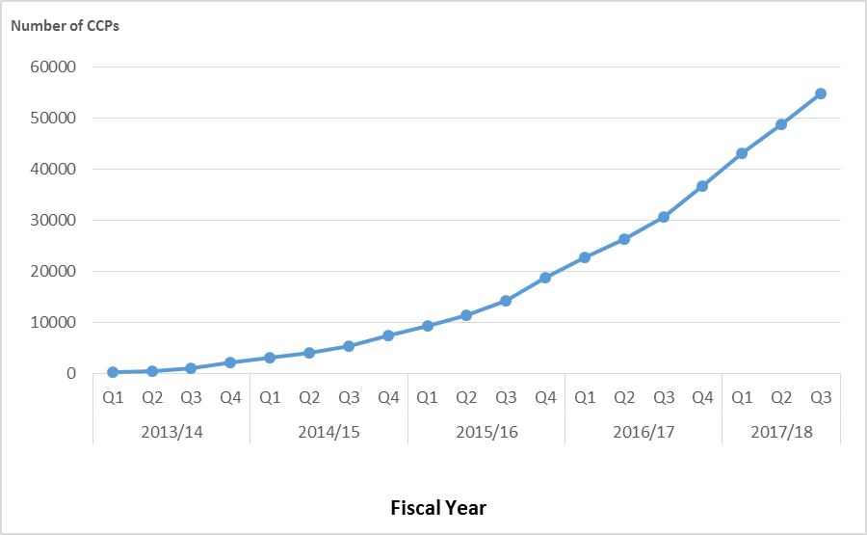
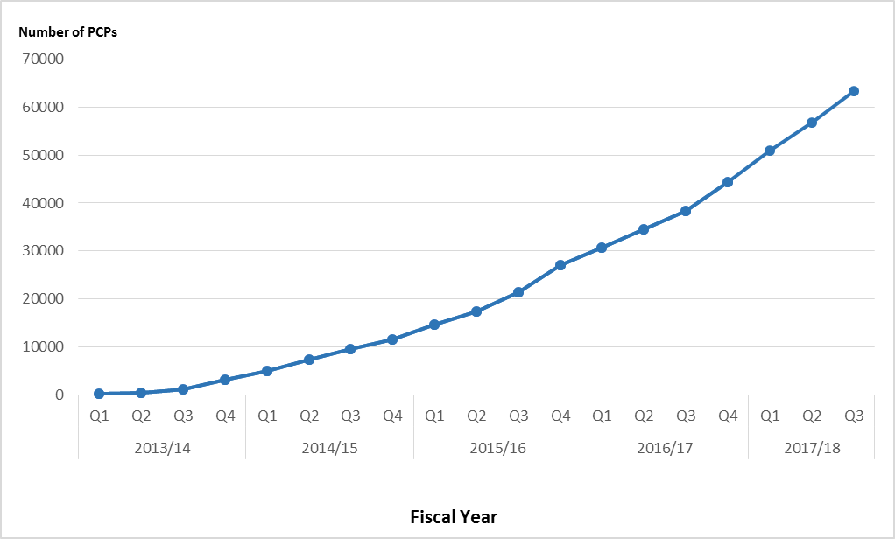
Impact of Health Links – Q3 Update
Cumulative Total Number of Coordinated Care Plans Completed
Cumulative Total Number of Patients with Access to Primary Care Providers
54,940 complex patients have been provided with coordinated care plans through Health Links to date.
63,333 complex patients have been connected to regular and timely access to primary care to date.
Data Source: Health Quality Ontario’s Quality Improvement Reporting and Analysis Platform (QIRAP) – self-reported by Health Links.

Slide 10
Quarterly and Cumulative Data – Q3 Update
CCP—coordinated care plan, C—Central, CE—Central East, CW—Central West, ESC—Erie St. Clair, HL—Health Link, HNHB—Hamilton Niagara Haldimand Brant, LHIN—Local Health Integration Network, MH—Mississauga Halton, MOHLTC—Ministry of Health and Long-Term Care, NE—North East, NSM—North Simcoe Muskoka, NW—North West, SE—South East, SW—South West, TC—Toronto Central, WW—Waterloo Wellington.
*SW, ESC, NE, and CE LHINs have changed their target populations to the sub-region numbers released by MOHLTC in October 2017 while others have kept the numbers from May 2016. One Health Link in the NE LHIN does not yet have a target population. It should be noted that the “target population” listed, based on patients with four or more chronic conditions, refers to the number of patients that may benefit from a Health Links approach to care and is generally accepted to be approximately 5% of the population in each LHIN. LHINs set and enter quarterly targets in QI RAP so that they can be reported here as a reference point.

Slide 11
Supporting the Health Links Approach to Care
Health Links: Improving Integrated Care for Patients with Multiple Conditions and Complex Needs
MOHLTC | LHIN
Sets the strategic direction for Health Links Provides overall funding to the LHINs Oversees the overall performance of the Health Links initiative to guide strategy Facilitates operational success by implementing provincial level tools and supports | Sets regional priorities for Health Links and ensures alignment with provincial priorities Funds Health Links in accordance with priorities Maintains overall accountability for Health Links performance Drives operations by implementing plans and supporting adoption of provincial tools Identifies and implements regional supports and tools as required
Health Quality Ontario
Supports data collection, timely reports, and analysis Leads systematic identification of emerging innovations and best practices Increases rate of progress through standardization of best practices across all Health Links Supports inter-Health Link sharing of lessons learned, regionally and/or provincially Connects LHIN Health Link Leads with other relevant provincial quality initiatives
Source: Adapted from “Guide to the Advanced Health Links Model Guide,” Ministry of Health Long-Term Care, November 12, 2015.
LHIN – local health integration network, MOHLTC – Ministry of Health and Long-Term Care.

