Slide 1

Health Links: Excerpts from the 2016-17 Q4 Report
09-June 2017
Health Quality Ontario
The provincial advisor on the quality of health care in Ontario

Slide 2
Health Links:
Improving integrated care for patients with multiple conditions and complex needs

Slide 3
Supporting the Advanced Health Links Model
Health Links Improving integrated care for patients with multiple conditions and complex needs
MOHLTC | LHIN
Sets the strategic direction for Health Links Provides overall funding to the LHINs Oversees the overall performance of the Health Links initiative to guide strategy Facilitates operational success by implementing provincial level tools and supports | Sets regional priorities for Health Links and ensures alignment with provincial priorities Funds Health Links in accordance with priorities Maintains overall accountability for Health Links performance Drives operations through implementation of plans and support for adoption of provincial tools Identifies and implements regional supports and tools as required
Health Quality Ontario
Support data collection, timely reports and analysis Lead systematic identification of emerging innovations and best practices Increase rate of progress through standardization of best practices across all Health Links Support inter-Health Link sharing of lessons learned on regional and/or provincial basis Connect LHIN Health Link Leads with other relevant provincial quality initiatives
Source: “Guide to the Advanced Health Links Model Guide” Ministry of Health Long-Term Care, November 12, 2015

Slide 4
Health Links at a Glance – Q4 Update
2016/17 | Number of Health Links Actively Recruiting Patients | Number of Coordinated Care Plans Completed | Number of Patients Connected to a Primary Care Provider
Q1 | 79 | 3,782 | 3,668
Q2 | 79 | 3,670 | 3,787
Q3 | 78* | 4,025 | 3,948
Q4 | 84 | 6,102 | 5,942
Cumulative Total to Date | 84 | 36,772 | 47,098
*Note: Toronto Central LHIN merged their nine Health Links into 5 to align with sub-region. Three new Health Links reporting the quarter, two in Central LHIN one in Central East LHIN
Notes:
Carol update numbers in graph

Slide 5
Patient Story
About the Client Elizabeth is in a wheelchair, mobility and transportation were major issues for her. This lead to social isolation as well as expensive taxi rides to medical appointments Health Link Supports Health Links connected Elizabeth with the Red Cross who provided rides to medical appointments, which not only helped a great deal financially, but also greatly reduced her stress levels.
Notes:
Add in the patient story

Slide 6
Patient Story
Health Link Supports Elizabeth speaks with great emotion when it comes to her Health Coach who she feels helped her more than words could express. “She’s my guardian angel.” Her Health Coach accompanied her to doctor’s appointments and having her there was a great benefit to Elizabeth. “It made appointments better,” she said. “Sometimes it’s hard for me to articulate what I want to say. Any question I forgot to ask the Doctor my Health Coach would ask.” This made for appointments that are more effective and improved her experience with the health care system. Before her doctor’s appointments, she now writes down all questions she wants to ask to make sure that nothing important is forgotten.
Notes:
Add in the patient story

Slide 7
Patient Story
During her time with Health Links, Elizabeth experienced a personal crisis and she didn’t know where to turn. She called her Health Coach who provided emotional support and assisted her in contacting the appropriate agencies in order to resolve the difficult situation. Like many seniors with numerous health conditions, Elizabeth has many medical appointments at several locations and keeping them straight was not always an easy task. This issue was exacerbated by the fact that Elizabeth is legally blind. She used to have her appointments written down for her by her doctor’s staff on pieces of paper with writing that was too small to read. Her poor vision caused her to misplace these notices and made organizing her life difficult and was a cause of anxiety for her. Her Health Coach came up with a solution. She brought in a large white board and drew a grid on it and each month her appointments were listed in large writing that was easy for her to read. This simple task went a long way to simplifying her life and reducing her anxiety.
Notes:
Add in the patient story

Slide 8
Patient Story
Today For Health Links patient Elizabeth, being part of the program changed her life. “I can’t say enough about what Health Links did for me.” She feels that the skills and supports that Health Links worked with her to gain has given her the confidence to take advantage of some of the programs in place for seniors in Thunder Bay, including the 55 Plus Centre. “I’ve started to evolve,” Elizabeth said. “I’m looking forward to things and I never did that before Health Links.”
Notes:
Add in the patient story

Slide 9
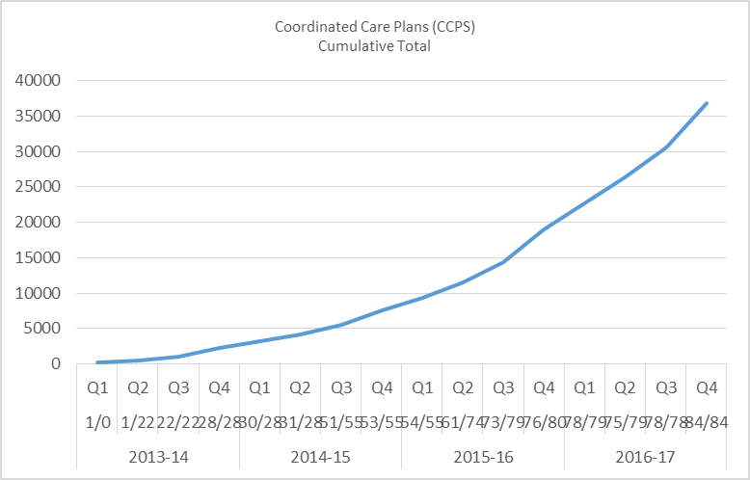
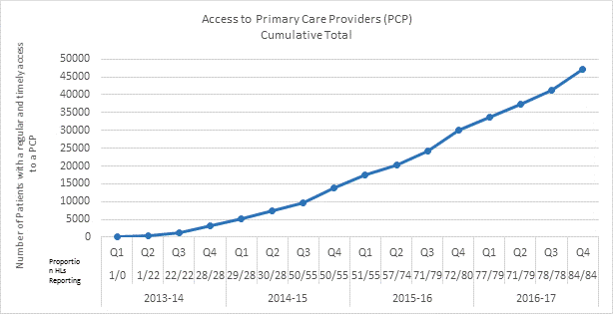
Impact of Health Links – Q4 Update
Coordinated Care Plans
Access to Primary Care
36,772 Health Links patients have been provided with coordinated care plans
47,098 Health Links patients have been connected to regular and timely access to primary care
Data Source: Health Quality Ontario’s Quality Improvement Reporting and Analysis Platform (QIRAP) – self-reported by Health Links
Notes:
“Health Links will encourage greater collaboration and co-ordination between a patient's different health care providers as well as the development of personalized care plans. This will help improve patient transitions within the system and help ensure patients receive more responsive care that addresses their specific needs with the support of a tightly knit team of providers” Announcement of the Health Links Initiative (Dec-2012)
The indicator used in QIRAP is the Number of Health Link patients with a coordinated plan of care developed through the Health Link during the past Quarter.
To be included, the CCP must 1) be developed with the patient/ caregiver and two (2) or more health care professionals AND 2) contain a plan for one (1) or more health issues.
*************************************************
Regular and timely access to primary care for complex patients. A central goal of Health Links continues to be the regular and timely access to primary care providers. As most patients first interaction with the health care system is through their primary care provider, ensuring patients are attached to primary care providers is essential to the effective provision of coordinated care for all of Ontario’s complex patients. ~ Excerpt from Advanced Health Links Guide
The indicator used in QIRAP is the Number of patients with regular and timely access to a Primary Care Provider (PCP).
There are three options for data collection, with the aggregate reported in QIRAP. In most cases, a single Health Link will only choose to use one target/actual pair.

Slide 10
Quarterly and Cumulative Data
LHIN | No. of Health Links |  | Target Population for Health Links (Data Source: MOHLTC Health Analytics Branch, 2016)* |  | Quarterly Targets identified by LHINs | No. Coordinated Care Plans completed |  |  | No. Patients with regular and timely access to a Primary Care Provider
 | No. Actively Recruiting Patients | Total No.of HL Planned | Total Patients | No. Target Population (4+ conditions) |  | No. HL Reporting | Q4 | Cumulative Total | No. HL Reporting | Q4 | Cumulative Total
 |  |  |  |  |  |  | Actual | Actual |  | Actual | Actual
ESC | 3 | 5 | 399,580 | 30,555 | 0 | 3 | 9 | 388 | 3 | 14 | 298
SW | 6 | 6 | 772,248 | 43,795 | 234 | 6 | 377 | 1392 | 6 | 216 | 3,995
WW | 4 | 4 | 612,255 | 27,260 | 0 | 4 | 370 | 3,478 | 4 | 433 | 3,805
HNHB | 11 | 11 | 1,192,442 | 80,155 | 377 | 11 | 866 | 2569 | 11 | 749 | 3,290
CW | 5 | 5 | 786,174 | 38,760 | 2,007 | 5 | 842 | 6,012 | 5 | 842 | 6,985
MH | 7 | 7 | 1,018,435 | 47,385 | 0 | 7 | 212 | 1184 | 7 | 268 | 1304
TC | 5 | 5 | 1,004,644 | 59,980 | 738 | 5 | 929 | 7,593 | 5 | 920 | 12,858
C | 5 | 5 | 1,565,436 | 79,485 | 480 | 5 | 521 | 2,644 | 5 | 521 | 2,840
CE | 7 | 7 | 1,340,417 | 78,395 | 815 | 7 | 762 | 3,806 | 7 | 757 | 4,356
SE | 7 | 7 | 413,366 | 26,895 | 430 | 7 | 385 | 3,733 | 7 | 361 | 3,603
Champlain | 10 | 10 | 1,074,031 | 56,980 | 0 | 10 | 328 | 1187 | 10 | 306 | 1080
NSM | 5 | 5 | 385,057 | 23,320 | 166 | 5 | 237 | 1765 | 5 | 291 | 1681
NE | 6 | 14 | 472,283 | 33,430 | 155 | 6 | 158 | 726 | 6 | 158 | 684
NW | 3 | 5 | 189,746 | 11,540 | 90 | 3 | 106 | 295 | 3 | 106 | 319
Total | 84 | 96 | 11,226,114 | 637,935 | 5,492 | 84 | 6,102 | 36,772 | 84 | 5,942 | 47,098
^{[1]} The “Total Patients” refers to all patients who used these services in the 2013/14 fiscal year. Note that “Total Patients” and the population in an area are NOT the same. The analysis identified the presence of 55 conditions/interventions within any diagnosis field in any clinical record during the fiscal year. The conditions selected were those that can be identified within administrative datasets and that: affect a large number of patients, are risk factors for other chronic conditions, or contribute to significant length of hospital stay and/or cost in one or more health care sector.
^{[2]} The TC LHIN is in the process of aligning nine Health Links to five LHIN sub-regions. Business processes are transitioning and Q2 data was reported in the revised structure of five Health Links.
Notes:
Carol ensure this chart is the latest one

Slide 11
hlhelp@hqontario.ca
www.HQOntario.ca
FOLLOW@HQOntario

