Slide 1
Health Links: Excerpts from the 2015-16 Q4 Report
10-Jun-2016
Health Quality Ontario
The provincial advisor on the quality of health care in Ontario

Slide 2
Health Links: Improving integrated care for patients with multiple conditions and complex needs

Slide 3
Provincial and Regional Accountabilities within the Health Links Model
MOHLTC | LHIN
Sets the strategic direction for Health Links Provides overall funding to the LHINs Oversees the overall performance of the Health Links initiative to guide strategy Facilitates operational success by implementing provincial level tools and supports | Sets regional priorities for Health Links and ensure alignment with provincial priorities Funds Health Links in accordance with priorities Maintains overall accountability for Health Links performance, LHIN by LHIN Drives operations through implementation of plans and support for adoption of provincial tools Identifies and implements regional supports and tools as required
Health Quality Ontario
Support data collection, timely reports and analysis Lead systematic identification of emerging innovations and best practices Increase rate of progress through standardization of best practices across all Health Links Support inter-Health Link sharing of lessons learned on regional or pan-provincial basis Connect LHIN HL Leads with other relevant provincial quality initiatives

Slide 4
Getting Started – Q4 Update
Health Links progressing from planning to recruiting patients
To date, 82 Health Links have been approved for funding by the MOHLTC
Additional Health Links have been planned by the LHINs to provide complete geographical coverage, bringing the total to 91
80 of 91 Health Links were actively recruiting patients by the end of Q4
The remaining Health Links continued with their planning
Data Source: Health Quality Ontario’s Quality Improvement Reporting and Analysis Platform (QIRAP) – self-reported by Health Links

Slide 5
Health Links at a Glance – Q4 Update
 | Number of HLs actively recruiting patients | Number of Coordinated Care Plans completed | Number of patients connected to a Primary Care Provider
2015-16 Q3 | 75 | 2680 (reported by 73 of 75 Health Links) | 3,934 (reported by 71 of 75 Health Links)
2015-16 Q4 | 80 | 4,622 (reported by 76 of 80 Health Links) | 5,713 (reported by 72 of 80 Health Links)
Cumulative total to date | 80 | 18,926 | 29,946

Slide 6

Jaun-Paul’s Story
http://healthcareathome.ca/northwest/en/who/Pages/Health-Links.aspx

Slide 7
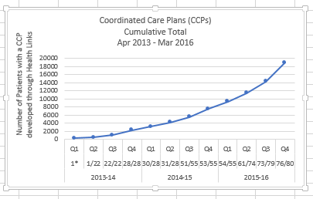
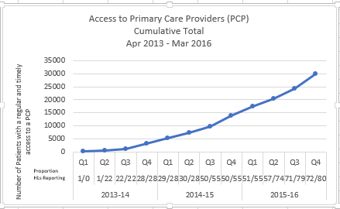
Impact of Health Links – Q4 Update
Coordinated Care Plans
Access to Primary Care
18,926 complex patients have been provided with coordinated care plans through Health Links
29,946 Health Links patients have been connected to regular and timely access to Primary Care
Data Source: Health Quality Ontario’s Quality Improvement Reporting and Analysis Platform (QIRAP) – self-reported by Health Links
Notes:
“Health Links will encourage greater collaboration and co-ordination between a patient's different health care providers as well as the development of personalized care plans. This will help improve patient transitions within the system and help ensure patients receive more responsive care that addresses their specific needs with the support of a tightly knit team of providers” Announcement of the Health Links Initiative (Dec-2012)
The indicator used in QIRAP is the Number of Health Link patients with a coordinated plan of care developed through the Health Link during the past Quarter.
To be included, the CCP must 1) be developed with the patient/ caregiver and two (2) or more health care professionals AND 2) contain a plan for one (1) or more health issues.
*************************************************
Regular and timely access to primary care for complex patients. A central goal of Health Links continues to be the regular and timely access to primary care providers. As most patients first interaction with the health care system is through their primary care provider, ensuring patients are attached to primary care providers is essential to the effective provision of coordinated care for all of Ontario’s complex patients. ~ Excerpt from Advanced Health Links Guide
The indicator used in QIRAP is the Number of patients with regular and timely access to a Primary Care Provider (PCP).
There are three options for data collection, with the aggregate reported in QIRAP. In most cases, a single Health Link will only choose to use one target/actual pair.

Slide 8
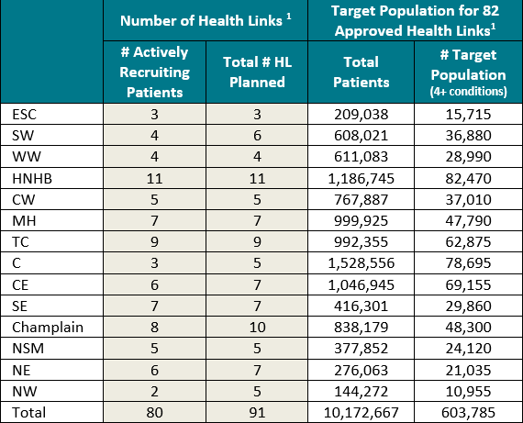
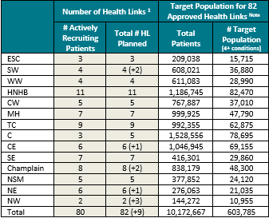
Target Population by LHIN
*Additional Health Links are in the early planning stages (operational funding not yet approved by MOHLTC)
Notes:
In brackets - Additional Health Links (Not included in total of 82)

Slide 9
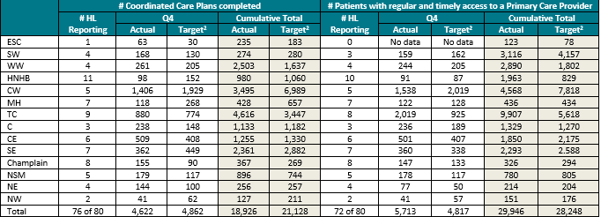
Progress by LHIN – Q4 Update
^{[1]} Targets are set by the Health Link and LHIN, and reflect the maturity of the Health Link (i.e., new Health Links have more modest targets to allow time to establish processes).
Data Source: Health Quality Ontario’s Quality Improvement Reporting and Analysis Platform (QIRAP) – self-reported by Health Links

Slide 10
Susan.Taylor@hqontario.ca
www.HQOntario.ca
FOLLOW@HQOntario

