Slide 1

Leadership Moments in
Eliminating Preventable Harm Through High Reliability

Slide 2
It all started with questions
How are we doing?
How do we know?
How can we do better?
How do we sustain and spread our improvements?

Slide 3
The Bottom Line: Our Performance Imperative In A Patient’s Voice
Don’t hurt me!
Heal me
Be nice to me
Order matters – but it doesn’t have to be linear
It’s all about performance
Leadership matters – attention is the currency
Mindfulness, effective communication, and accountability are the core behaviours – but hard to achieve

Slide 4
Care is all too frequently compromised by harm from error as well as potentially preventable complications of care
Hospital Acquired Conditions
Serious Safety Events
Adverse drug events
Falls
Central line infections
Thromboembolism
Surgical site infections
Catheter-associated Urinary Tract Infection
Ventilator associated pneumonia
Pressure ulcers
Diagnostic errors
Delays in definitive care
Delays in recognizing deterioration
Errors in medical or surgical decision-making
Technical errors
Slips/lapses
Moving from seeing these as inevitable consequences of caring for fragile patients to seeing these as preventable outcomes of improve-able care processes

Slide 5

Preventable Harm Is More Common Than We Might Think (or Acknowledge): The Canadian Pediatric Adverse Events Study
3.6% of pediatric admissions in Canada involve a preventable adverse event
Matlow et al, CMAJ. 2012.
Despite a history of excellent care and quality improvement, we recognize opportunities to increase safety
4

Slide 6
To Be Safe, We Need to Work Safely
STRATEGY
Set vision, strategy and objectives
Operating Plan
Policies, Procedures
Resources
Budgets, Positions, Capital
MEASUREMENT
Processes/outcomes to achieve business objectives
IMPROVEMENT
Departmental and cross-functional teams seek improvement
ACCOUNTABILITY
Hold people accountable for choices

Slide 7

High Reliability Is Our Objective: Manage The Unexpected
Minimize risk in the setting of challenging or unforgiving environments where the impact of failure is too high and the occurrences too infrequent to learn by trial and error
Preoccupation with failure
Sensitivity to operations
Reluctance to simplify
Commitment to resilience
Deference to expertise
Weick, Sutcliffe, Obstfeld - 1977

Slide 8

The Arithmetic of Safety
(and Performance in General)
Reliability
Doing it right
Resilience
Adjusting effectively
Pre-occupation with failure
Burning platform
Standardization
Celebrating success
Appreciative inquiry
Selective improvisation

Slide 9
The 3 E’s of Safety Improvement and Risk Reduction
Harm
DANGER
Rescue
Hazards
Defenses
Eliminate
Elevate
Ensure
Prevent occurrence
Minimize Effect
Modified From: Reason, J, 1997

Slide 10


We Are Collaborating (Internationally and Locally) To Accelerate Progress
The Children’s Hospital’s Solutions for Patient Safety (SPS):
Mission: to eliminate serious harm across all children’s hospitals in the US.
2005: 6 Ohio Children’s Hospitals CEOs form The Ohio Children’s Hospital Association (OCHA)
2009: Expands to all 8 Ohio Children’s Hospitals
2012: US Federal Funding for 25 Children’s Hospitals to form Hospital Engagement Network
2013: SPS expands to include 80 US Children’s Hospitals
2014: SickKids joins SPS as 1st International partner
Toronto Partnership: High Reliability to Eliminate Harm
15
Notes:
NOTE SLIDES 7-11 CAN BE TRUNCATED WITH THIS MATERIAL PUT IN A PREREAD
The Children’s Hospital’s Solutions for Patient Safety (SPS)
The Children’s Hospitals’ SPS network is an unparalleled, collaborative effort among children’s hospitals working to transform pediatric patient safety in pursuit of an urgent mission: to eliminate serious harm across all children’s hospitals in the United States. With support from the federal Partnership for Patients initiative, the network grew from 8 hospitals in Ohio in 2011 to 78 hospitals nationwide in 2013. Their initial efforts are estimated to have saved 7,700 children from unnecessary harm and avoided $11.8 million in unnecessary health care costs.
How Did the SPS Begin?
In 2005, the CEOs of six children’s hospitals in Ohio agreed to work together on safety, setting aside competition and focusing on patient safety instead of other aspects of quality. They formed The Ohio Children’s Hospital Association (OCHA). Originally, the goal was to eliminate preventable cardiac and cardiopulmonary arrests outside the intensive care units. The collaborative achieved a 46 percent reduction across all hospitals.
With this success, in 2009 the Ohio collaborative expanded to include all eight pediatric referral centers in the state and to focus on additional quality improvement projects. With this expanded effort and with all Ohio children’s hospitals participating, the Ohio Children’s Hospitals Solutions for Patient Safety (OCHSPS) network was formed.
As a result, SSIs in high risk children were reduced by 60 percent and ADEs were reduced by 50% across all eight children’s hospitals in Ohio.

Slide 11
Implementing a Comprehensive Program: Leadership Methods and Staff Training Support Improvement
Objective | Tools to Support
Teamwork and Communication | Appropriate Assertion Structured Communication
Learning from Failure | Reporting and Root Cause
Fair and Just Culture | Leadership and Performance Mgmt
Sound Decision Making | Mindful Practice
Anticipating Failure | Situational Awareness – Daily Briefings
Measurement, Analysis, and Feedback | Transparency
Standard Work | Care Bundles, Guidelines
Relentless Pursuit of Perfection | Continuous Improvement Lean Thinking

Slide 12
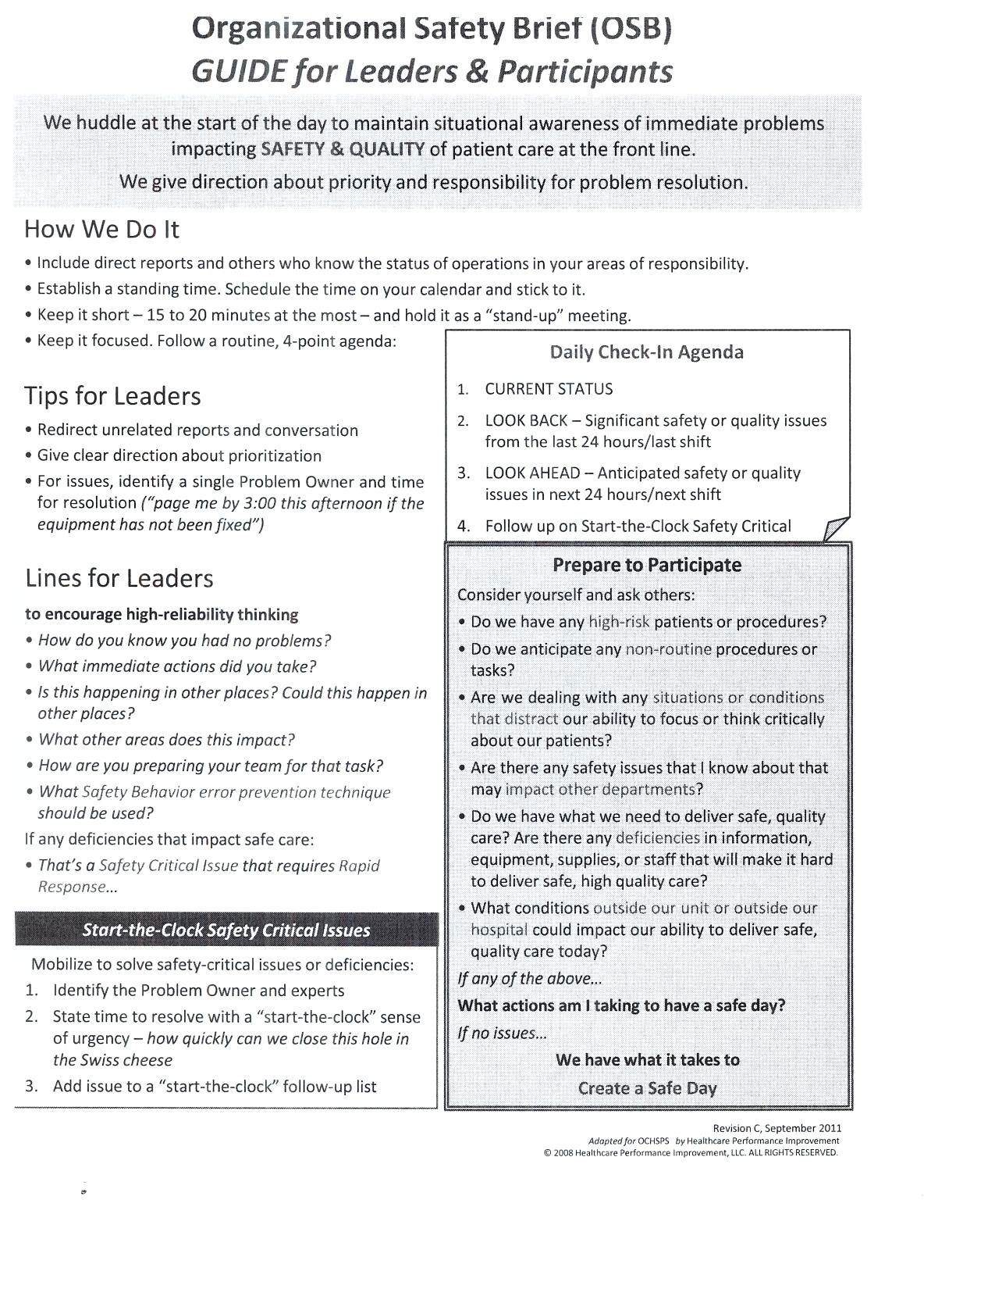
Daily Safety Briefing to Increase Situational Awareness

Slide 13
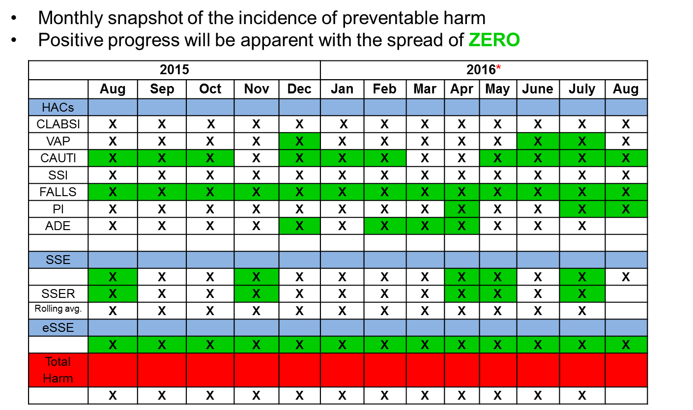
Harm Reports to Highlight Children Rather Than Statistics

Slide 14
Introducing a Mindset Change: Patients and Families As Part of the Team, or, “Nothing About Me Without Me”
Patients and Families have unique perspectives
Critical information including vital feedback
Goals of care
Prioritization among competing goals
Patients and Families are conduits of information among other team members
Consistent longitudinal conduit across disciplines, specialties, and venues
Healthcare is “co-produced” by caregivers and patients
Families and patients become caregivers
Outcomes depend on compliance and engagement
Engaging patients and families as partners requires different mindsets and different processes

Slide 15
Resistance is the natural response to change – find the right level to resolve
Disagreement on the Problem
Disagreement on the Solution
Disagreement on the Implementation
Buy In
There is no problem
Disagreement on the problem
Problem out of my control
Disagreement on direction of solution
Disagreement on details of solution
Yes but…. Negative ramifications
Yes but…. We can’t implement
Disagreement about implementation details
You know the solution holds risks
I don’t think so – social/psych barriers
Goldratt: Theory of Constraints

Slide 16
Leaders Can Expect to Create (and Manage) Some Tensions – or, the things leaders knew before they start
Failure feels bad – cognitive dissonance from preventable harm
Transparency accelerates learning but amplifies shame
Avoid “comfort seeking” over “problem solving”
Celebrate excellence and successes more than failures
Not everyone will “buy in” at the same rate
Early adopters will be impatient with more reluctant staff
Manage the pace of change and recognize it can’t be fixed overnight
Appropriate assertion (including by patients/families) will create some conflict
Embrace conflict management instead of avoidance
Performance management will identify normalized deviance
Must address management consistency and systems before personal accountability – but you need to address accountability
People will question priorities – decision making seen through a safety lens
Balance short-term/narrow focus with long-term/greater good perspectives
These tensions create leadership “moments” that will define success or failure

Slide 17
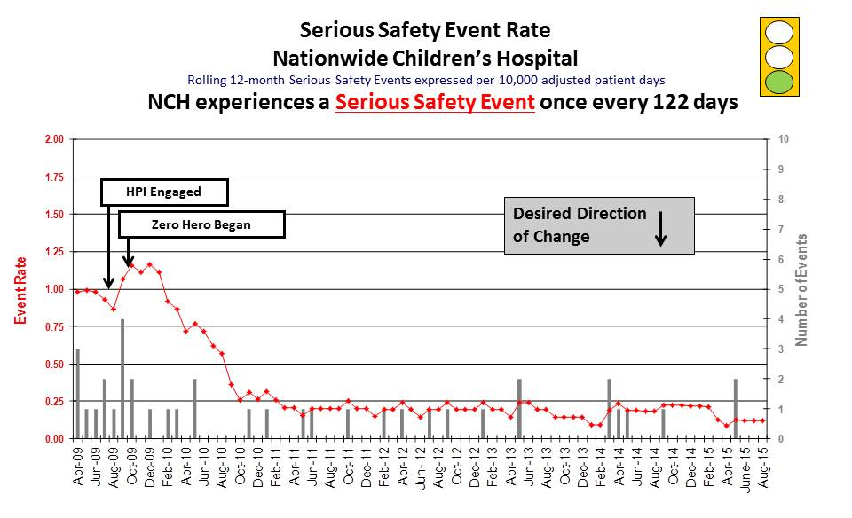
Aiming For a Significant Reduction in Harm

Slide 18

The Target is Perfection But It’s a Journey: Take the First Step
Eliminate Failures to Deliver Effective Care
Eliminate Preventable Harm
Ensure Service Excellence
“All this will not be finished in the first one hundred days. Nor will it be finished in the first one thousand days, nor in the life of this Administration, nor even perhaps in our lifetime on this planet. But let us begin.”
J.F.K Inaugural Speech 1961
Negotiate Timelines Not Targets

