Slide 1

Health Quality Ontario
Quality Rounds
Gertie Mai Muise, BA, MAL
Aboriginal Health Access Centre & Aboriginal Community Health Centres Building Capacity for the Wholistic Model of Health and Wellbeing
June 16, 2016

Slide 2
Greetings!
M’Tallawin
Kweh
Boozhoo
Ahnee
Shekóli
Shé:kon
Tansi
Watchiya

Slide 3
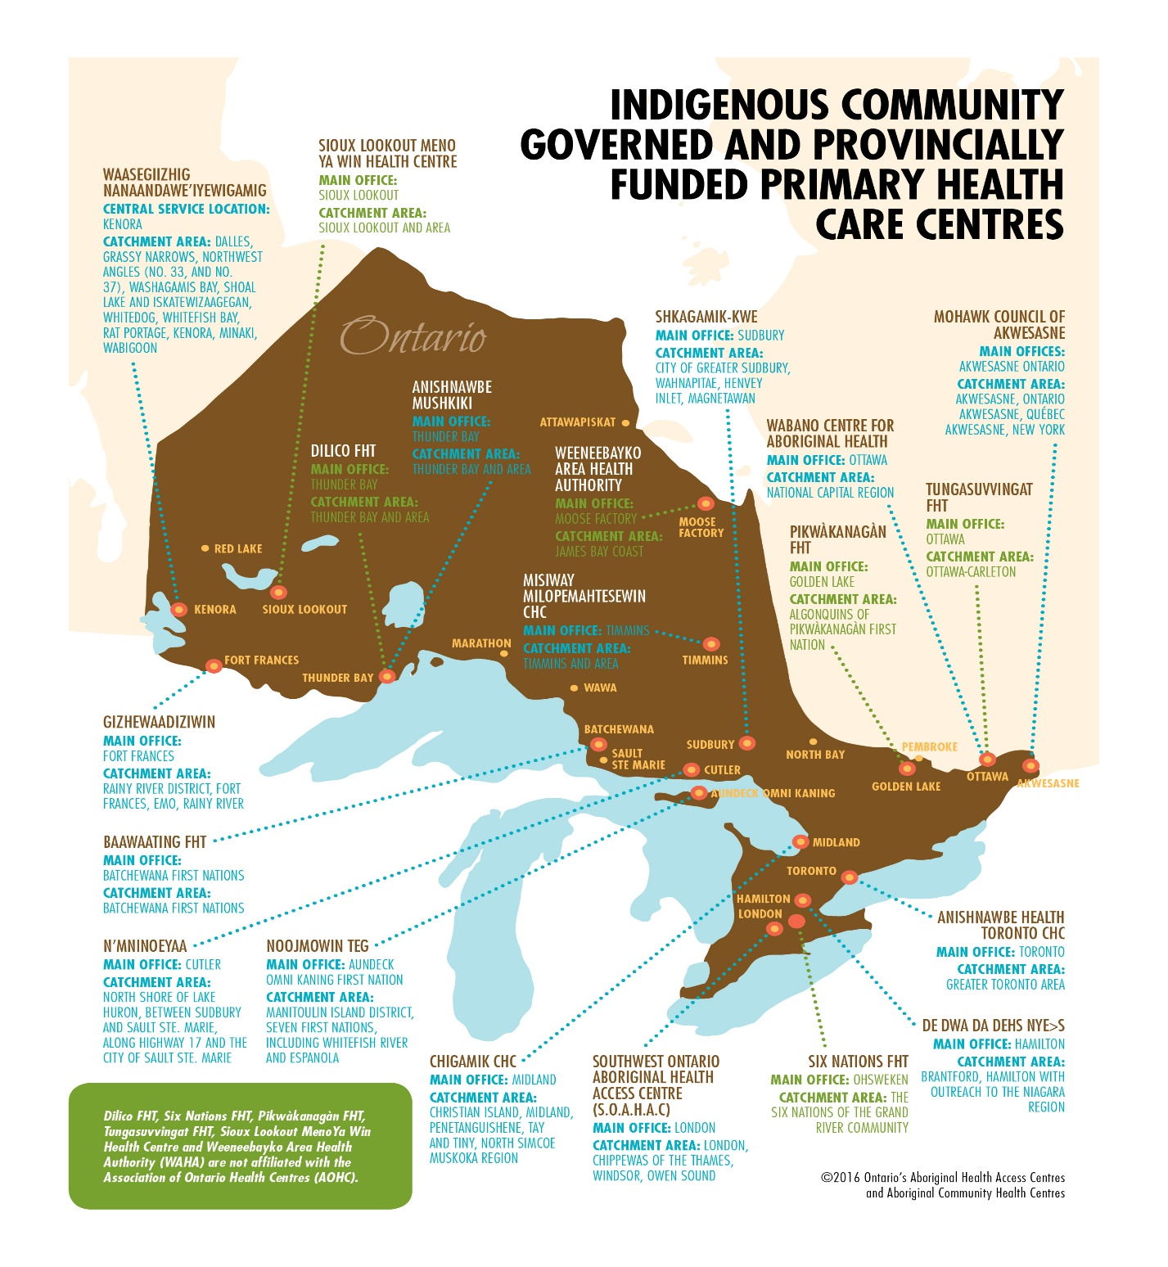

Slide 4
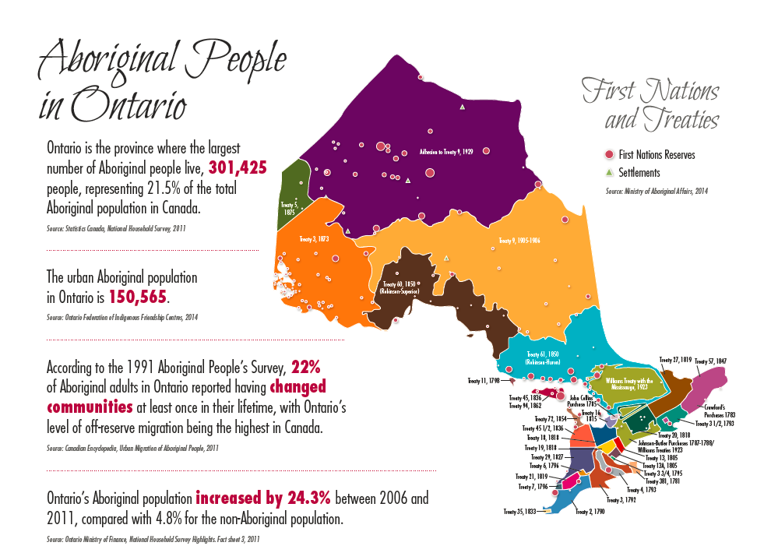
Notes:
Colours correspond to treaty areas/boundaries
AHACs serve Aboriginal communities on and off reserve and urban Aboriginal populations
Emphasize fast growing and migration

Slide 5

Unique in Canada and made in Ontario, the 10 AHACs and 3 ACHCs are community-led, primary health care organizations, providing an array of health and social services to Indigenous people across the province
  Primary Health Care
  Traditional healing
  Mental Health & Wellness
  Cultural programs
  Health promotion
  Social supports
  Community development

Slide 6
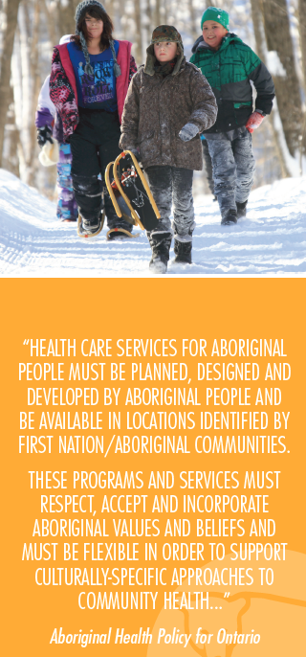
AHACs born out of Aboriginal Healing and Wellness Strategy (AHWS) and Aboriginal Health Policy
The original goals of AHWS were to:
  Improve Indigenous health
  Reduce family violence
  Promote collaboration and integration of services and programs
All within a wholistic, culture-based framework

Slide 7
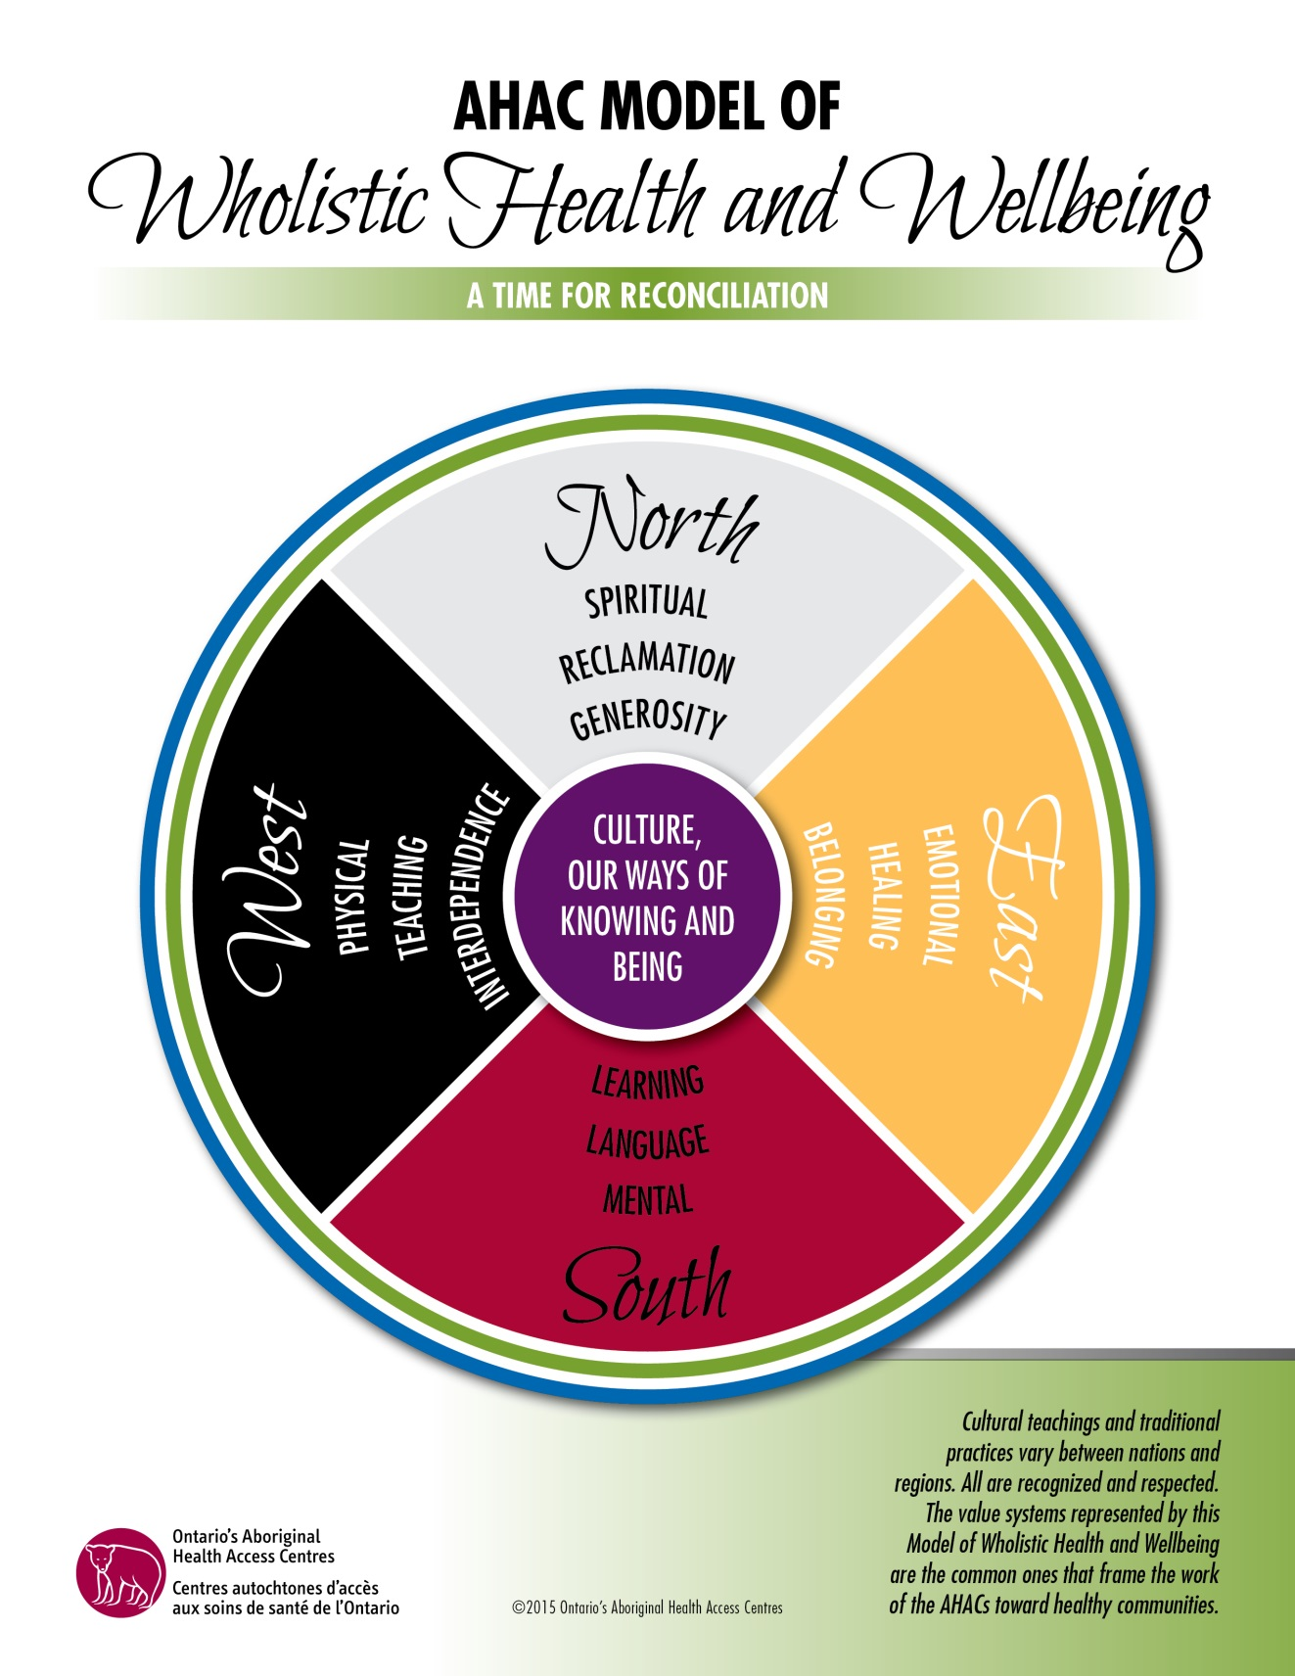
Notes:
Significance of the wheel- Angela
Go through the wheel as she’s been taught
-emphasize the diversity of teachings and emphasize the vast nation-hood.
Overview of meaning of colours
Overview of directions and associated meaning
-just reference Carlie’s video as an additional resource
-this model through AWHS was sanctioned not just by Aboriginal people but also the government of Ontario.

Slide 8
AHAC & ACHC Service Types
Unique Services, Unique Health Human Resource Requirements

Slide 9
Program | Funder | Spiritual | Mental | Physical | Emotional
Traditional Counselling | MoHLTC - Core | YES | YES | YES | YES
Sweatlodge | MoHLTC - Core | YES | YES | YES | YES
Full Moon Ceremonies | MoHLTC - Core | YES | YES | YES | YES
Traditional Healing Support | City of Hamilton | YES | YES | YES | YES
Clinic | MoHLTC - Core |  | YES | YES
Transportation Services | HNHB LHIN | YES | YES | YES
Advocacy Services | MoHLTC - Core | YES | YES | YES | YES
Patient Navigation | HNHB LHIN | YES | YES | YES | YES
FASD Program | MoHLTC | YES | YES | YES | YES
Healthier You | MoHLTC | YES | YES | YES | YES
Diabetes Education | MoHLTC | YES | YES | YES | YES
STRONG | New Horizons | YES | YES | YES | YES
Children and Youth | MCYS | YES | YES | YES | YES
Addictions | HNHB LHIN | YES | YES | YES | YES
Adult Case Management | HNHB LHIN | YES | YES | YES | YES
Notes:
This is a sample of programs and services from one AHAC, it is not an exhaustive list of programs and services.
Highlight that primary care in Anita’s AHAC does address spiritual and emotional needs beyond just mental and physical through assessment process (SOAP)

Slide 10
Program | Funder | Spiritual | Mental | Physical | Emotional
Primary Care | MOHLTC |  | YES | YES | YES
Opiate Withdrawal | Health Canada (HC) | YES | YES | YES
Mental Health Counselling | NE LHIN |  | YES |  | YES
Healing Services | MOHTLC/HC | YES | YES | YES | YES
Medicine Making/Walks | MOHLTC/HC | YES | YES | YES | YES
FASD | MCYS | YES | YES | YES | YES
Seniors Community Support | NE LHIN | YES | YES | YES | YES
Health Promotion | MOHLTC | YES | YES | YES | YES
Notes:
This is a sample of programs and services from a second AHAC, it is not an exhaustive list of programs and services.

Slide 11
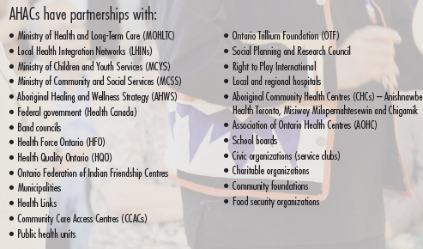
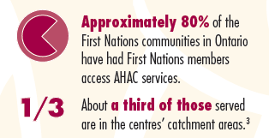
Interconnected & Interdependent
Notes:
Example of AHAC specific partnerships:
Shkagamik Kwe AHAC Partnerships
Association of Ontario Health Centres
Health Sciences North
Northern Ontario School of Medicine
Laurentian University
Cambrian College
Sudbury District Health Unit
Rainbow District School Board – Mishko-deh-Wendam : Cultural Restoration and Integrated Health Program
FASD Diagnostic Clinic
FASD Network
Sudbury District Health Unit
Health Sciences North
FASD Annual Conference
Aboriginal Health Access Centres Network
Community Mobilization Sudbury
First Nations Partnerships
Metis Nation of Ontario – Sudbury Local
Cancer Care Ontario – Aboriginal Strategy
Union of Ontario Indians

Slide 12
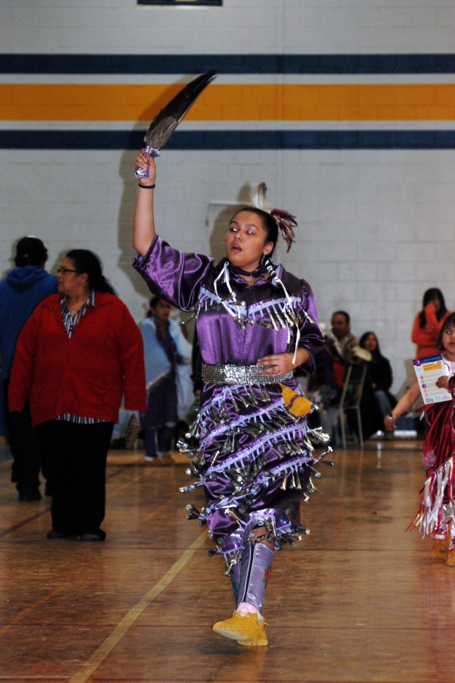
7 Natural Ways of Healing
  Talking
  Crying
  Laughing
  Dancing
  Sweating
  Yawning
  Yelling

Slide 13
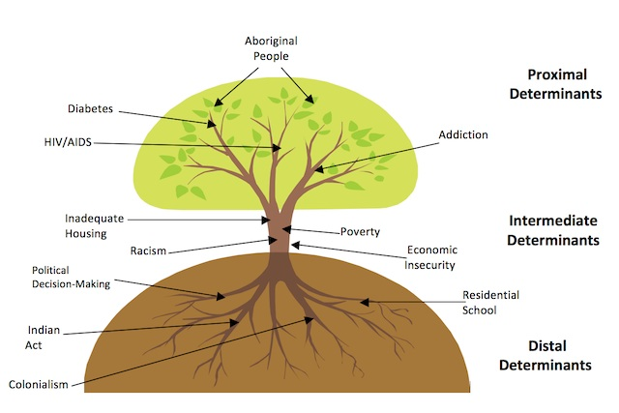
Tree Metaphor
Notes:
In everything we do in health care system design, services design, planning and evaluation we have to understand the connection of history and colonization to current day issues. We have to continually be working and structure ourselves to continually work cross sector. We must shift our consciousness, our ways of thinking to be inclusive of these realities that often remain hidden.
Understand that this is not an accident. It is perpetrated, we are living in a colonized country. The federal government spends hundreds of millions of dollars fighting against Indigenous treaty rights and other human rights like the campaign to fight Aboriginal Child Activist, Cindy Blackstock case against the Government to fund Aboriginal childrens education and social welfare on par with other Canadian children.
To contextualize the proximal, the everyday situations we have to have critical reflection to the roots.

Slide 16
AHACs & ACHC Reports
Serves Indigenous people on and off-reserve and in urban and rural settings
For more detailed information about AHACs go here: AHAC Report 2015

Slide 17
Quality Population Needs Based Health Planning
Closing gaps in Indigenous population health data

Slide 18
Why population based health assessment?
Sophisticated population level tracking of the incidence, risk factors related to, and course of acute and chronic disease are taken for granted by the majority of Ontario citizens.
This information guides the strategic implementation of evidence based health interventions such as vaccinations, primary and tertiary health care enhancements and health promotion programs.
These interventions in turn reduce morbidity, mortality, and overall health care expenditures.
Service-based information only tells us about the health of people who are already accessing health services – so it will be biased. (ie.Aboriginal women and breast cancer)

Slide 19
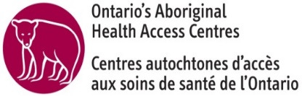
Why urban Aboriginal population based health assessment?
Ontario has the largest population of self-identified Aboriginal people of any province or territory – 301,425 persons or 21.5% of the total Aboriginal identity population in Canada according to the 2011 NHS
The large majority of this population lives in urban areas of Ontario (69% in CMAs, 2011 NHS)
A small minority (17%) of this population is First Nations with status living on reserve

Slide 20
Urban Aboriginal population based health assessment (con’t)
This is a rapidly growing and youthful population – 2011 NHS Aboriginal identity population estimate for Ontario is 24% higher than 2006 Census estimate
First Nations and non-Status Indians, Inuit and Métis populations experience striking disparities in health determinants and health status outcomes compared to non-Aboriginal people and these disparities do not improve in urban areas (ie. poverty, inadequate housing, infant mortality, respiratory infection, HTN, diabetes)

Slide 21
Urban Aboriginal population based health assessment (con’t)
Existing health services data indicates that health services for urban Aboriginal populations are poorly matched to health needs
To continue this health assessment double standard, which is undoubtedly resulting in unnecessary morbidity and mortality for urban Aboriginal people is unacceptable morally and practically and in tension with domestic and international human rights obligations

Slide 22
Distribution of Aboriginal Populations in Ontario by Identity

Slide 23
Distribution of Aboriginal Population in Ontario by Census
Metropolitan Area (CMA)

Slide 24
Population Coverage of MOHTLCs current Aboriginal health information

Slide 25
http://aboriginalhealthcentre.com/services/our-health-counts/
Notes:
90-95% linked to ICES data banks
Showing clearly a very serious undercount of Indigenous people
Stark levels of poverty

Slide 26
Indigenous Health Human Resource Capacity Development
Unique Health Human Resource Requirements

Slide 27
Trends in Aboriginal Health Human Resources
The majority of Aboriginal health human resources are located in Ontario (24.8 per cent)
Continual increases in First Nation and Metis but not Inuit
Higher # of health workers in urban areas
Increases in all health professionals
Ontario
Indigenous Health Professionals 5,415 (24.82 per cent)
Total Ontario Health Professionals 356,460 (35.97 per cent)

Slide 28
Health Human Resource Strategies in Ontario
Pan Canadian Health Human Resources Strategy
First Nation and Inuit Health Strategic Plan (Health Canada)
Healthforce Ontario Retention & Recruitment

Slide 29
Unique Health Human Resources Capacity Initiatives
Community Worker Training Program
Traditional Healing Training Model (AHT)
Aboriginal Nurses Mentorship (ANAC)
Physicians Cultural Safety Training Programs
Physicians remote and isolated internships (NOSM)
New in 2016 – Masters of Social Work with specialization in Indigenous Trauma and Resiliency Program (OFIFC)
Culture as Treatment Symposium (Wabano)

Slide 30
Aboriginal Midwives in Ontario
Aboriginal Midwives and Traditional Healers are exempted from Ontario’s Health Professions Act 1991
Aboriginal Midwives have own culturally safe and appropriate education pathway
National Aboriginal Council of Midwives (NACM) and the Ontario Association of Ontario Midwives (AOM) working to restore Aboriginal midwifery
Ontario now has 2 Indigenous Birthing Centres
  Seven Generations Midwives Toronto
  Six Nations Birthing and Training Centre
Notes:
Midwifery is a health model that works and which addresses inequities and disparities in Indigenous health
Midwifery makes a health intervention at a critical time and has the potential to be healing for the parent (or parents and families) as well as contribute to life long health of the child and of the community
Indigenous communities always had midwives for taking care of pregnant women
However, midwifery was largely eradicated by colonialism and by the medicine, which worked to move birth out of communities and into hospital institutions
NACM and the AOM are working to support the restoration and renewal of Aboriginal midwifery
In the next two slides, I’ll quickly go over the inequities and lack of quality for maternal and newborn health indicators for Indigenous communities and then talk about how the midwifery model addresses these disparities

Slide 31
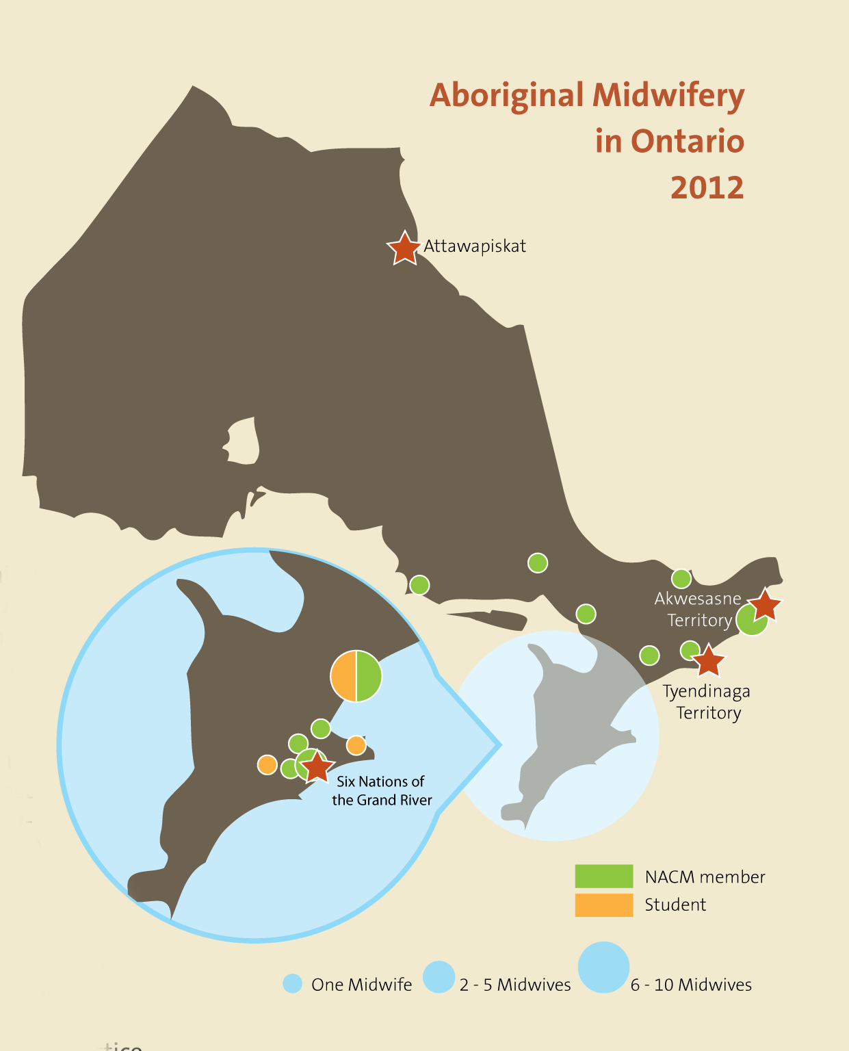
Notes:
however, at present, most communities do not have access to Aboriginal midwifery
This map, created by the AOM, shows that there are currently only four places where women and families can access midwifery care: on-reserve: Attawapiskat, Akwesasne, Tyendinaga and Six Nations
in the north, at least 35 communities routinely evacuate women for their birth; this practice has been referred to as “the residential schools of medicine” (Elizabeth Payne) – it removes women, usually at 36 weeks of pregnancy, and sends them, often alone, to a hospital in the south to await their pregnancy, where they give birth, often alone and with high levels of interventions, in a place that is far from home and removed from family and ceremony – women have reported experiencing isolation, separation from families, financial stress, the loss of cultural ties to the land, and a loss of continuity of care; evidence also shows this practice contributes to higher rates of postpartum depression and poor rates of breastfeeding

Slide 32
New Indigenous Accreditation Standards
Within the Canadian Centre of Accreditation (CCA) for all community primary care and health centres
Applies to all Indigenous Community Health Centres and to those mainstream services providers delivering services to Indigenous people
Imbeds cultural safety
Includes respect for Indigenous determination in healthcare and access to traditional healers and medicines
Follows Ontario’s Aboriginal Health Policy Principles

Slide 33
New Cultural Safety Training Requirements
Ontario’s Premier, Catherine Wynne has mandated that all Ontario public service employees (60,000) receive Indigenous cultural safety training!
Ontario’s Online Indigenous Cultural Safety Training program is an anti-racist, anti-oppressive, de-colonizing training developed by the Southwest Aboriginal Health Access Centre, in partnership with the Provincial Health Services Authority in British Columbia, ON Ministry of Health and SW Local Health Integration Network
Ontario's Online Cultural Safety Training

Slide 34
Moving Forward
We need to plan our own health care systems in our own ways in collaboration with excellent partners – apply evidence already available
Need to close the gaps in population health data and information
Health Human Resources Capacity development has to include restoring traditional healing knowledge, land and appropriate training for healers (Tribal Doctors)
Restore Indigenous practices of identifying young people who have capacity and potential for health careers - informed by traditional worldviews and values

Slide 35
Moving Forward
Develop professional education pathways inclusive of Indigenous worldviews for all health professionals working inside Indigenous communities
Plan for system wide cultural safety development
Include in recruitment the demonstrated ability to be self reflective to lower systemic racism

Slide 36
Contacts
Gertie Mai Muise, BA, MAL
Director, AHAC Strategy and Transformation
Association of Ontario Health Centres
500 – 970 Lawrence Avenue West
Toronto, ON M6A 3B6
Tel. 416.236.2539 ext. 331 Fax. 416.236.0431
Cell: 519.317.0087
Gertiemai.muise@aohc.org

Slide 37
Indigenous Cultural Safety Contact
Diane Smylie
Provincial Manager, Indigenous Cultural Safety Program
Southwest Ontario Aboriginal Health Access Centre
500 – 970 Lawrence Avenue West
Toronto, ON M6A 3B6
416.529.7021 I dsmylie@soahac.on.ca

Slide 38
Midwifery Contact
Ellen Blais
National Co- Chair
National Aboriginal Council of Midwives
nacm@aboriginalmidwives.ca
www.aboriginalmidwives.ca
Ellen Blais
Policy Analyst, Aboriginal Midwifery
Association of Ontario Midwives
Ellen.blais@aom.on.ca

Slide 39
Thank-you!
Wellaylin
Chi-Miigwetch
Nia:wen
Yaw^ko

